Slide 1
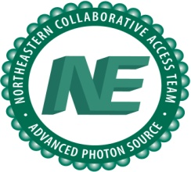
Vector-Scanned Microcrystallographic Data Collection Techniques
Malcolm Capel
NE-CAT
Dept. Chemistry & Chemical Biology
Cornell University

Slide 2
Agenda
Beamline & Control Software background.
Description of vector-scanned data collection techniques.
Comparison of rastered and continuously scanned data.
Auxilliary scanned methods.
Future enhancements.

Slide 3
Vector-Scanned Data Collection
Definition:
Data collection in conjunction with programmed displacements of the sample along a 3-space vector (the spanning vector), aligned to the major axis of the sample.
Vectorial displacements can be parallel or normal (at constant omega) to the spanning vector.
Vectorial sample displacements occur either between runs or between images.
Crystal orientation matrix is invariant to displacements along the spanning vector.

Slide 4
Vector-Scanned Data Collection
Motivation:
Efficient use of crystals larger than beam size.
Minimize impact of radiation damage on data quality by spreading damage out over the entire scanned volume…permits use of more intense beams, and more optimal use of detector dynamic range.
Find and utilize best region of large crystals.
Align crystals embedded in opaque matrices (e.g. ice contaminated samples, bi-phases.

Slide 5
Vector-Scanned Data Collection
Implementation:
Exploitation of MD2’s crystal visualization capabilities and the high precision and reproducibility of the MD2’s crystal alignment system.
ADSC multiplex control socket – programming of all aspects of data collection under beam line control system scripting engine (Console).
ADSC control system modified to support per Frame or Per Run MD2 x,y,z crystal centering axis adjustment.

Slide 6
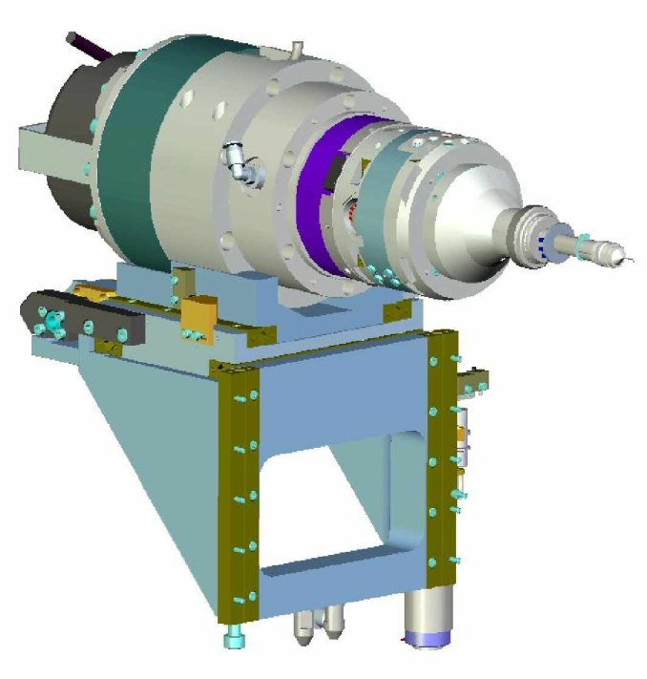
Notes:
Remainder of the construction summary will deal with installation, integration and commissioning of the MD2 microdiffractometer at 24ID-E.
Two main efforts:
Design and construction of a precision support structure providing stability and accurate height, transverse position pitch and yaw of the MD2 (relative to beam).
Modifications to the 24ID-E end station and the MD2 itself to improve beam stability, reduce scattering background and safe the MD2 against collision with the cryostream head and thermal drift.

Slide 7
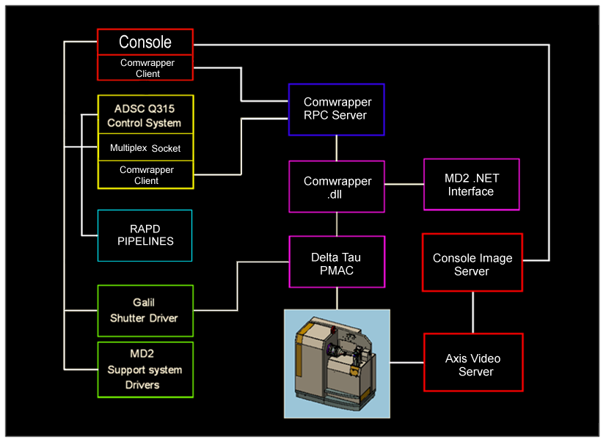
Changes to MD2 Control System
NE-CAT Server Architecture

Slide 8
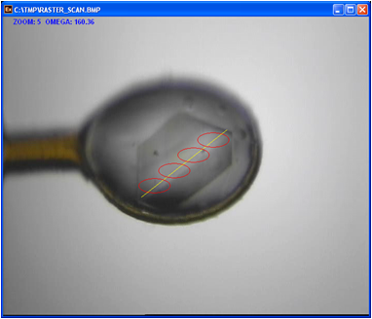
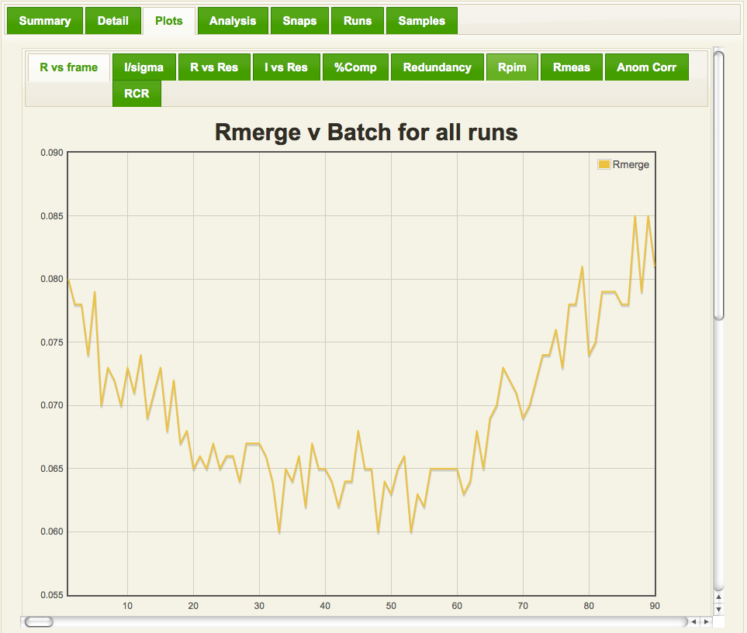
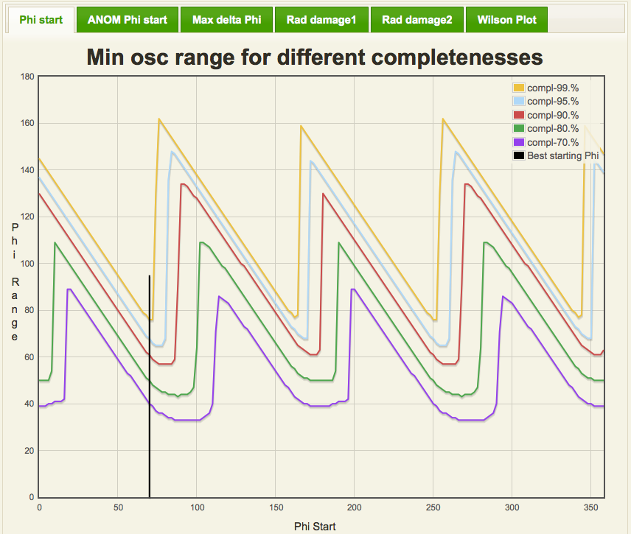
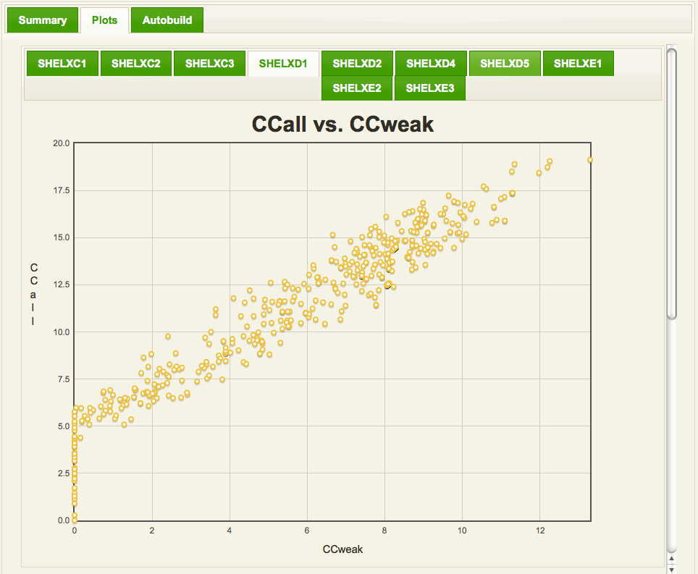
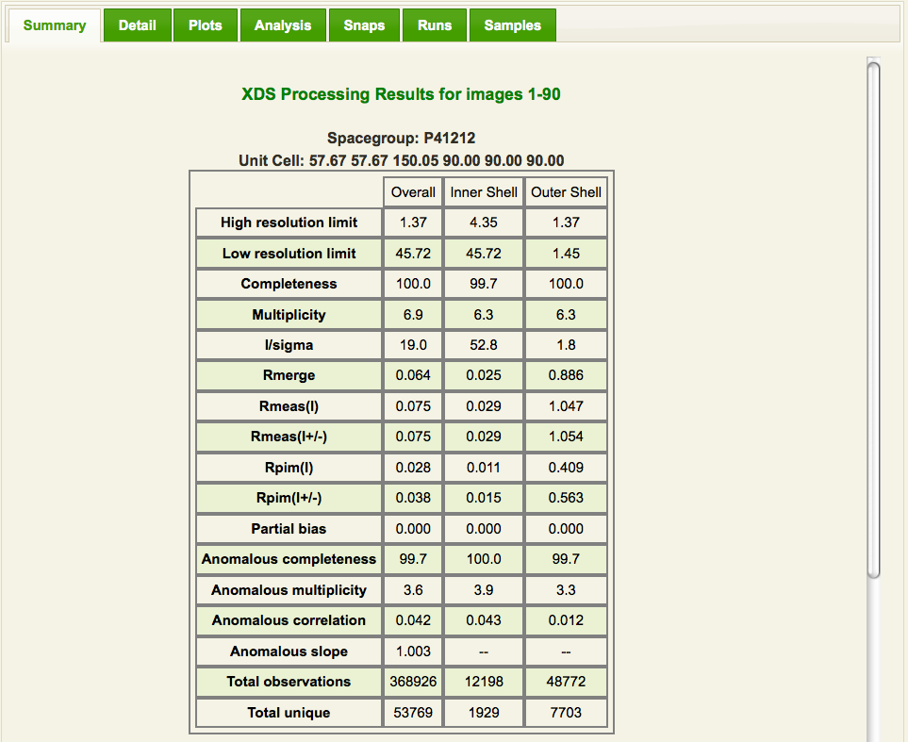
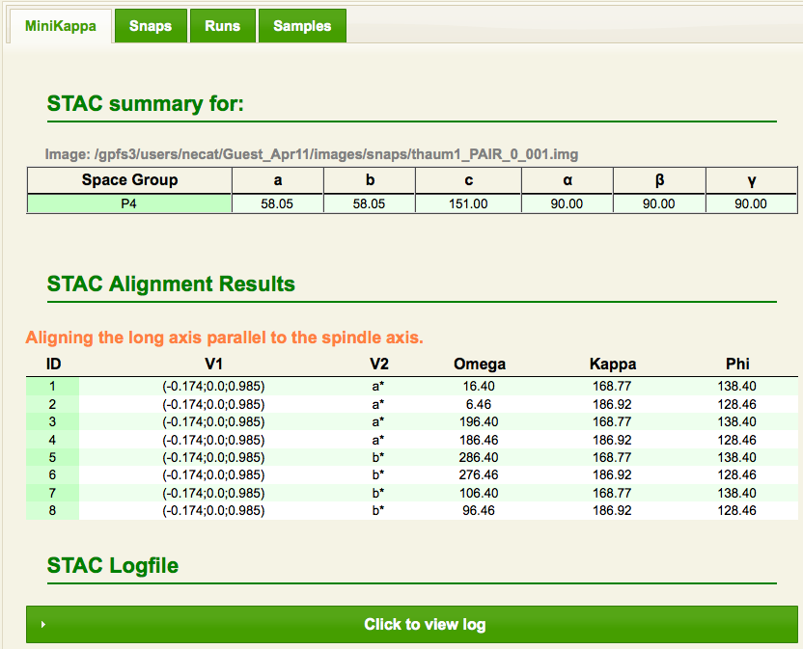
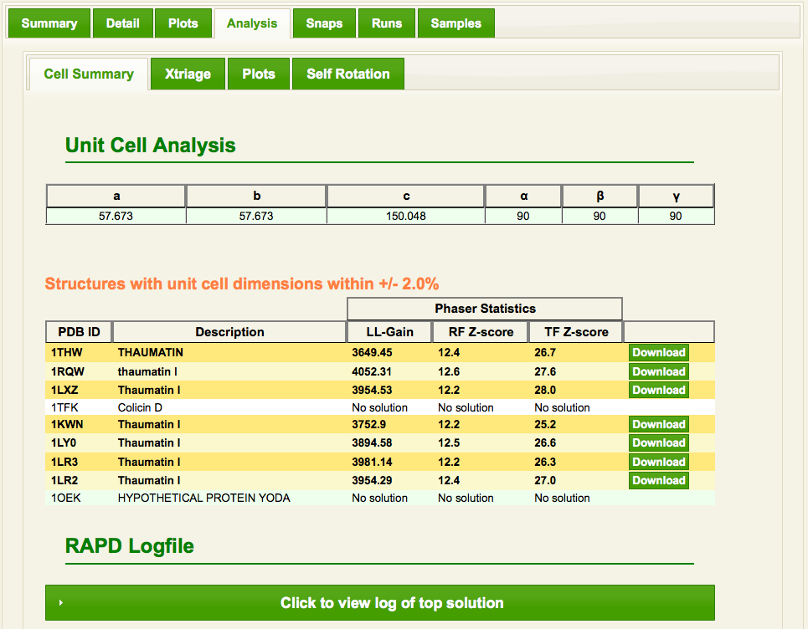
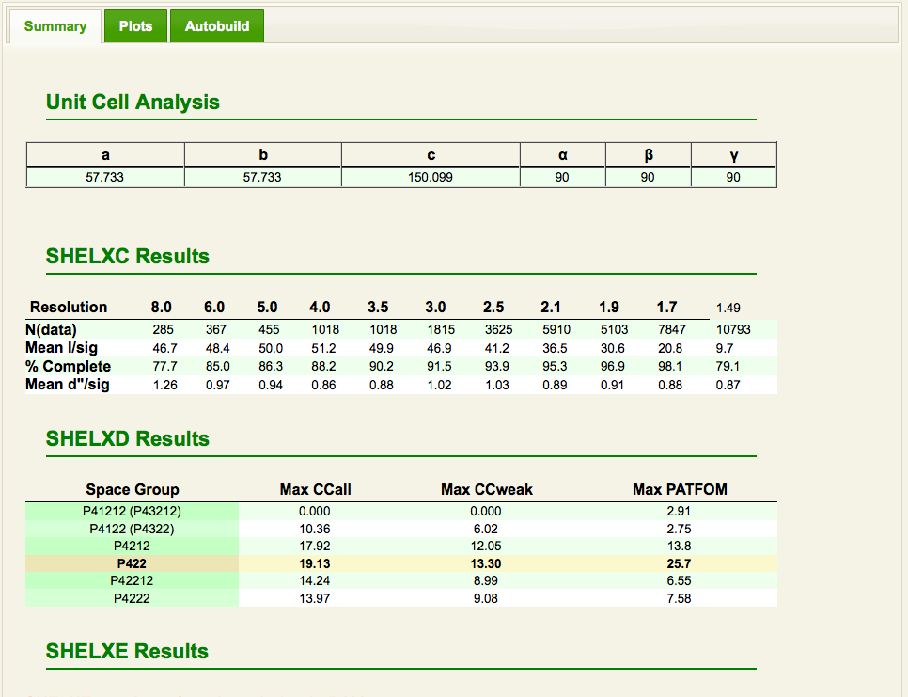
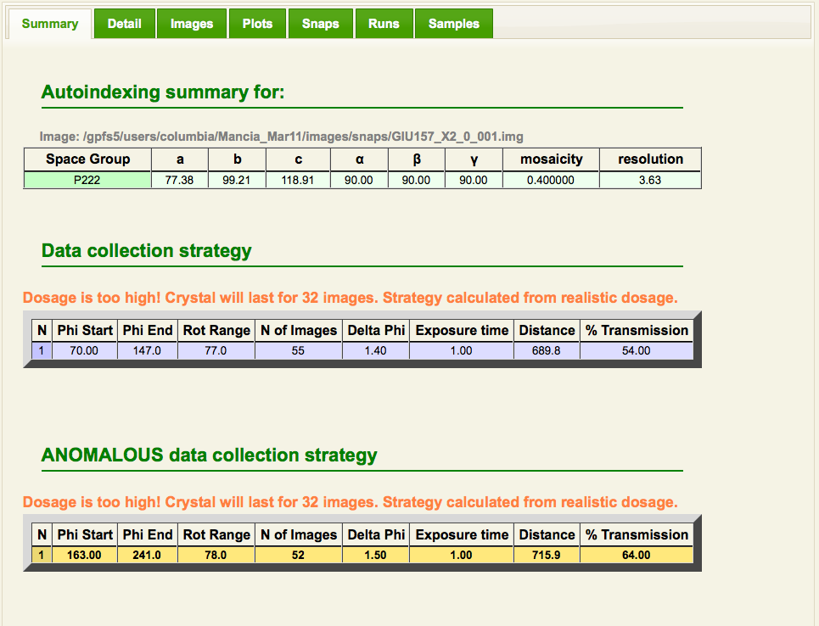
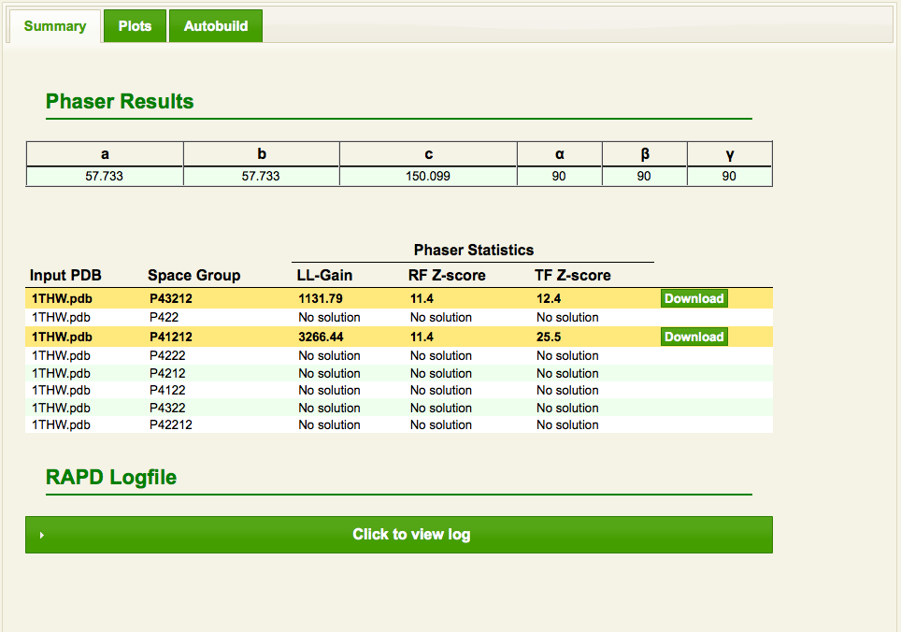
RAPD Functionalities
Diffractive Alignment
& RasterSnap
Autoindex & Strategy
Minikappa Orientation
Integration
Merging
MR
SAD
Diffractive Alignment
& RasterSnap
Autoindex & Strategy
Minikappa Orientation
Integration
Merging
MR
SAD
Diffractive Alignment
& RasterSnap
Autoindex & Strategy
Minikappa Orientation
Integration
Merging
MR
SAD
Diffractive Alignment
& RasterSnap
Autoindex & Strategy
Minikappa Orientation
Integration
Merging
MR
SAD
Diffractive Alignment
& RasterSnap
Autoindex & Strategy
Minikappa Orientation
Integration
Merging
MR
SAD
Diffractive Alignment
& RasterSnap
Autoindex & Strategy
Minikappa Orientation
Integration
Merging
MR
SAD
Diffractive Alignment
& RasterSnap
Autoindex & Strategy
Minikappa Orientation
Integration
Merging
MR
SAD
DISTL
Labelit
Labelit
Mosflm
Raddose
Best
XDS
Scala
Pointless
STAC
Scala
Pointless
Phaser
Phenix
RAPD provides diffraction spot counts and resolution information.
RAPD provides optimal strategies for data collection.
RAPD provides minikappa settings for different requirements: long, anomalous, smart, a*, b*, c*, split axes
Settings can be sent to beamline by doubleclick.
RAPD provides real time integration, simplified statistics presentation and full analysis.
RAPD provides merging for two datasets with full analysis.
RAPD provides robust molecular replacement from starting PDB code or file.
ShelX
Phenix
RAPD provides fast structure solution with minimal user inputs in all possible spacegroups simultaneously.

Slide 9
Vector Scanned Data Collection
Discrete Raster Scans
Complete or partial runs collected at a set of points along the spanning vector
Continuous Vector Scans
Displacements along the spanning vector following each exposure of a run

Slide 10
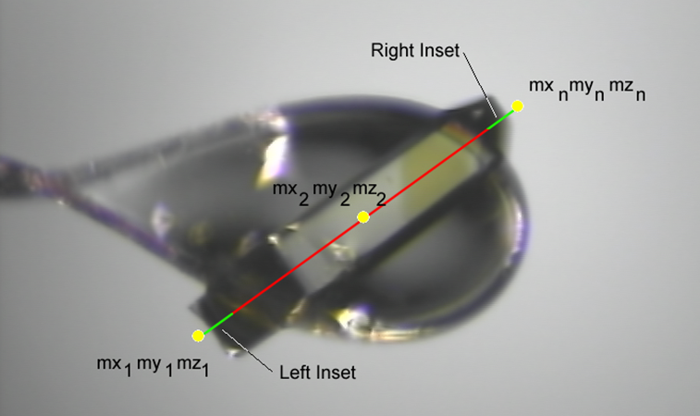
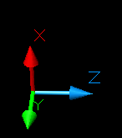
Definition of the Spanning Vector
mx = a1.mz + b1 my = a2.mz + b2

Slide 11
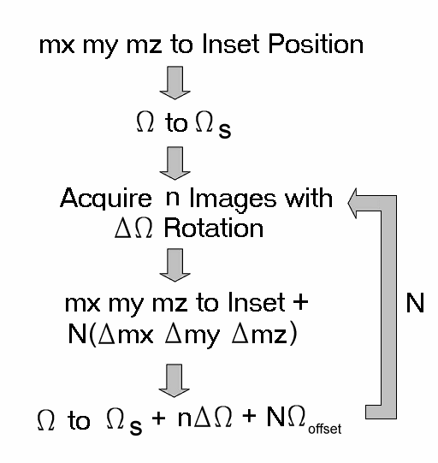
Raster Scan Algorithm

Slide 12
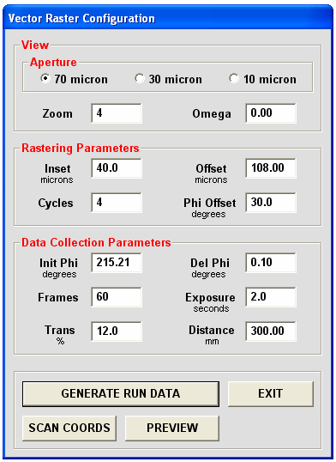
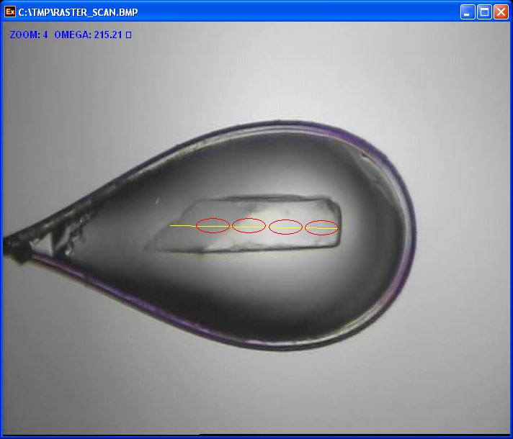
Discrete Raster Scanning

Slide 13
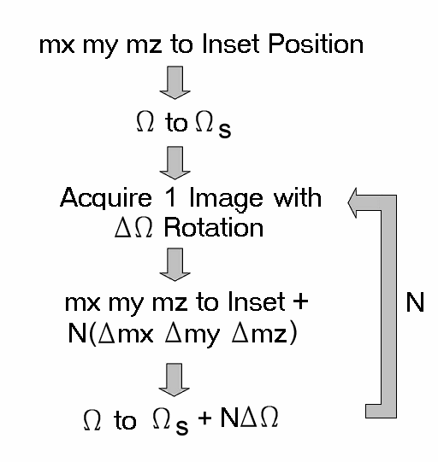
Continuous Scan Algorithm

Slide 14
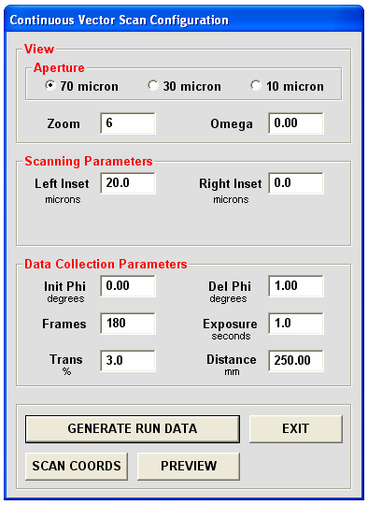
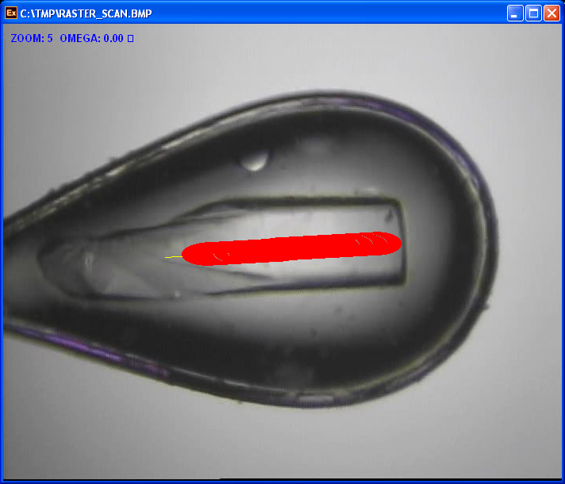
Continuous Raster Scanning

Slide 15
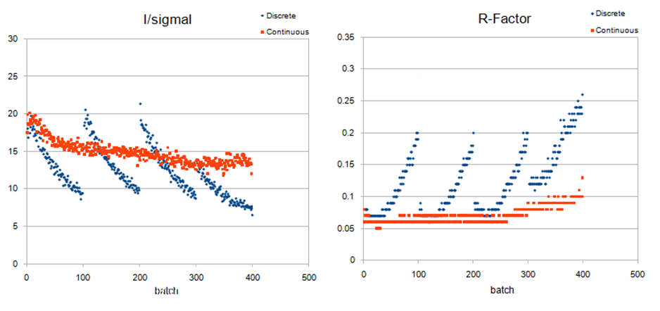
Comparison of Discrete & Continuous Rastered Data
Thermus thermophilus 30S subunits P₄₁₂₁₂ 400x400x180 90x90x90

Slide 16
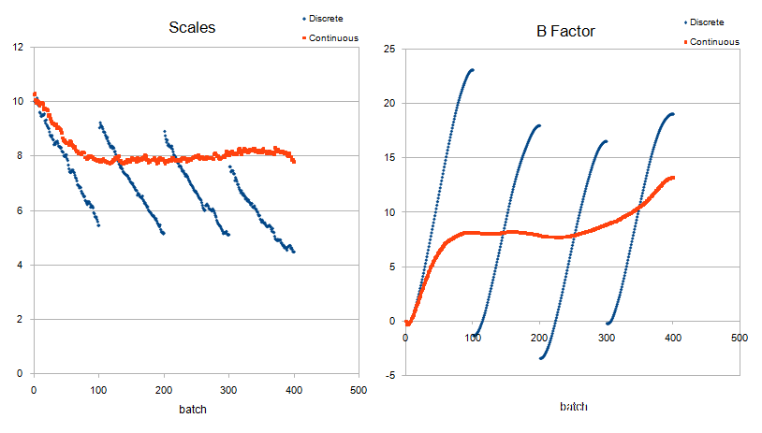
Comparison of Discrete & Continuous Rastered Data

Slide 17
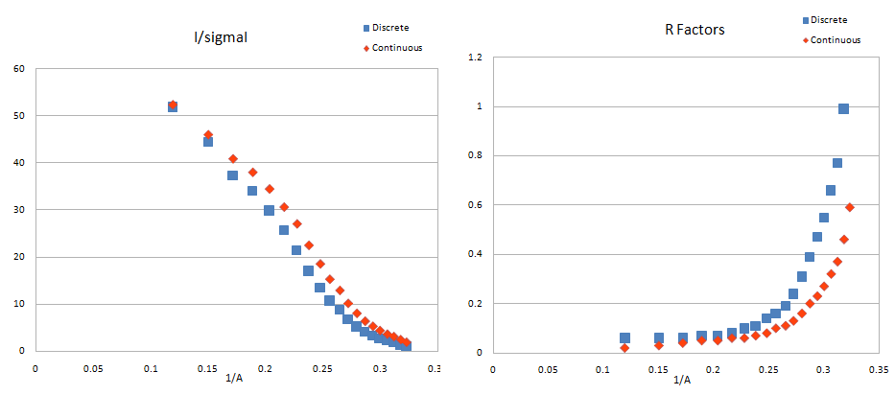
Comparison of Discrete & Continuous Rastered Data

Slide 18
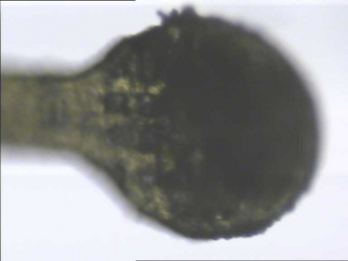
Auxiliary Scanned Methods
Diffractive crystal alignment
Locate and align crystals embedded in opaque frozen cryomatrix
Occluded View alignment
1D diffractive alignment along vector normal to oblique orientation of sample.
Rastersnap
Diffraction quality vs. position along scan vector.

Slide 19
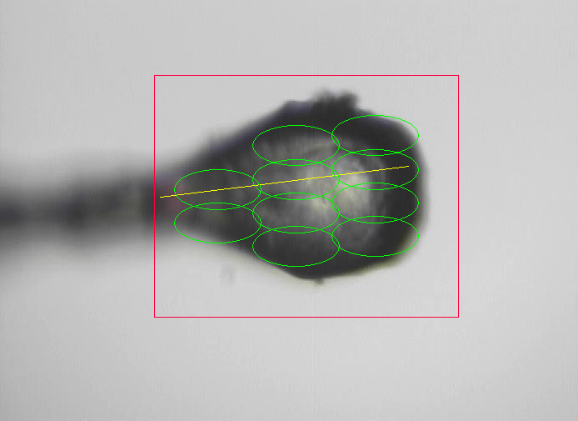
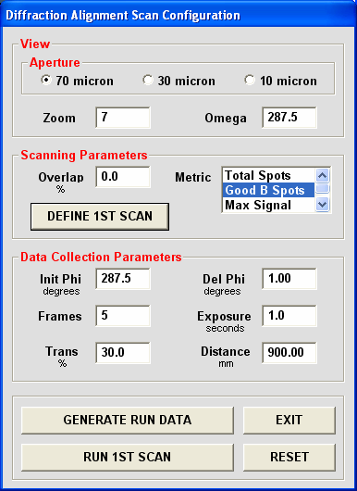
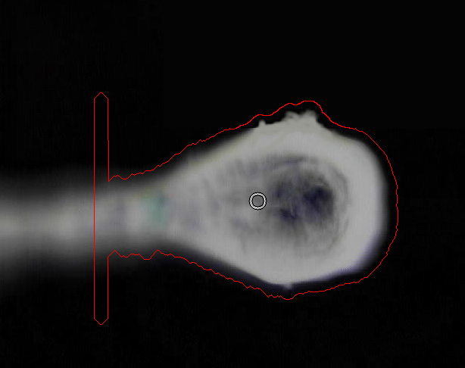
Diffractive Alignment of Crystals

Slide 20
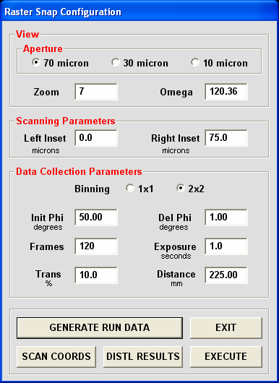
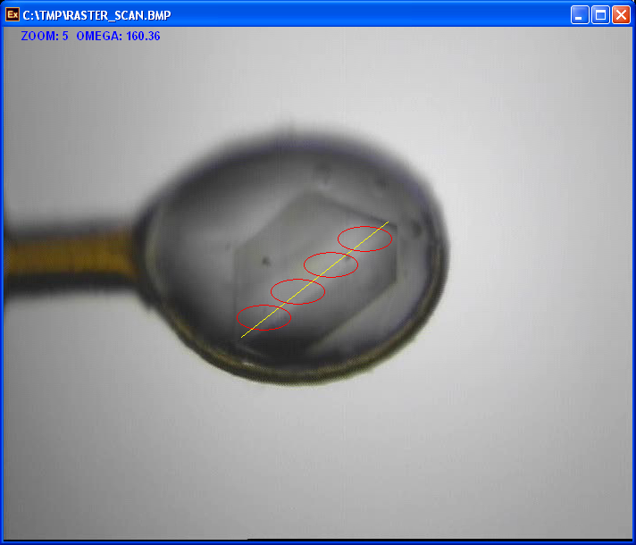
RasterSnap Diffraction Quality Analysis

Slide 21
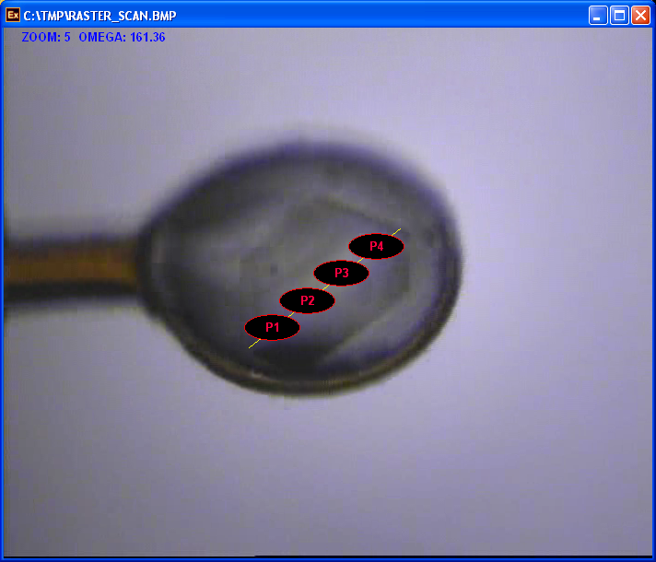
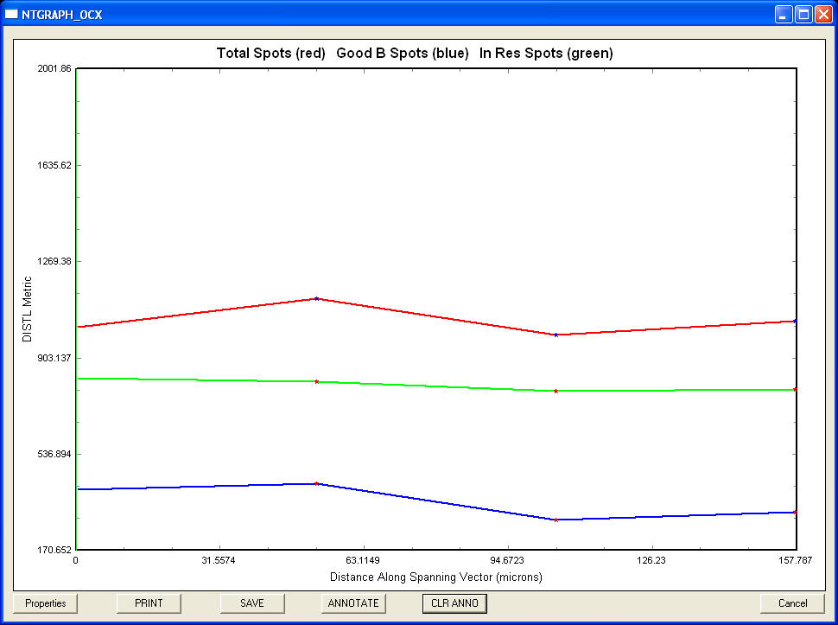
RasterSnap Output

Slide 22
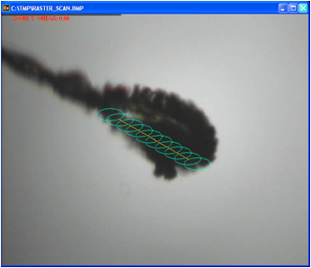
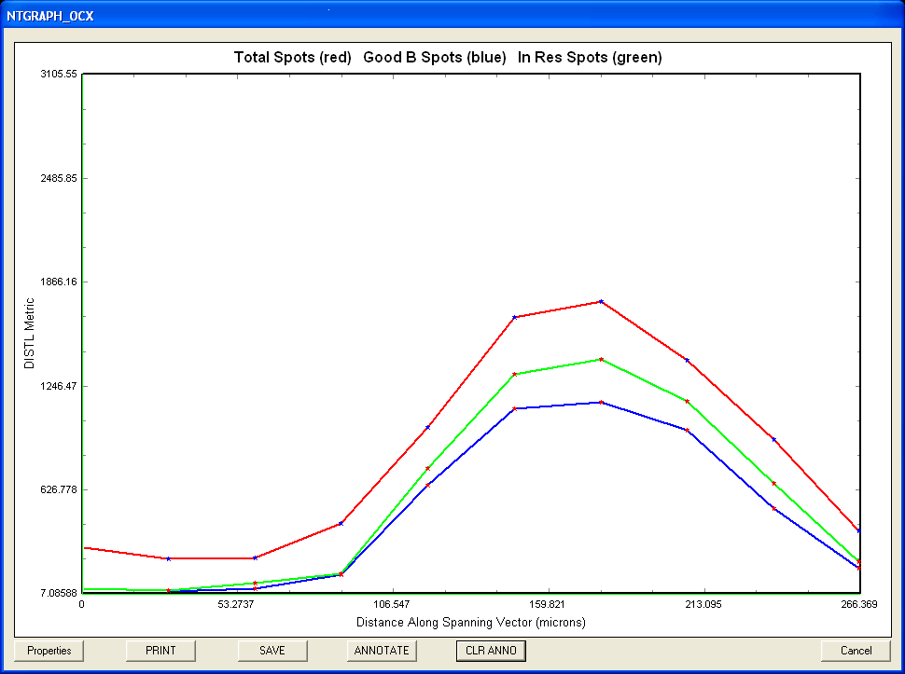
Crystal Location via RasterSnap

Slide 23
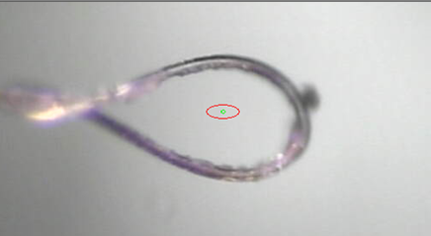
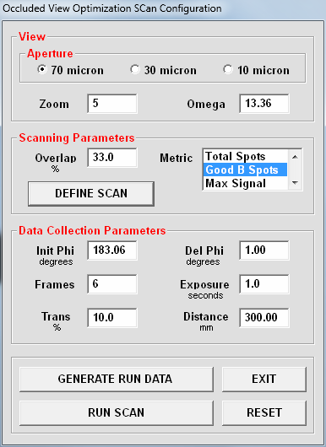
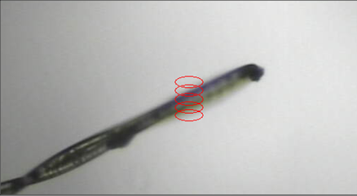
Occluded View Diffractive Alignment

Slide 24
Future Scanned Data Collection Developments:
Improved diffraction-based centering of opaque samples (faster, more effective).
Rapid 2D diffraction metric measures for diffraction quality survey.
Increase framing speed of Q315 – replace MD2 data collection routines with Delta Tau macros.
Data collection strategy advisor: Software package that will encapsulate the experience of our beam line scientists for providing guidance in the use of the beam lines and creation of optimized data collection strategies.
Adaptation of scanning routines for Pilatus 6M detector.

Slide 25
Multiple Spanning Vectors

Slide 26
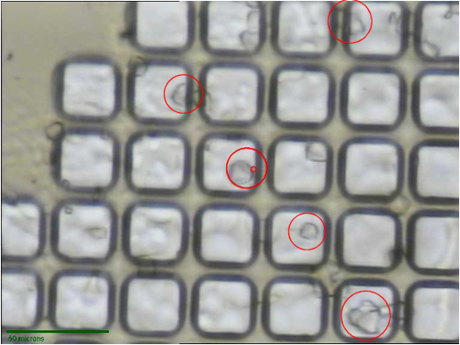
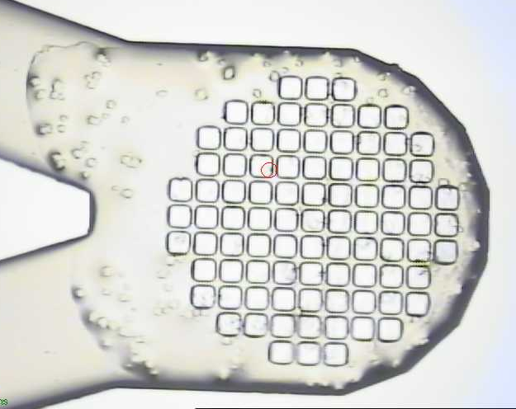
Image-Analysis Guided Automatic Grid Scanning

Slide 27
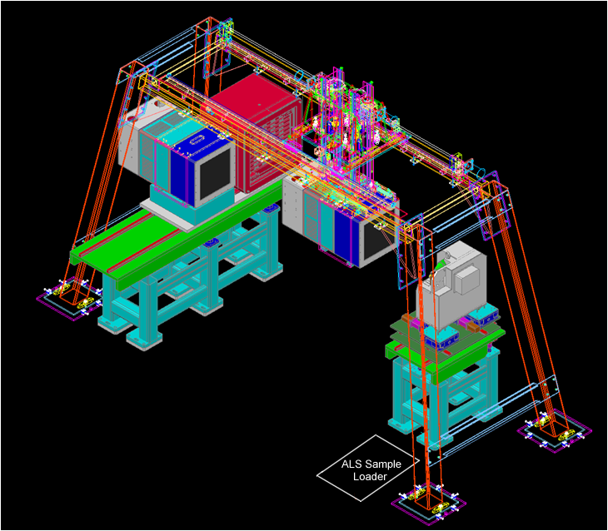
Pilatus 6M Installation

Slide 28
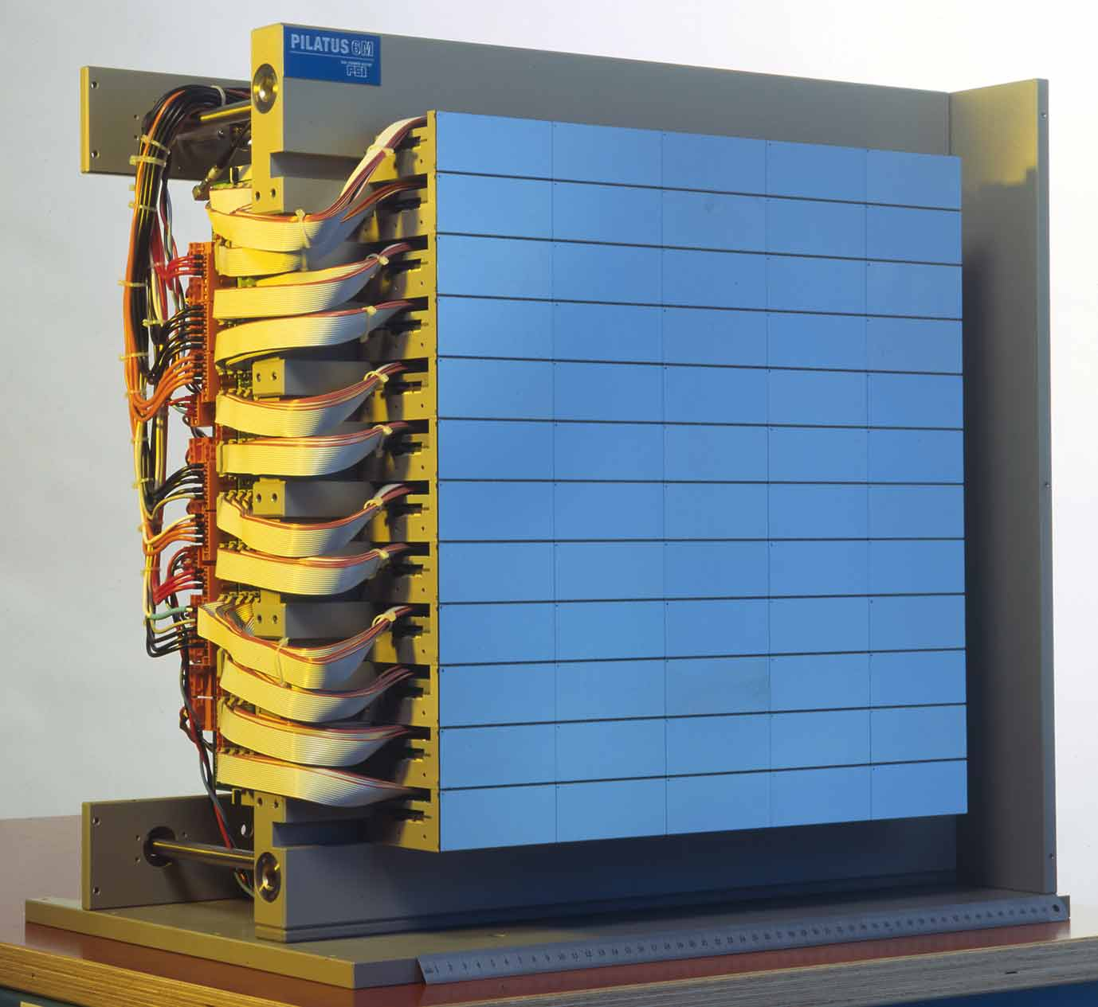
Modifications to Support Pilatus 6M Shutterless Operation
Discrete Vector Scans:
Work without modification –> no effect on data collection
rate.
Continuous Vector Scans:
Require a pause between frames for completion of
programmed centering axis motions –> degradation
of data collection rate.
Rastersnap & Diffrative Alignment:
Record MD2 centering stage encoder outputs as
frame metadata – reconstruct correlation between data
frames and mx,my,mz positions as part of analysis.

Slide 29
Summary Benefits of Scanning Data Methods:
Makes best use of crystals larger than x-ray beam.
Mitigates radiation damage effects on data from large crystals and enables use of higher flux and full utilization of detector dynamic range.
Enables autoalignment of crystals, even in opaque matrices via diffractive alignment.
Useful for analyzing spatial distribution of diffraction quality.

Slide 30
Acknowledgements
RAPD
Kanagalaghatta Rajashankar
Frank Murphy
John Schuermann
David Neau

Slide 31
Aux Slides

Slide 32
North Eastern CAT

Slide 33
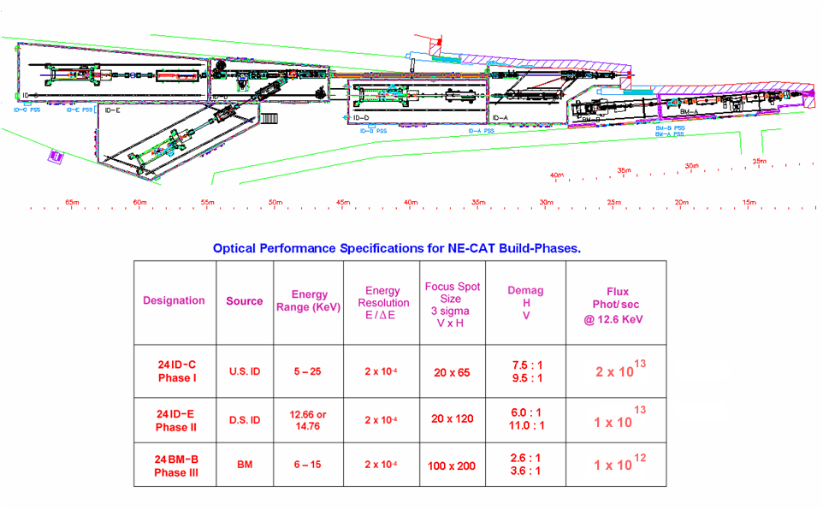
Notes:
point out:
B station (containing bo ID monos)
Each end station…which give beamline designation
Point out last collumn: total flux in focused-monochromatic beam
24ID-C and 24ID-E direct measurement with calibrated ion chamber
24BM-B estimated

Slide 34
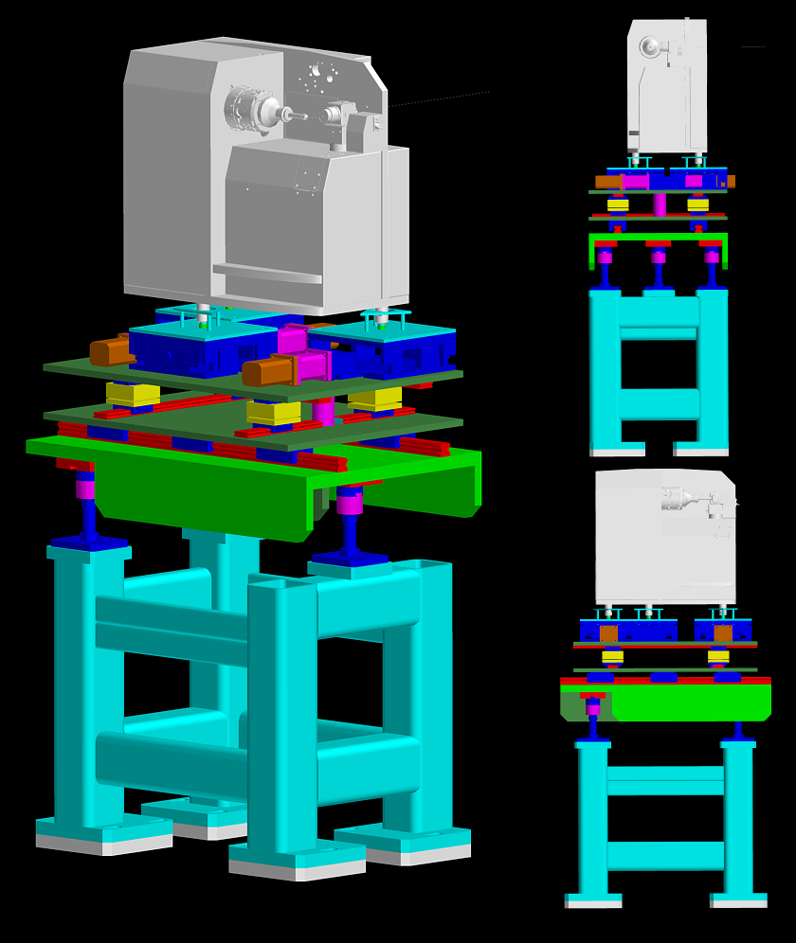
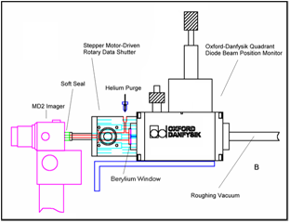
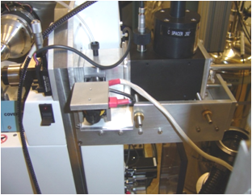
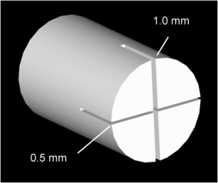
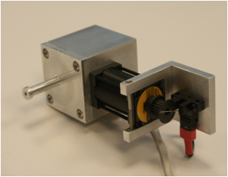

Slide 35
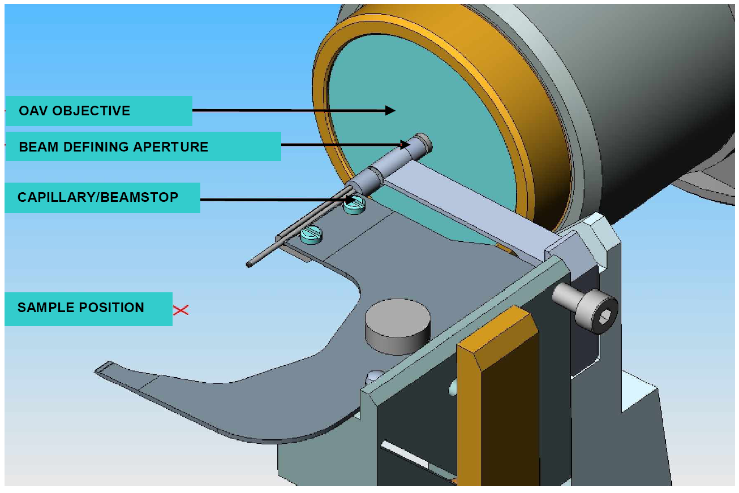
Beam Shaping System

Slide 36
RAPD Data Collection Capabilities
Frank Murphy, Jon Schuermann, David Neau, Kay Perry,
Surajit Banerjee

Slide 37
RAPD Functionalities
Diffractive Alignment
& RasterSnap
Autoindex & Strategy
Minikappa Orientation
Integration
Merging
MR
SAD
DISTL
Labelit
RAPD provides diffraction spot counts and resolution information.

Slide 38
RAPD Functionalities
Diffractive Alignment & RasterSnap
Autoindex & Strategy
Minikappa Orientation
Integration
Merging
MR
SAD

Slide 39
RAPD Functionalities
Diffractive Alignment
& RasterSnap
Autoindex & Strategy
Minikappa Orientation
Integration
Merging
MR
SAD
Labelit
Mosflm
Raddose
Best
RAPD provides optimal strategies for data collection.

Slide 40
RAPD Functionalities
Diffractive Alignment
& RasterSnap
Autoindex & Strategy
Minikappa Orientation
Integration
Merging
MR
SAD
STAC
RAPD provides minikappa settings for different requirements: long, anomalous, smart, a*, b*, c*, split axes
Settings can be sent to beamline by doubleclick.

Slide 41
RAPD Functionalities
Diffractive Alignment
& RasterSnap
Autoindex & Strategy
Minikappa Orientation
Integration
Merging
MR
SAD
XDS
Scala
Pointless
RAPD provides real time integration, simplified statistics presentation and full analysis.

Slide 42
RAPD Functionalities
Diffractive Alignment
& RasterSnap
Autoindex & Strategy
Minikappa Orientation
Integration
Merging
MR
SAD
Scala
Pointless
RAPD provides merging for two datasets with full analysis.

Slide 43
RAPD Functionalities
Diffractive Alignment
& RasterSnap
Autoindex & Strategy
Minikappa Orientation
Integration
Merging
MR
SAD
Phaser
Phenix
RAPD provides robust molecular replacement from starting PDB code or file.

Slide 44
RAPD Functionalities
Diffractive Alignment
& RasterSnap
Autoindex & Strategy
Minikappa Orientation
Integration
Merging
MR
SAD
ShelX
Phenix
RAPD provides fast structure solution with minimal user inputs in all possible spacegroups simultaneously.

Slide 45
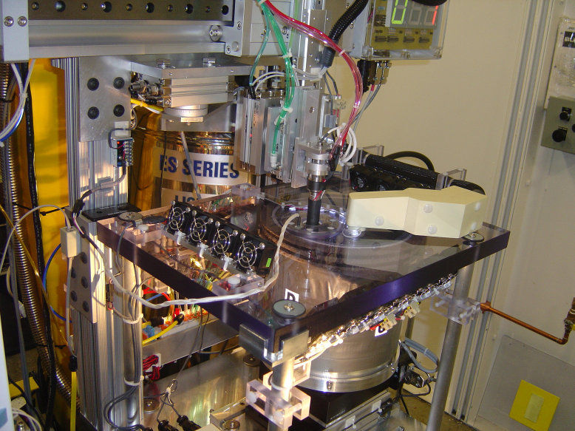
ALS-Type Sample Loader

