Slide 1

Moving on from VME without Breaking the Bank
Mark Rivers
GSECARS, University of Chicago
APS Technical Working Group
August 18, 2022

Slide 2
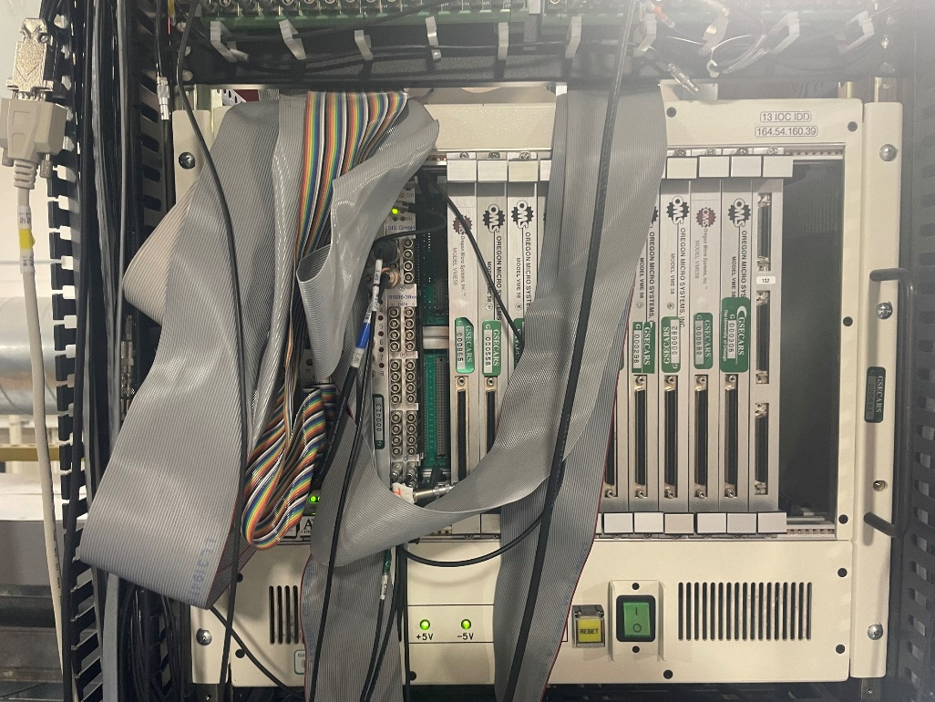
Motivation
VME has a few advantages:
  Has been quite reliable
  Has predictable interrupt response time
  We have a lot of $$$ invested in it
VME has many disadvantages:
  Very poor price/performance
  Difficult development/debugging environment
  Aging technology:
    Existing devices becoming obsolete and unsupported
    Few new devices being developed
  Local vxWorks expertise is disappearing as staff retire
We need to look to alternatives for the next decades of the APS
Must not be too expensive because funds to replace a “working” system will be difficult to obtain

Slide 3
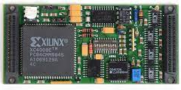
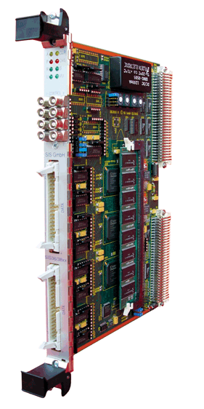
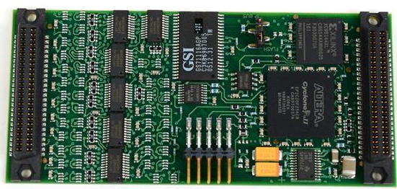
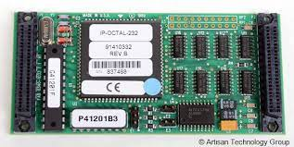
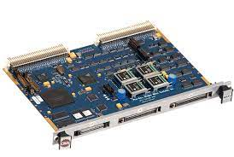
Current Beamline VME Functionality
Analog to digital (IP330 and others)
Digital to analog (DAC128V and others)
Digital I/O (IP-Unidig and others)
SoftGlue (IP-201)
Counter/timer (Joerger VSC-16, SIS-3800, SIS-3802)
Multi-channel scaler (SIS-3800, SIS-3802)
Serial communications (IP-Octal and others)
Motion control (OMS-58, MAXv)
APS timing system (FRX-200, FRX-300, TMG-1)
Allen-Bradley SLC-500 PLC communications (6008SV)
Will discuss affordable replacements for most of these.

Slide 4
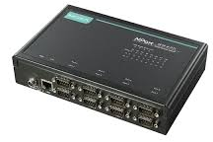
Easy VME Replacements
Serial communications (IP-Octal and others)
  Replace with Ethernet terminal servers (Moxa, Digi, etc.)
SoftGlue (IP-201)
  Replace with Soft Glue Zynq
  On-board EPICS IOC
  Ethernet communication

Slide 5
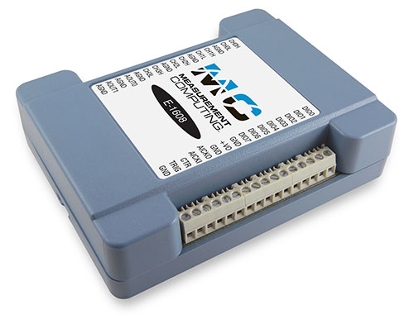
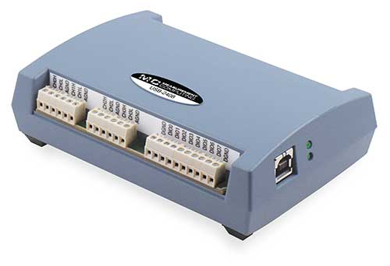
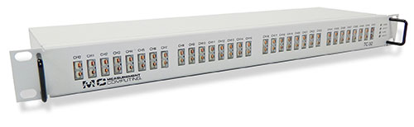
VME Replacements
Analog to digital, digital to analog, and digital I/O
Replace with Measurement Computing Ethernet and USB devices
R4-0 of EPICS measComp module uses the Measurement Computing libuldaq SDK on Linux.
  Open source, vendor support
  Supports all of their modules
  Similar to, but not source compatible with their Window ULDaq SDK
  EPICS drivers now make different calls for Linux and Windows

Slide 6
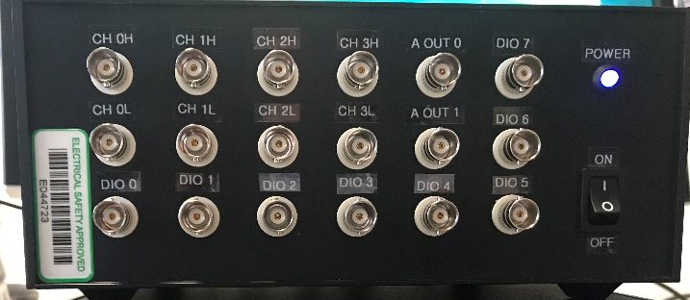
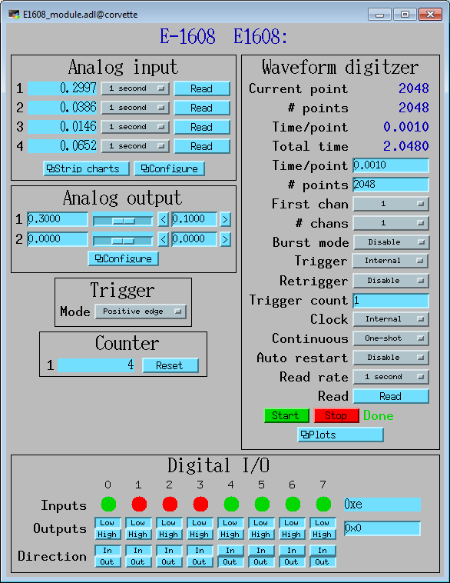
Measurement Computing E-1608 ($579)
Ethernet interface
16-bit analog inputs
  8 single-ended channels or 4 differential channels
  Programmable per-channel range: +-1V, +-2V, +-5V, +-10V
  250 kHz total maximum input rate.
  Internal or external trigger.
  Internal or external clock for input signals.
  Input FIFO, unlimited waveform length
16-bit analog outputs
  2 channels, fixed +-10V range
Digital inputs/outputs
  8 signals, individually programmable as inputs or outputs
Counter
  1 input
  10 MHz maximum rate, 32-bit register

Slide 7
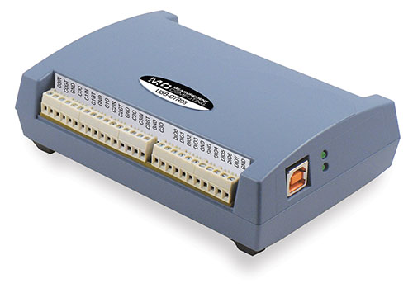
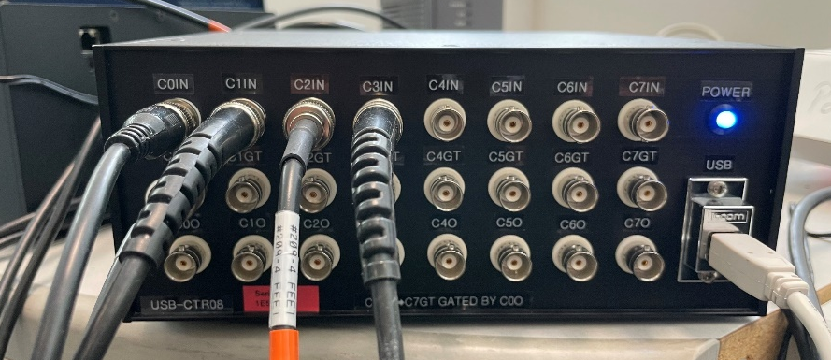
Measurement Computing USB-CTR08 ($489)
Replaces Joerger and Struck scalers and MCS
8 counters
  48 MHz maximum count rate
  Up to 64-bit counter depth
  Counters can be read synchronously on-the-fly
  4 modes:
    Totalize (count number of pulses)
    Period (measure time between rising or falling edge of successive pulses)
    Pulse width (measure time between rising and falling edge of a single pulse)
    Timing mode (measure time between edges of two different input signals)
4 pulse generators
  48 MHz clock
  Programmable period, width, number of pulses, polarity
Digital inputs/outputs
  8 signals, individually programmable as inputs or outputs

Slide 8
USB-CTR08 vs VME SIS3820
 | USB-CTR08 | SIS3280
# Counters | 8 | 32
Interface | USB 2.0 | VME
Maximum count rate | 48 MHz (TTL) | 100 MHz (TTL) 250 MHz (ECL, NIM)
Minimum dwell time | 250 ns per active counter | 220 ns for 8 active counters
Pulse generators | 4 | 0
Digital I/O bits | 8 | 1
Price | $489 | $4,350

Slide 9
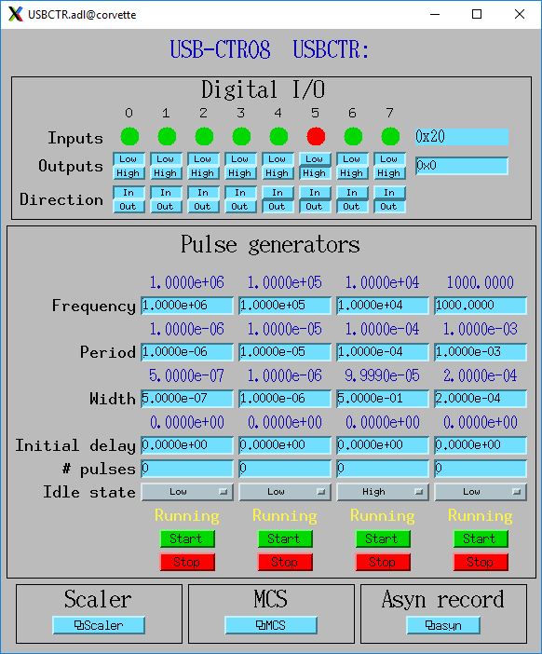
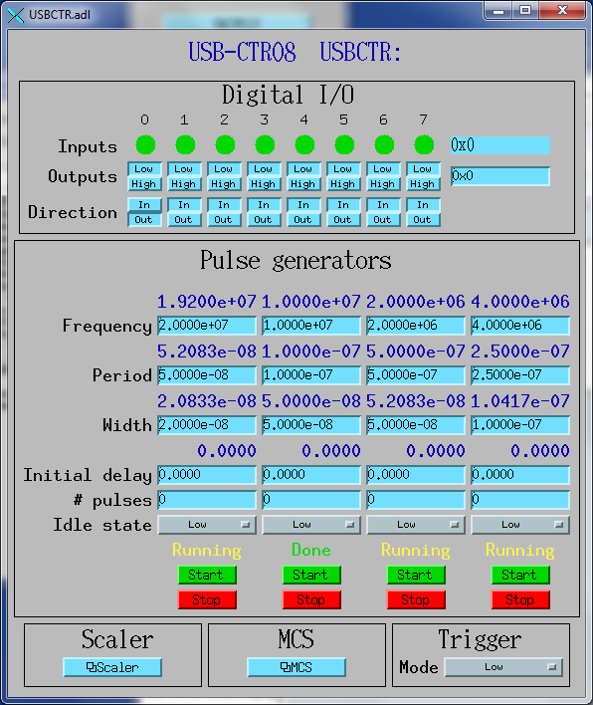
USB-CTR08 Main medm Screen

Slide 10
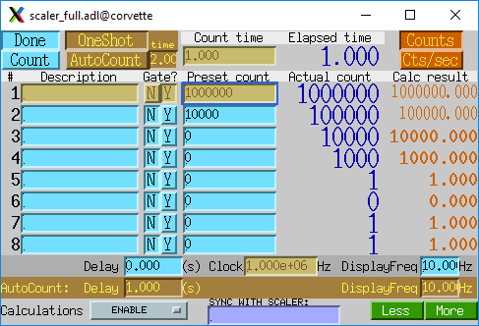
USB-CTR08 Scaler Record Mode

Slide 11
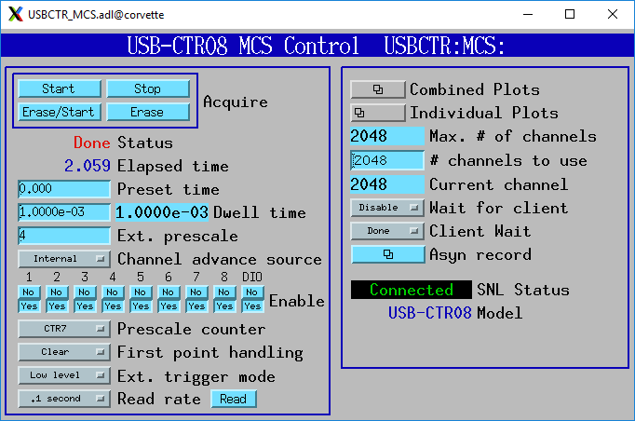
USB-CTR08 Multi-Channel Scaler (MCS) Mode

Slide 12
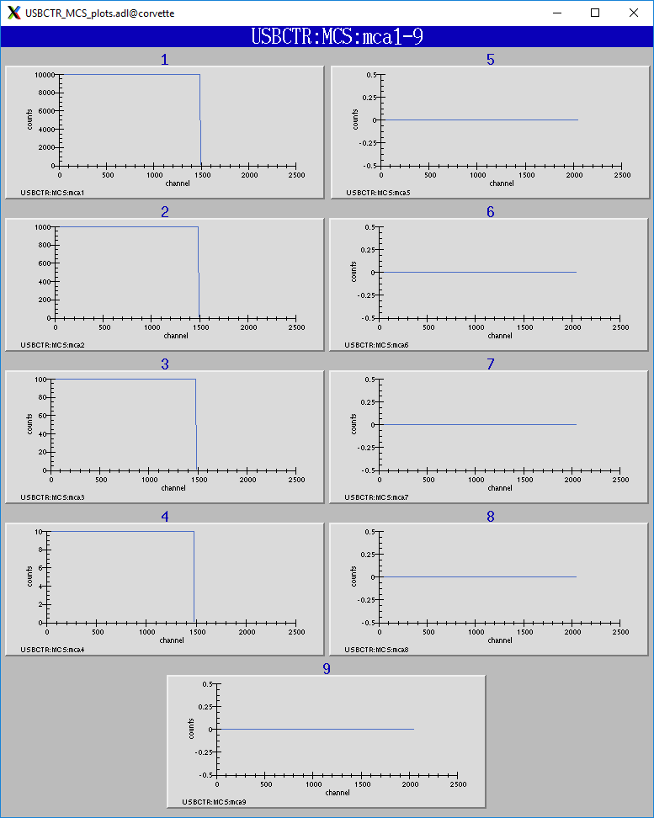
USB-CTR08 MCS Mode Plots

Slide 13
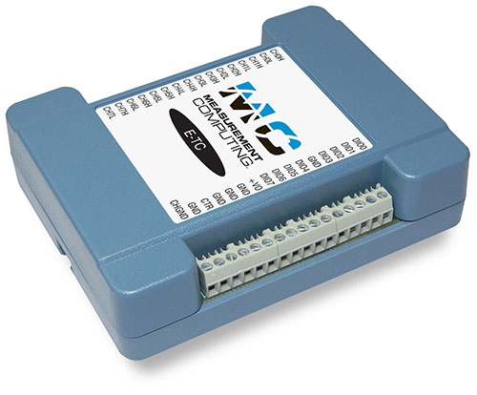
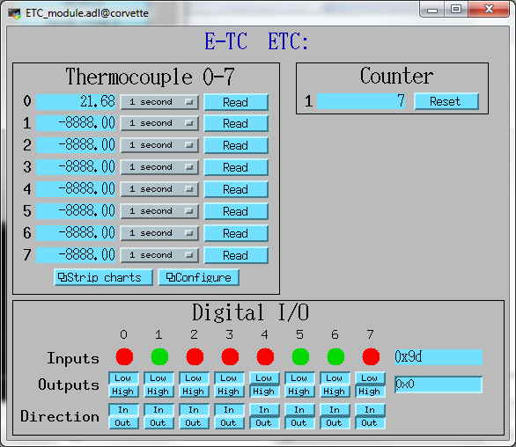

Measurement Computing E-TC ($559)
Ethernet interface
8 thermocouple inputs
  8 channels with cold-junction compensation. Types J, K, T, E, R, S, B, and N.
  4 samples/s
  24-bit analog outputs
Digital inputs/outputs
  8 signals, individually programmable as inputs or outputs
Counter
  1 input
  10 MHz maximum rate, 32-bit register

Slide 14
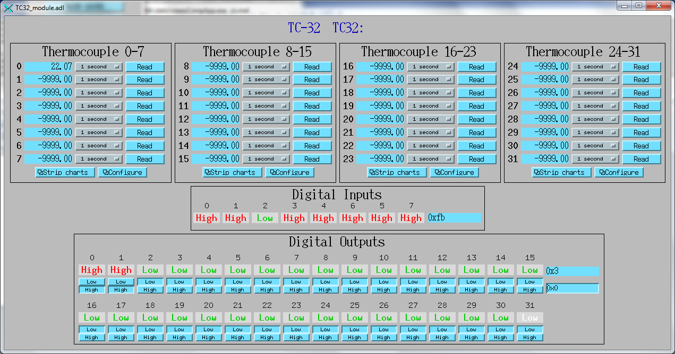
Measurement Computing TC-32 ($2,319)
Ethernet and USB interfaces, either can be used.
32 thermocouple inputs
  32 channels with cold-junction compensation. Types J, K, T, E, R, S, B, and N.
  3 samples/s if reading all 32 channels, faster if reading fewer.
Digital inputs
  8 digital inputs, switch-selectable pullup resistor
Digital outputs
  32 digital inputs, switch-selectable pullup resistor
  Each output can either be controlled by software or can be controlled by the alarm status of the corresponding thermocouple. Flexible alarm configuration, i.e. hysteresis.

Slide 15
Other Measurement Computing Modules
USB-1608GX-2A0 ($919)
  16-bit analog inputs (16 single-ended channels or 8 differential)
    500 kHz total maximum input rate, i.e. 1 channel at 500 kHz, 8 channels at 62.5 kHz, etc.
    Waveform digitizer support
  16-bit analog outputs
    2 channels, fixed +-10V range
    500 kHz total maximum output rate, i.e. 1 channel at 500 kHz, 2 channels at 250 kHz
    Arbitrary waveform generator support
USB-2408-2A0 ($809)
  24-bit analog inputs (16 single-ended channels or 8 differential)
    Programmable per-channel range: 8 ranges from +-0.078V to +-10V
    Thermocouple support for 8 channels with cold-junction compensation. Types J, K, T, E, R, S, B, or N.
    1 kHz total maximum input rate, i.e. 1 channel at 1 kHz, 8 channels at 125 Hz, etc.
    Waveform digitizer support
USB-TEMP ($629)
  8 temperature inputs, mix of platinum resistance thermometers (RTD), thermocouples, thermistors, or semiconductor sensors.

Slide 16
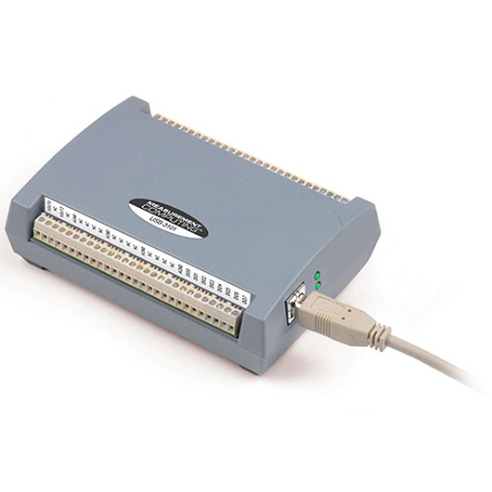
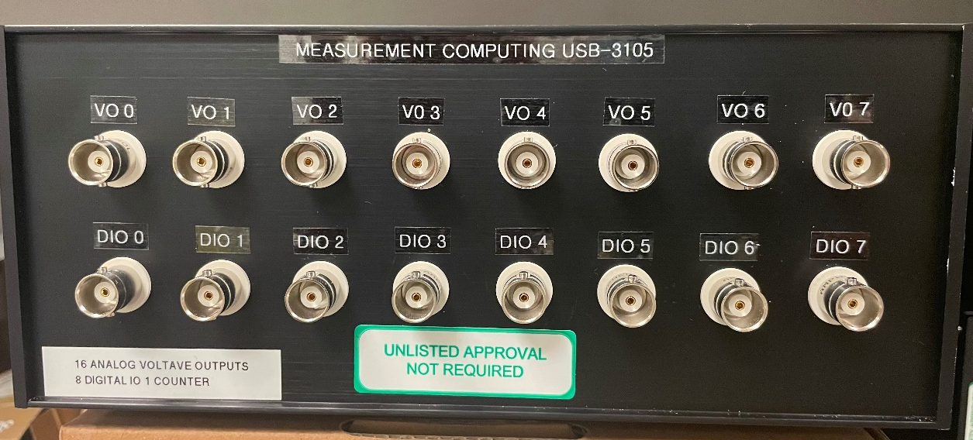
Other Measurement Computing Modules
E-DIO24 ($335)
  Ethernet interface
  24 digital signals, individually programmable as inputs or outputs
USB-310X ($459 - $689)
  16-bit analog outputs (4, 8, or 16)

Slide 17
Note on USB Devices
Sometimes viewed as difficult because of length limitations
We have excellent success with 20 m USB-3.0 extension cables from SIIG ($200).
Using USB 3.1 hub ($150) 4 devices can be controlled over a single USB cable from server.
Measurement Computing devices are USB-2.0, so USB-3.0 cable and hub can easily handle the traffic from 4 devices.
Following configuration with 25 meters (82’) between computer and high-speed streaming devices running simultaneously worked fine.
USB-1608GX-2AO
Linux Computer
20 meters
USB 3.1 Hub
5 meters
USB-CTR08

Slide 18
Motion Control
This is the most challenging aspect of moving away from VME at reasonable cost.
This is a count of the motor controllers and axes at GSECARS.
Motor controllers at GSECARS
 | VME |  | Non-VME
 | OMS-58 | OMS MAXv | Newport XPS | ACS MCB-4B | Aerotech | Delta Tau
Total controllers | 44 | 8 | 17 | 8 | 1 | 2
Total axes | 352 | 64 | 136 | 32 | 7 | 14
Total axes | 605
Two popular non-VME motor controllers are Newport XPS and ACS MP4U. These each cost about $15,000 for an 8-axis version.
  The controllers have advanced features like complex coordinated motion that are needed in some applications.
GSECARS needs to replace 52 VME motor controllers, which would be $780K.
  This is not feasible within our budgets.
These are all controlling simple open-loop stepper motors, mainly with Step-Pak drivers.

Slide 19
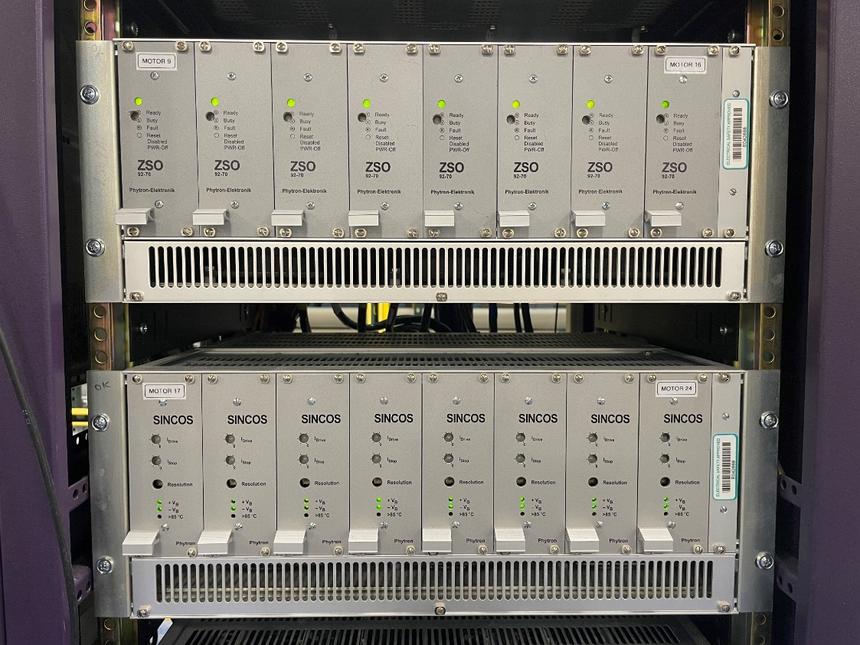
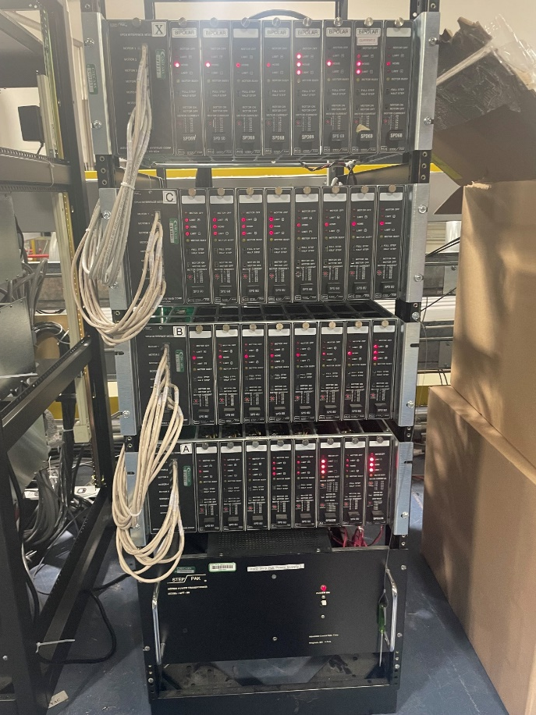
Motion Control
Much of the cost of the Newport XPS or ACS MP4U is the drivers.
No need to replace the drivers, we can continue to use the Step-Paks or Phytron drivers that most beamlines are using.
We just need an inexpensive Ethernet controller with pulse and direction output.
Phytron drivers
Step-Pak drivers

Slide 20
Galil DMC-41X3
Galil DMC-4143 (4 axis) and DMC-4183 (8-axis)
DMC-4183 with enclosure costs $2,330 (quantity 1) and $1,620 (quantity 100)
6-9 times less expensive than XPS or ACS controllers.
Ethernet interface
Pulse and direction and analog drive outputs for steppers or servos.
Optional on-board stepper and/or servo drivers.
8 analog inputs
16 optically isolated inputs and outputs

Slide 21
Galil DMC-4183
Up to 15 MHz encoder frequency
Multitasking for concurrent execution of up to eight programs.
Optically isolated home and limit inputs.
PID compensation with velocity and acceleration feedforward, integration limits, notch filter and low-pass filter.
Modes of motion include point-to-point positioning, jogging, PVT, contouring, linear and circular interpolation, electronic gearing and ECAM.
Mature EPICS driver written at the Australian Synchrotron
Supports complex coordinated motion (EPICS profile moves)
Supports Position Compare Output (PCO) for triggering detectors at specific positions
Optional plugin amplifier boards up to 750 W.
  4 axis 1.4A microstepping driver plugin ($205)
  4 axis 3.0A microstepping driver plugin ($675)
  Also servo and linear brushless motor driver plugins.

Slide 22
Galil DMC-4183
Each axis has high-density DA-26 connector with pulse, direction, encoder, limits, home, etc.
Pulse and direction outputs are single-ended.
  Needed to modify Step-Pak SPC-3 interface to be single-ended, not differential.
  Remove 4 chips and jumper 8 connections.
ACS quoted building a custom interface with DA-26 connectors and single-ended inputs for $800.
We built 2 custom DA-26 to DB-25 cables for testing 2 axes
We have a quote for custom cables from readytogocables.com for $19/each.
The DMC-4183 can be mounted to the same rack as the Step-Pak or Phytron, only 3’ cables needed.

Slide 23
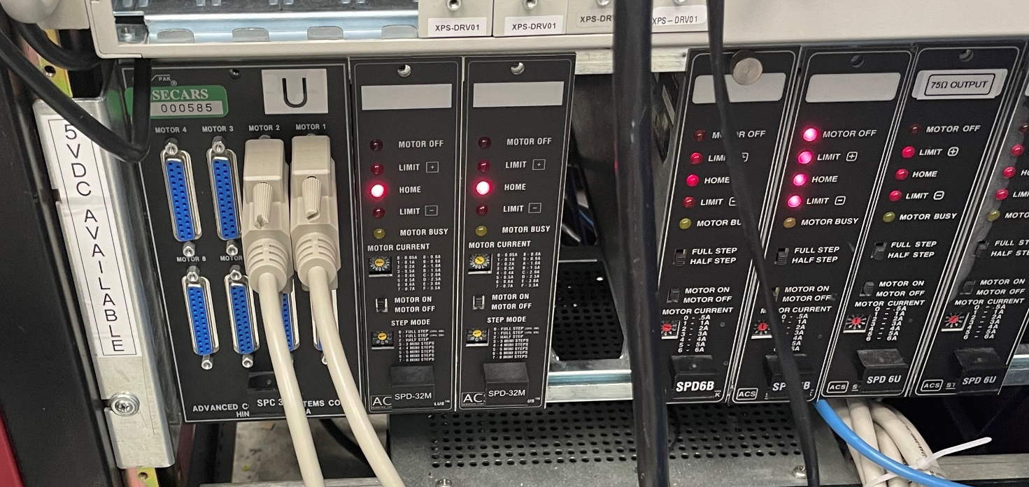
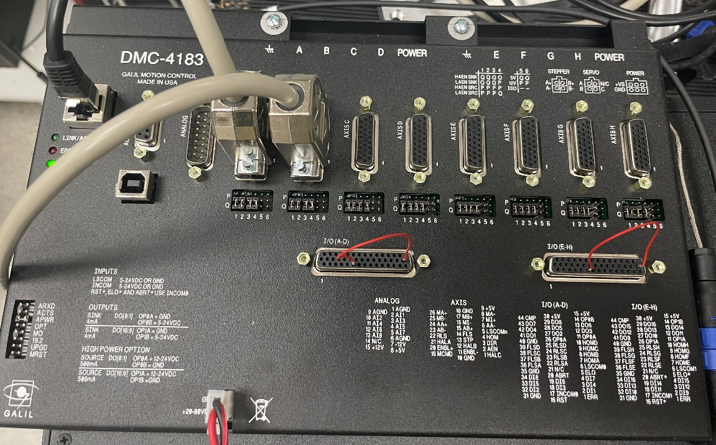
Galil DMC-4183
DMC-4183 with cables connected to channels 1 and 2
Step-Pak with cables connected to channels 1 and 2 of SPC-3 interface
SPD-32M ministepper drivers

Slide 24
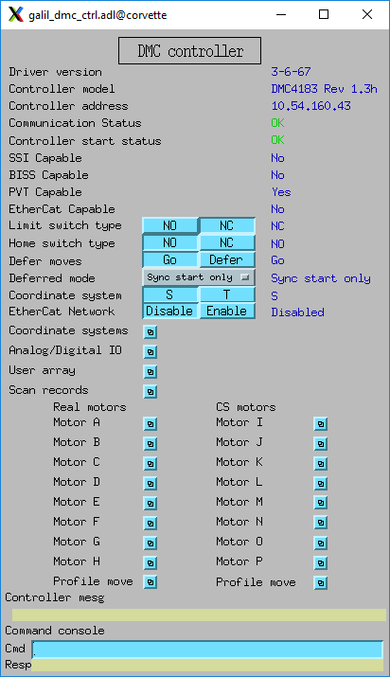
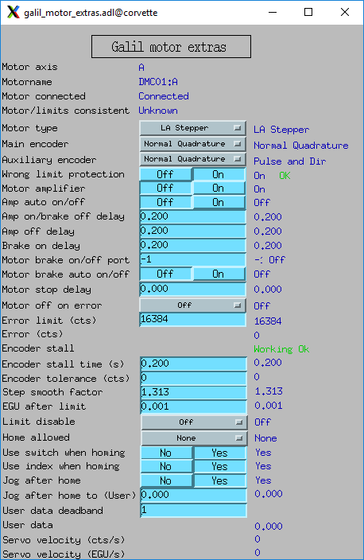
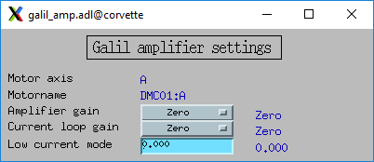
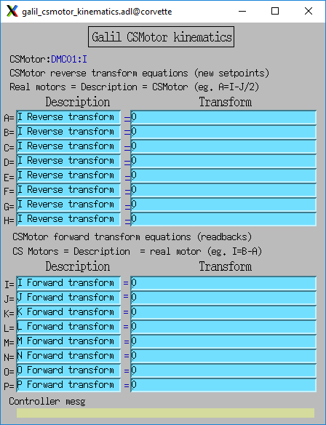
Galil Specific Screens – Rich Features

Slide 25
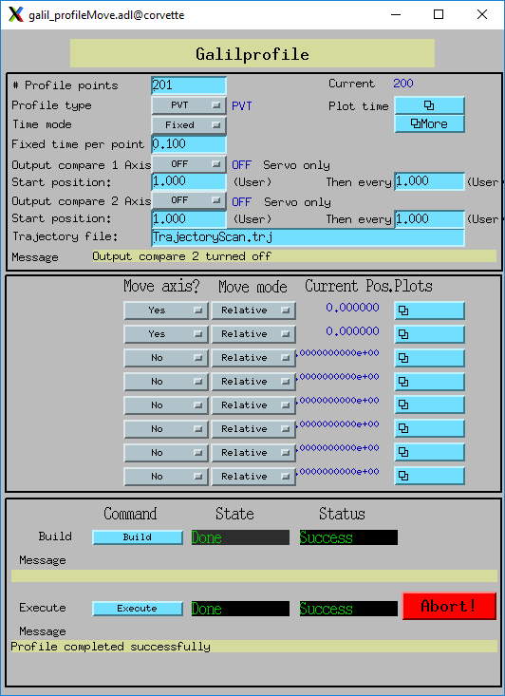
Multi-Axis Complex Coordinated Motion
The EPICS driver for Galil controllers implements the Model 3 “Profile Move” interface.
This supports complex coordinated motion
PVs for the number of profile points and time per point.
Waveform records define the position of each enabled axis for each point in the profile.
Very similar interface to the Newport XPS profile move.

Slide 26
Python Script to Define and Execute Profile Move
2 motors each executing cosine wave motion with different amplitudes and number of periods
from epics import PV
import numpy as np
import time
def galil_sin_profile_test(prefix='DMC01:Prof1:',
num_points=1000, time_per_point=0.1, nperiods1=1,
nperiods2=2, ampl1=1, ampl2=2):
points_pv = PV(prefix + 'NumPoints')
points_pv.put(num_points)
profile_type_pv = PV(prefix + 'PROFILETYPE_CMD')
profile_type_pv.put('PVT')
time_mode_pv = PV(prefix + 'TimeMode')
time_mode_pv.put('Fixed')
time_pv = PV(prefix + 'FixedTime')
time_pv.put(time_per_point)
# Define and write waveform1
waveform1 = ampl1 * (np.cos(np.linspace(0, nperiods1 * 2
* np.pi, num=num_points)) -1)
waveform1_pv = PV(prefix + 'M1Positions')
waveform1_pv.put(waveform1)
use1_pv = PV(prefix + 'M1UseAxis')
use1_pv.put('Yes')
# Define and write waveform2
waveform2 = ampl2 * (np.cos(np.linspace(0, nperiods2 * 2
* np.pi, num=num_points)) -1)
waveform2_pv = PV(prefix + 'M2Positions')
waveform2_pv.put(waveform2)
use2_pv = PV(prefix + 'M2UseAxis')
use2_pv.put('Yes')
# Build the trajectory
build_pv = PV(prefix + 'Build')
build_pv.put(1)
time.sleep(1)
build_message_pv = PV(prefix + 'BuildMessage')
build_message = build_message_pv.get()
if (build_message[0] != 0):
print('Build error=',
build_message_pv.get(as_string=True))
return
execute_pv = PV(prefix + 'Execute')
execute_pv.put(1)
print('Executing profile')

Slide 27
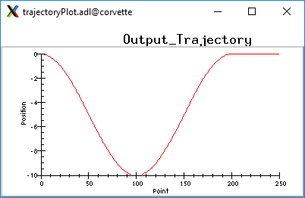
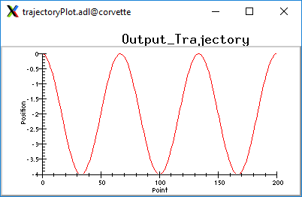
Multi-Axis Complex Coordinated Motion
>>> from galil_sin_profile_test import *
>>> galil_sin_profile_test(num_points=201, time_per_point=.1,
nperiods1=1, ampl1=5, nperiods2=3, ampl2=2)
Executing profile
Motor 1 has 1 period with a peak-to-peak amplitude of 10 rotations
Motor 2 has 3 periods with a peak-to-peak amplitude of 4 rotations

Slide 28
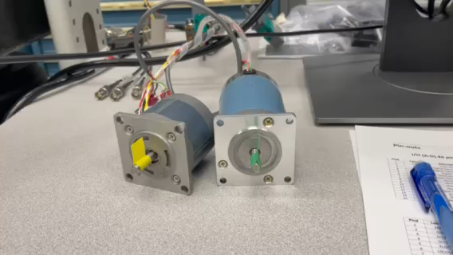
Multi-Axis Complex Coordinated Motion
Video of motor motion when profile move is executed

Slide 29
Status
GSECARS is gradually moving VME functions like A/D, D/A, digital I/O to Measurement Computing
Galil motor controller is still in the early evaluation stage
We currently have 1 controller with no on-board drivers
We have ordered 4 more controllers:
  1 with no amplifiers for use with Step-Pak
  2 with 4040 stepper drivers for 8 axis with up to 1.4 A/phase, 16 microsteps/step
  1 with 4140 stepper drivers for 8 axis with up to 3.0 A/phase, 64 microsteps/step
4040 driver version can replace OMS-58 and CARS BP8000 box used to drive small motors, e.g. in K/B mirror systems.
  May need to reduce minimum current from 0.5A to 0.25A.
Hope to convert one VME crate before the dark period.

