Slide 1



APS Hard X-ray Transition Edge Sensor Spectrometer
Orlando Quaranta
Detectors Group, X-ray Science Division
Advanced Photon Source, Argonne National Laboratory
T. Guruswamy, L. Gades, A. Miceli, U. Patel and S. Bean
Argonne National Laboratory is a
U.S. Department of Energy laboratory managed by UChicago Argonne, LLC.
TWG Talk - Argonne, 20 July 2023

Slide 2

Outline
Introduction to superconductivity
Superconducting detectors
X-ray spectrometer for the APS
Examples of application

Slide 3
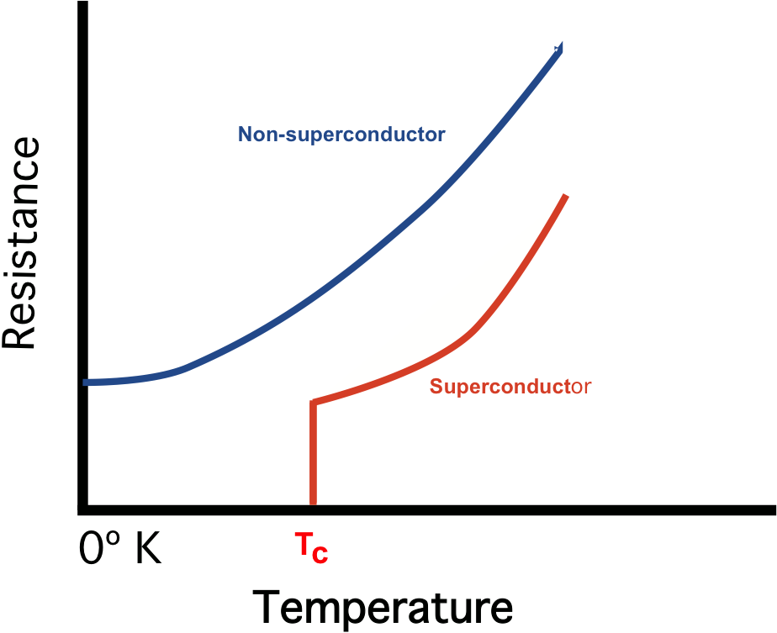

Superconductivity
The sudden and complete disappearance of DC electrical resistance in a material below a transition or critical temperature T_{C} (divided in low and high T_{C})
Electrons pair up and become Cooper pairs, any leftover electrons are quasiparticles
Vast majority of superconducting electronics is based in low T_{C} materials

Slide 4
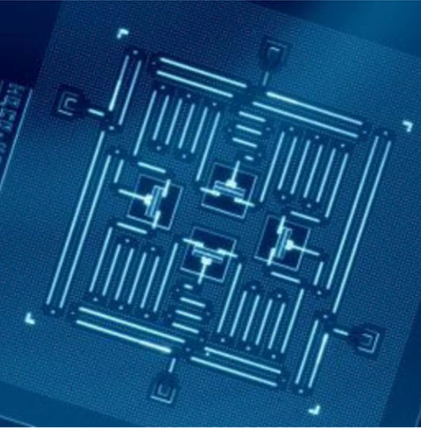

cQED, Quantum Computing, and Physics-on-a-chip
Superconducting circuits allow individual Cooper pairs and electrons to be controlled
Circuit Quantum Electrodynamics, Quantum Computing, and much more
“Artificial atoms”, “Qubits”
Also low-loss (energy efficient), fast classical computing with Single Flux Quantum (SFQ) logic and superconducting memory
Made with standard semiconductor integrated circuit techniques (photolithography, etching, sputtering, etc.)
Four transmon qubits with readout resonators, by J. Gambetta, J. Chow & M. Steffen (IBM), CC BY 4.0, https://www.nature.com/articles/s41534-016-0004-0

Slide 5
Outline
Introduction to superconductivity
Superconducting detectors
X-ray spectrometer for the APS
Example of application

Slide 6
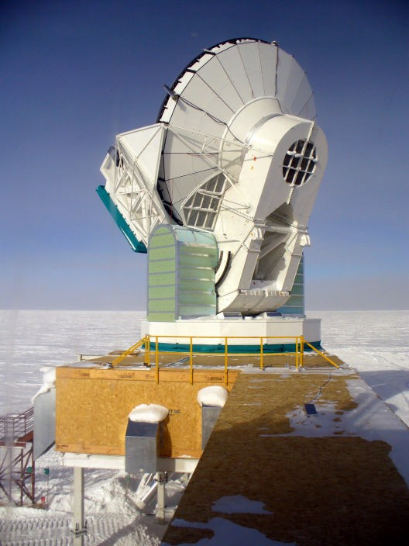

Applications of superconducting detectors
Ultra-sensitive bolometers, calorimeters, and photon counting detectors
Terahertz, infrared, visible, UV, X-ray, γ-ray, particle, dark matter, neutrino
Astronomy (ground and space-based), meteorology and earth observation
Telecommunications (especially quantum communication)
Medical imaging
Defense and military
SPT, by Amble, CC BY-SA 3.0, https:
//commons.wikimedia.org/w/index.php?curid=9057466
High energy physics, nuclear and X-ray science

Slide 7

Why superconducting detectors?
Photon or other signal must interact with detector and measurably change it
Semiconductor (e.g. CCD in digital camera) – photon creates electron-hole pairs (1 eV)
Superconductor – photon creates quasiparticles (1 meV)
For same photon energy, you get 1000 times more signal!
Superconducting photon detectors are very low noise, very high sensitivity
hν > 2∆
E = ∆
E = 0
Cryogenic temperatures good for reducing thermal noise anyway

Slide 8
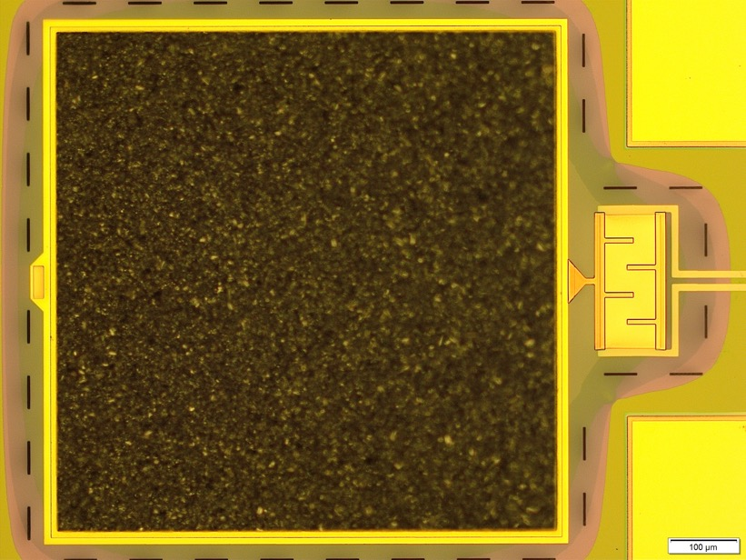

Superconducting Detectors
Transition Edge Sensor (TES)
Superconductor at the transition – large dR/dT
Feedback loop to bias and stabilize small superconducting square at transition
Large absorbers to stop photons
Very high energy/power resolution
X-ray
E=hν
Thermometer, ΔT
Absorber/Heat Capacity, C
C
10
E
τ =
Temperature
G
C
6
Resistance (mΩ)
Thermal Conductance, G
2
Time
0
E = C x ΔT
ΔE = (k_{B} x T² x C)^{1/2}
95.8
96
96.2
Temperature (mK)

Slide 9
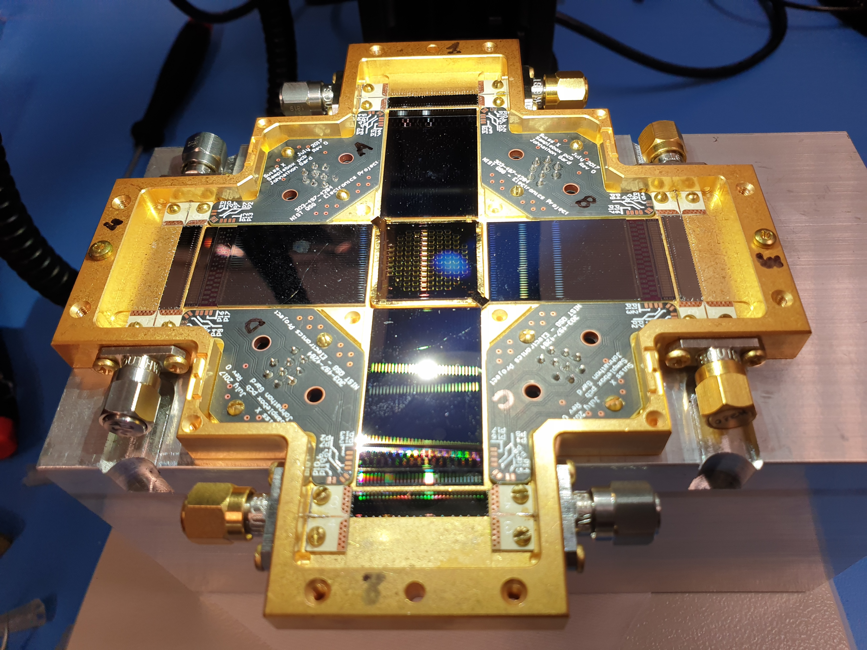
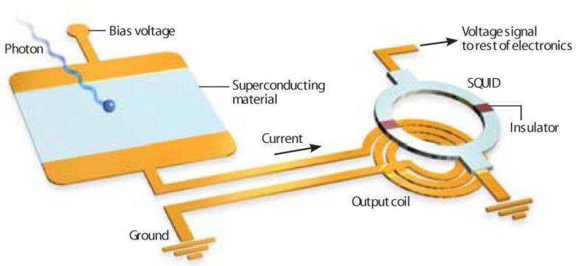
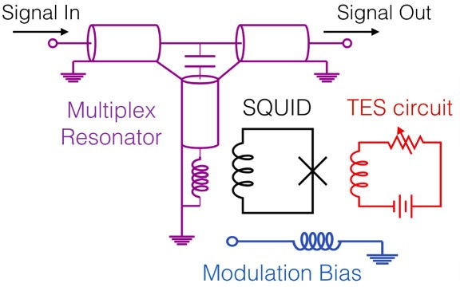
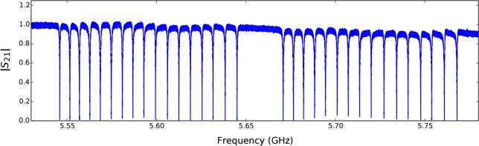

Superconducting Detectors
Transition Edge Sensor (TES) - Multiplexing
Array read out with microwave frequency domain multiplexing (µmux)

Slide 10
Outline
Introduction to superconductivity
Superconducting detectors
TES X-ray spectrometer for the APS
Example of application

Slide 11
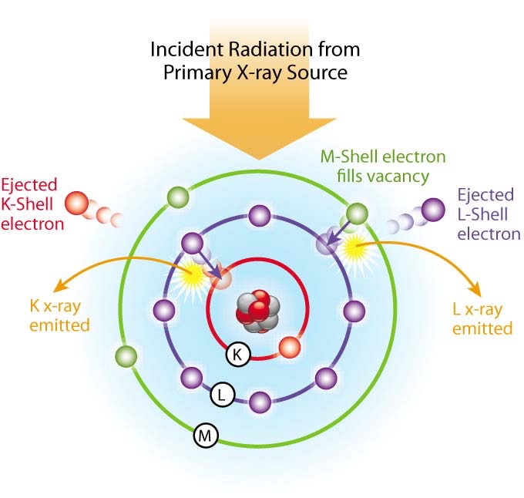
X Ray Fluorescence
Emission of characteristic secondary X-rays from a material that has been excited by bombarding with high energy X-rays
X-rays emitted when electrons make transitions from a higher to a lower atomic energy level
Characteristic X-rays are unique for each element as energy emitted is proportional to the binding energy of the element
Measuring the energy of the emitted photons allows the identification of the composing elements and potentially their chemical state
Complex samples can have “overlapping” emission lines – e.g. K-line from an element close to L-line from another

Slide 12
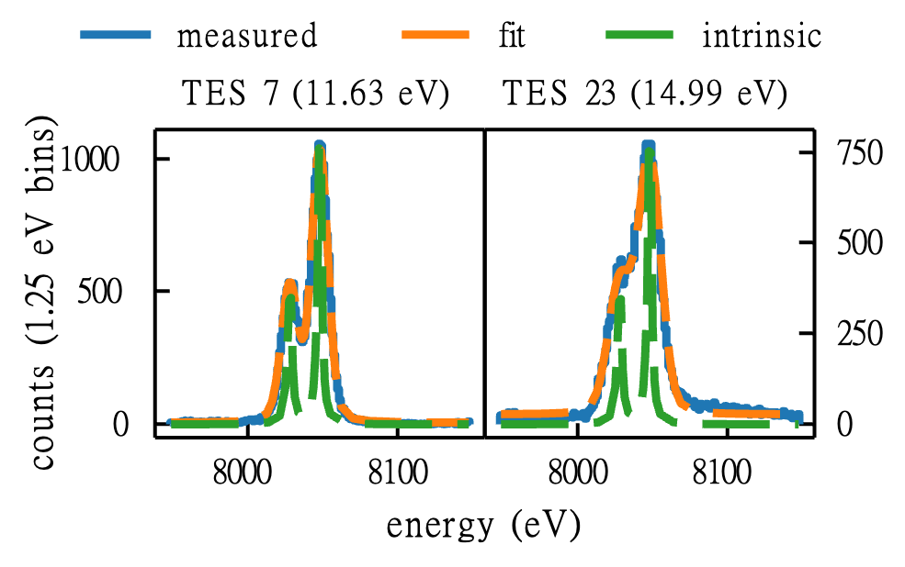
Spectroscopy X-ray detectors
Generally, can either measure energy spectrum slowly but accurately, or fast but with poor resolution
Superconducting detectors can be fast(-ish) and have good resolution
TES array improve energy resolution (ΔE) from ~150 eV to ~10 eV at 20 keV
10⁴
Fe Kα Hf Li
Hf Lα Cu Kβ
Hf Lγ1
Hf Lγ2 Hf Lγ3
W Li Cu Kα
W Lα
Hf Lβ1 Hf Lβ3
Hf Lβ2
W Lβ1
W Lβ2
10⁴
TES counts (0.625 eV bins)
SDD counts (13.0 eV bins)
10³
10³
10²
10²
10¹
10¹
6000
7000
8000
9000
coadded energy (eV)
10000
11000
12000
Cu Kα Hf Lα Cu Kβ
W Lα Hf Lβ1 Fe Kα
Hf Lβ2 W Lβ2 W Lβ1
Hf Lγ1 Hf Lβ3 Hf LR
Hf Lγ3 Hf Lγ2 W LR

Slide 13
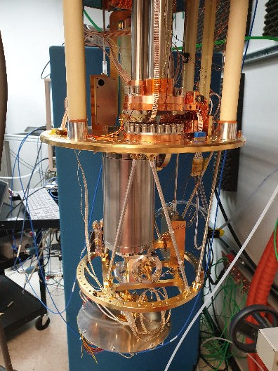
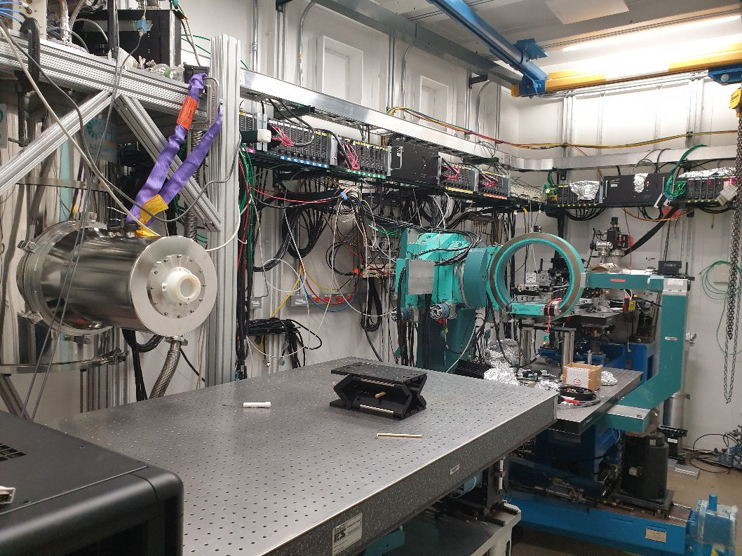
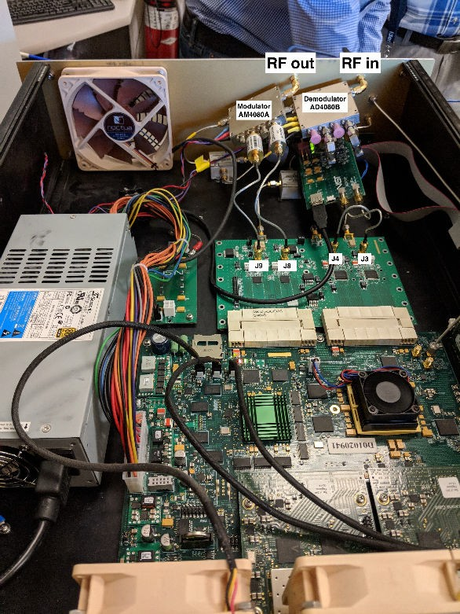

APS X-ray TES Instrument
Instrument needs
Cryostat for array operation at 60 mK:
- 60 K and 4 K stages using pulse-tube cryocooler (active gas ⁴He)
                - 300 mK stage ³He sorption
                - 35 mK stage adiabatic demagnetization (ADR)
Room-temperature electronics to power and read out array, process and save data
Beamline integration

Slide 14
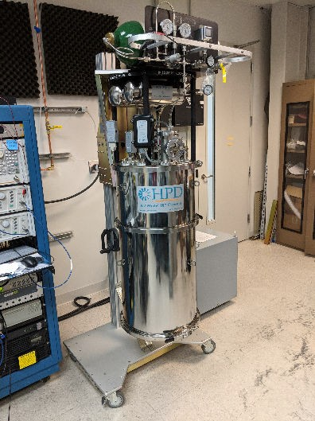
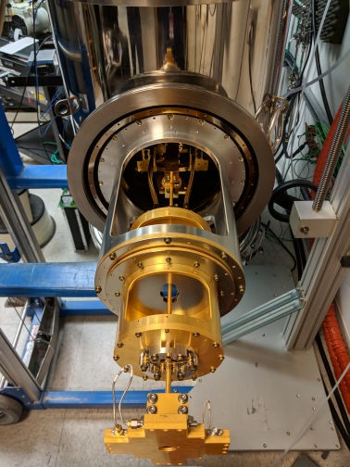
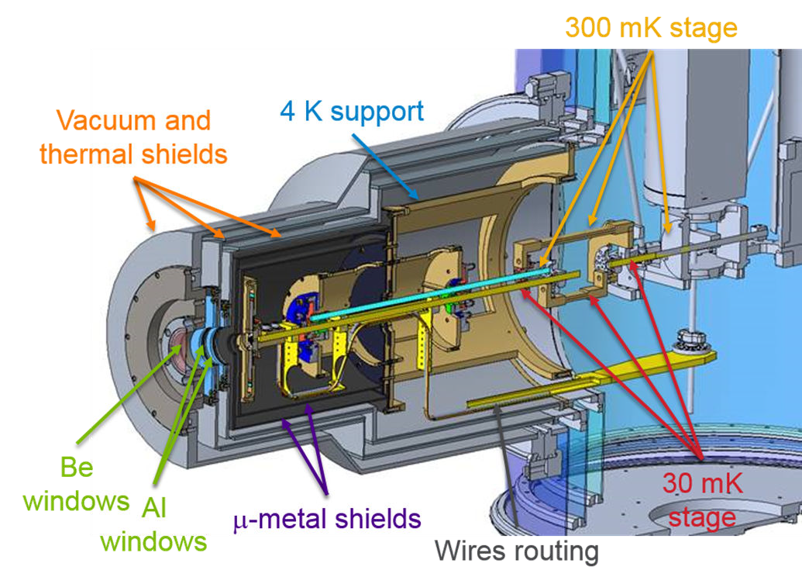
APS X-ray TES Instrument
Cryostat and vacuum engineering
Snout structure to point the sensor at the sample
µ-metal magnetic shields around sensor array
Be window to let in X-rays
Mechanically disconnected but thermally connected!
Sensor box (and most of cryostat) made of gold-coated copper
Designed by Sunil Bean

Slide 15
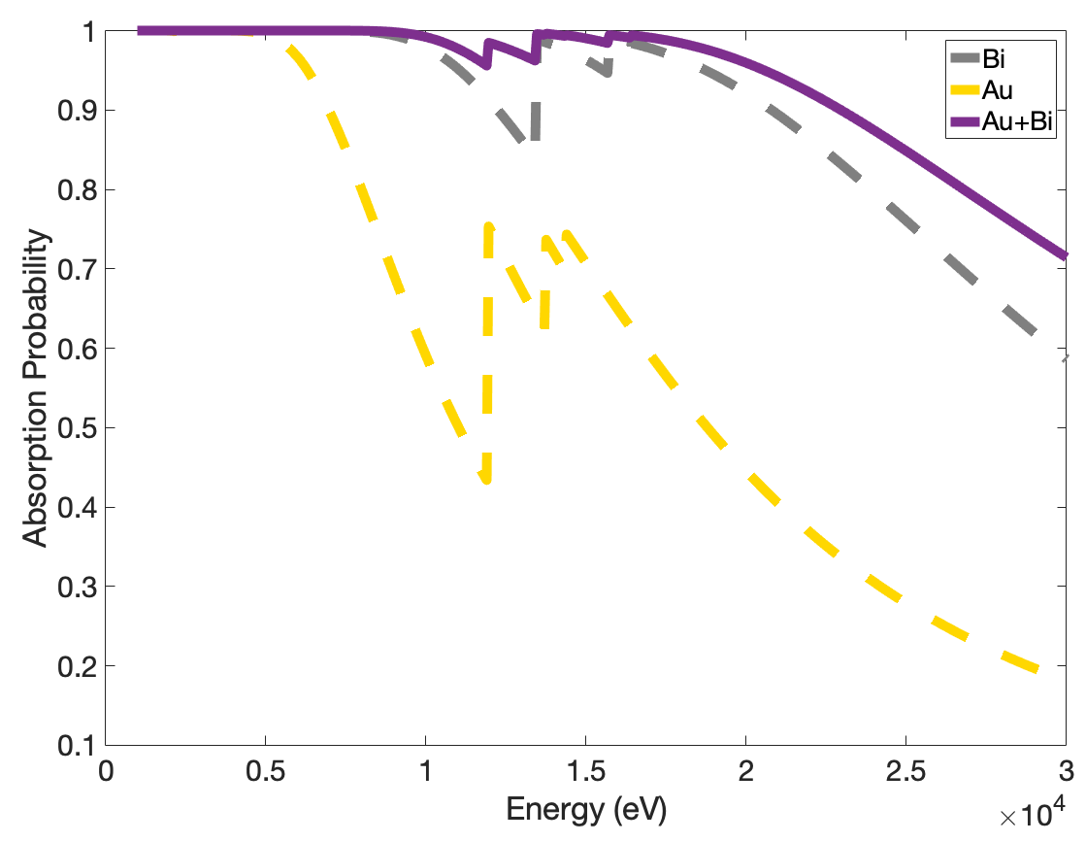
APS X-ray TES Instrument
Sensor - Linearity
Sensors linear up to ~ 60+ keV (reached the limit of 1-BM). Expected to be linear up to ~ 80 keV (averaged across the entire array)
Detection efficiency: good up to ~ 50 keV (~ 50%), reasonable up to 80 keV (~ 20%)

Slide 16
APS X-ray TES Instrument
Sensor – Energy resolution
E/ΔE ≥ 1000 at all energies (averaged across the entire array)
ΔE only minorly dependent on count rate (at tested energies). At 10 input cps/pixel total out cps ~ 500

Slide 17
APS X-ray TES Instrument
Sensor - Summary
Approximately 85 working pixels
Absorber (800 x 800 μm) composed of Au ~ 4 μm + Bi ~ 30 μm
Proven linear up to 60+ keV, expected up to 80 keV
E/ΔE ≥ 1000: ΔE measured from ~ 10 eV to ~ 40 eV
Total count rate: 500 cps without degradation in resolution
Initial prototype arrays fabricated at APS/CNM - production array fabricated by NIST “foundry”

Slide 18
Outline
Introduction to superconductivity
Superconducting detectors
TES X-ray spectrometer for the APS
Example of application

Slide 19
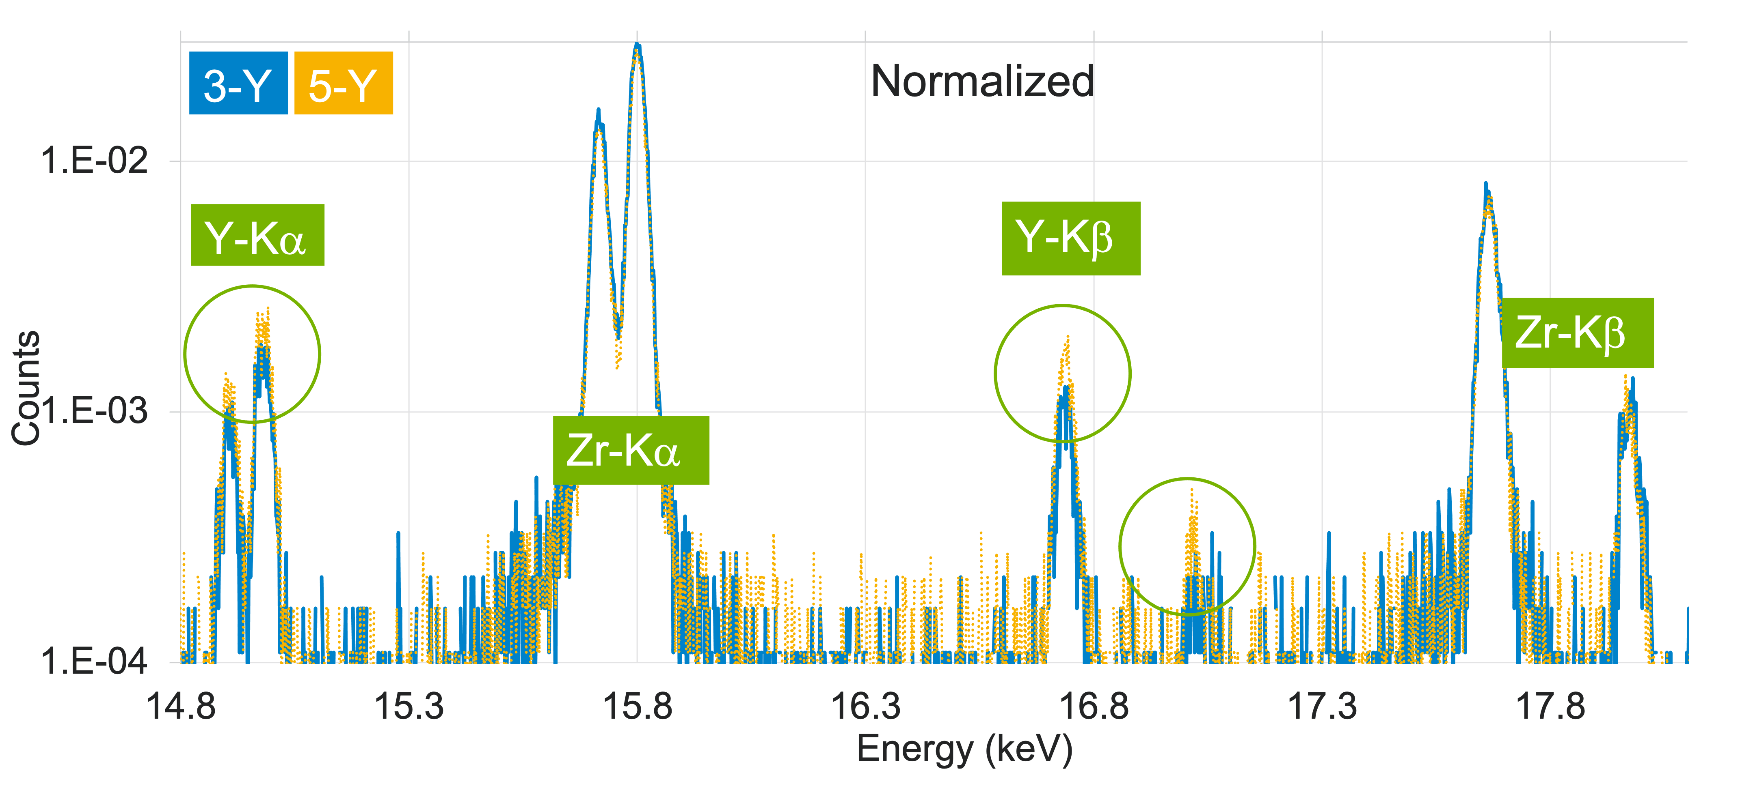
Quantitative fluorescence analysis
“Zpex Smile” - Zirconia for Dental Implantation (XSD MIC group)
Micro-quantity analysis of compounds with elements with overlapping emission lines: 3% vs 5% molar mass

Slide 20

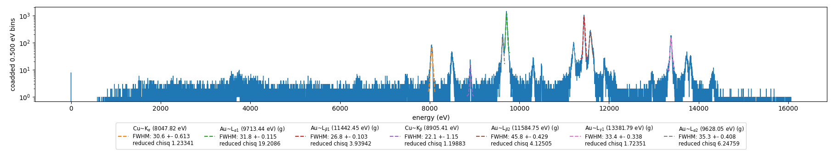
High-resolution line tracking
Thermographic Phosphor Experiment (SNL)
Can we correlate temperature with high-resolution XRF measurements for remote thermal sensing?
  Challenge is detector calibration: How to monitor lines without calibrating for them?
Au foil illuminated by a ~ 10.5 keV beam, i.e., below Au L-edge energy
3rd harmonic able to excite L-lines fluorescence (Lα₁ = 9.713 keV Lβ₁ = 11.442 keV), used for calibration. Filter to control ratio between 1st and 3rd harmonic
1st harmonic elastic scattering line representing the variable line. High-precision control on the line energy via beamline monochromator (~ eV).
Target line

Slide 21
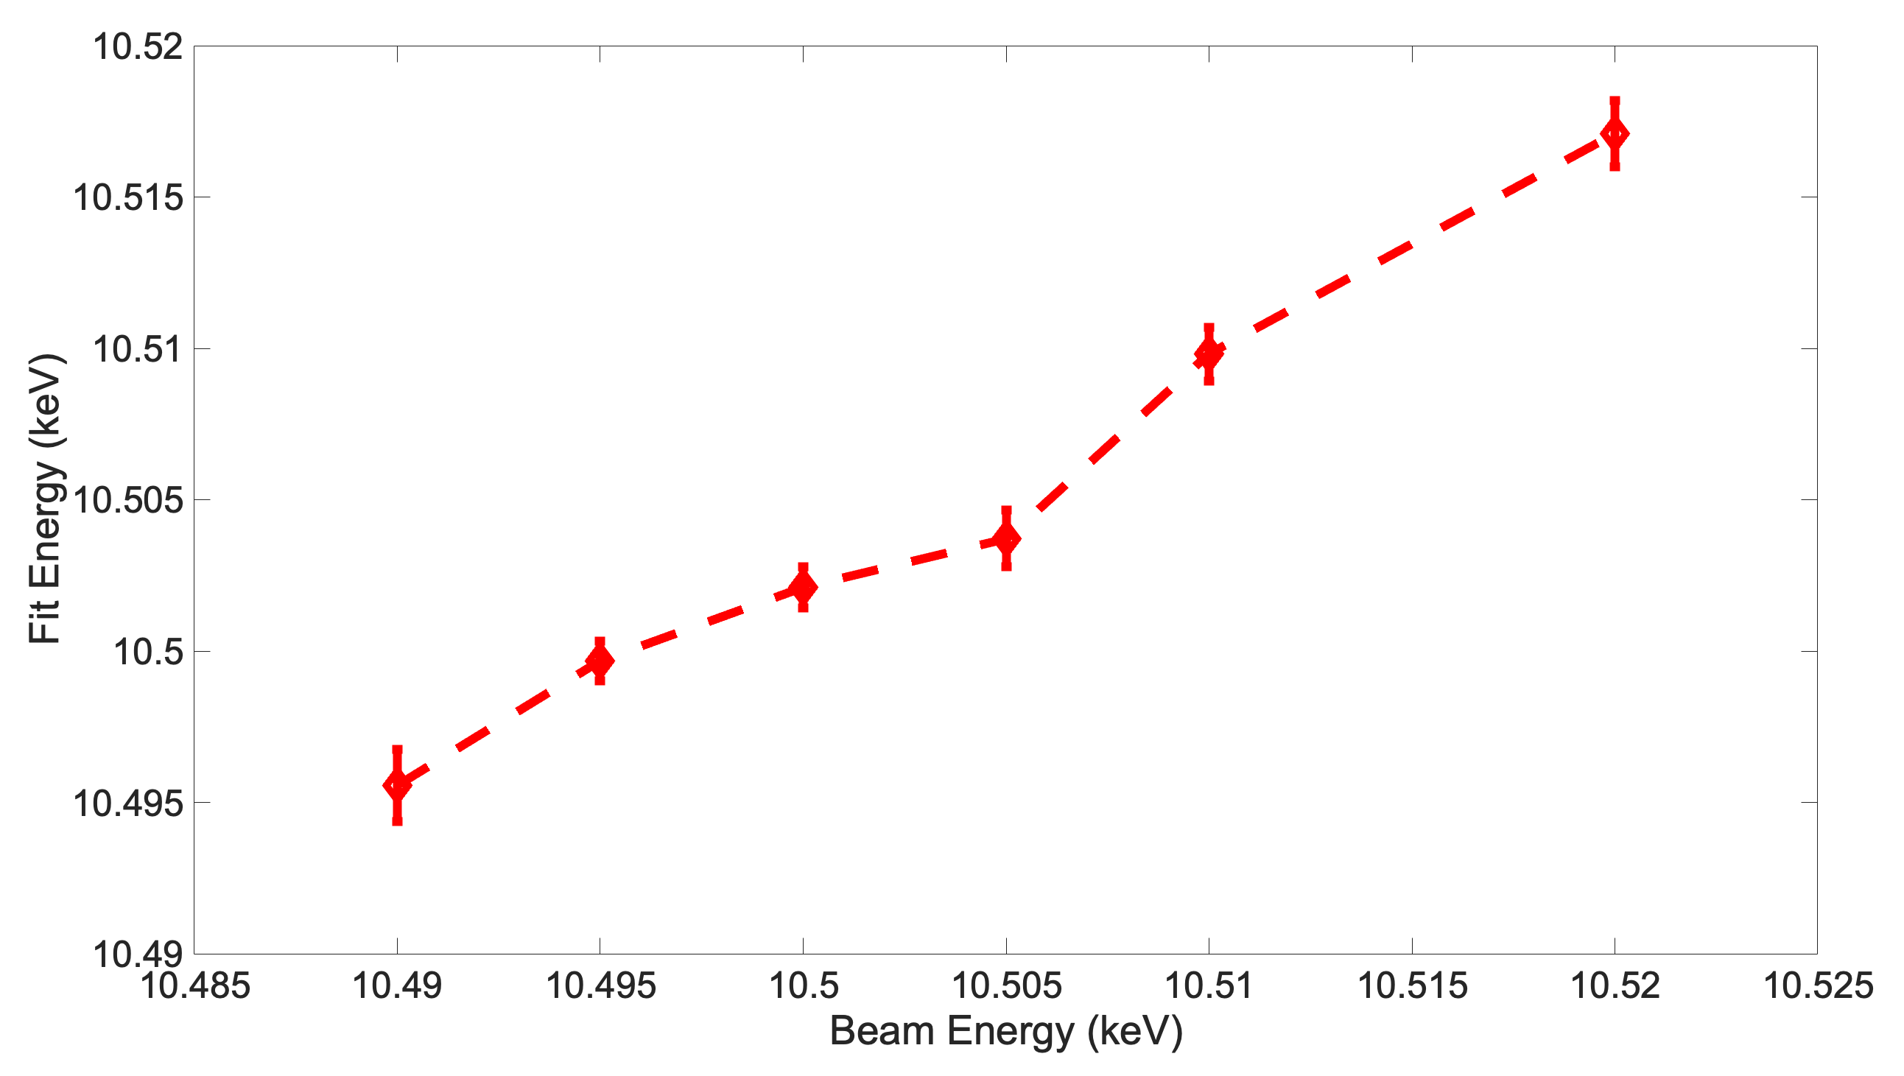
High-resolution line tracking
Thermographic Phosphor Experiment (SNL)
Measured energy from Gaussian fit
Reasonable match between expected energy and fitted energy and good linearity
Ability to distinguish shifts of the order 2-3 eV
Reference lines don’t need to be very close to the “unknown” line
Didn’t find any measurable effect in the YAG phosphor

Slide 22
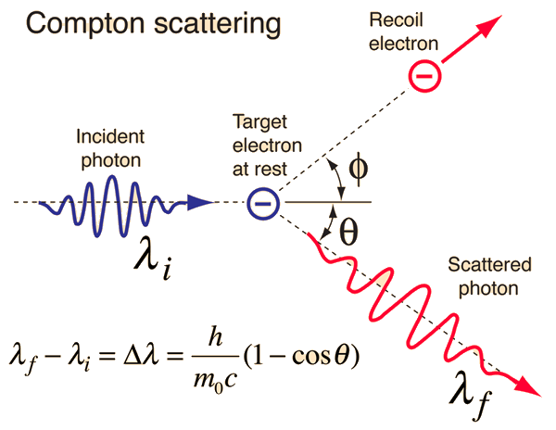
Compton Scattering
/
Li Battery (XSD SRS group)
Scattered photon provides info on electron momentum
Distinguish between valence and core electrons
Distinguish chemical oxidation states in low Z materials using penetrating high energy X-rays
Goal is to measure the electron concentrations in the various elements of the battery

Slide 23
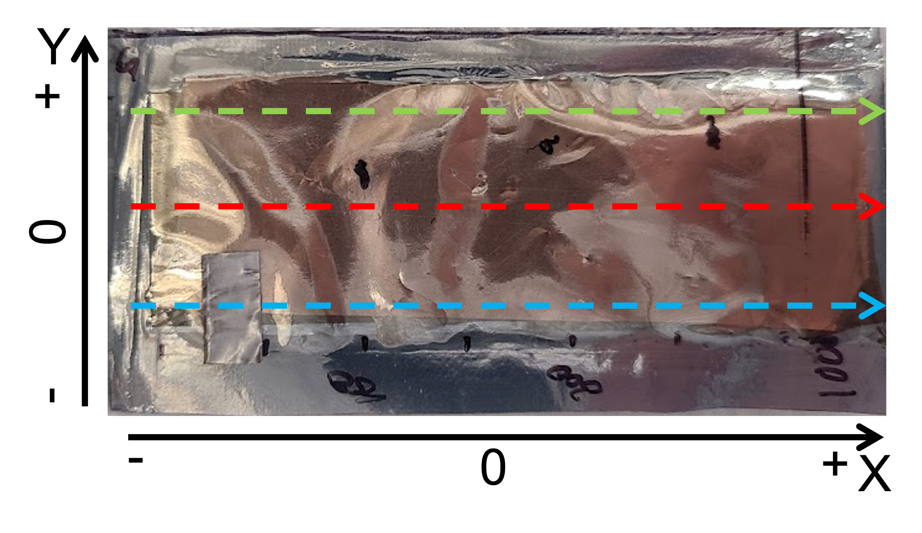
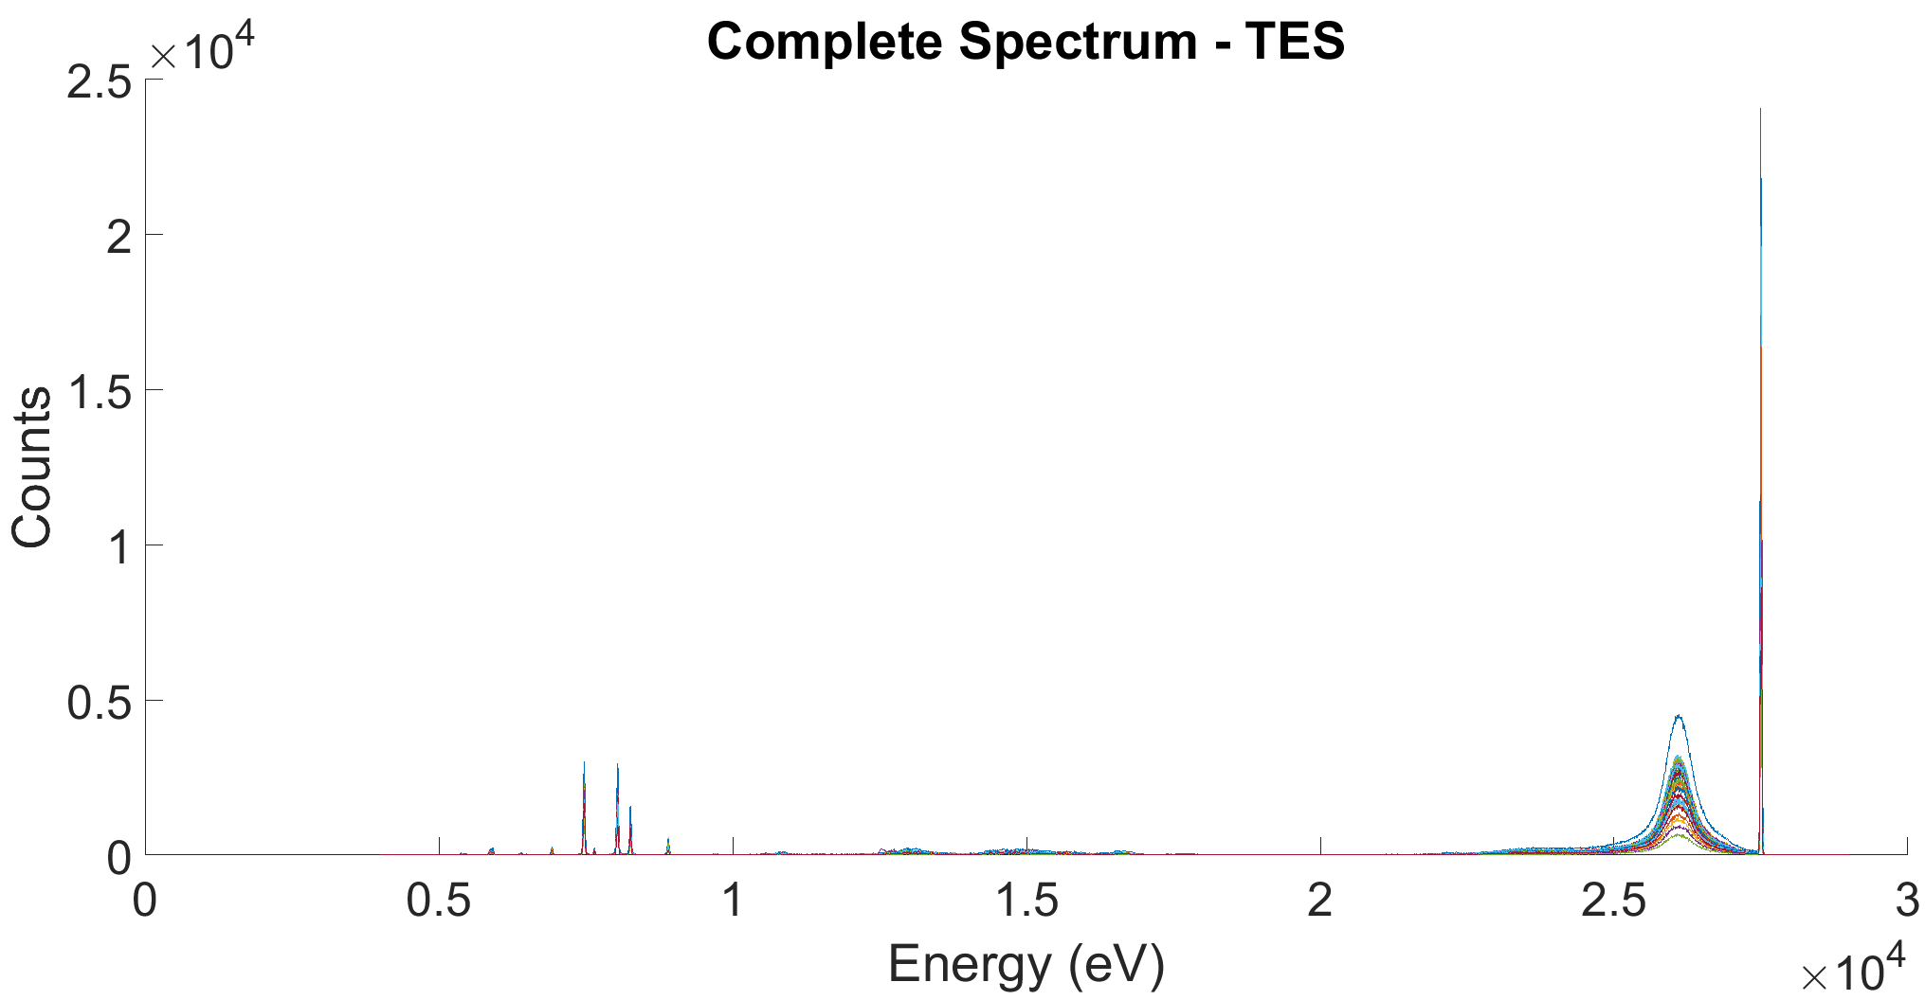
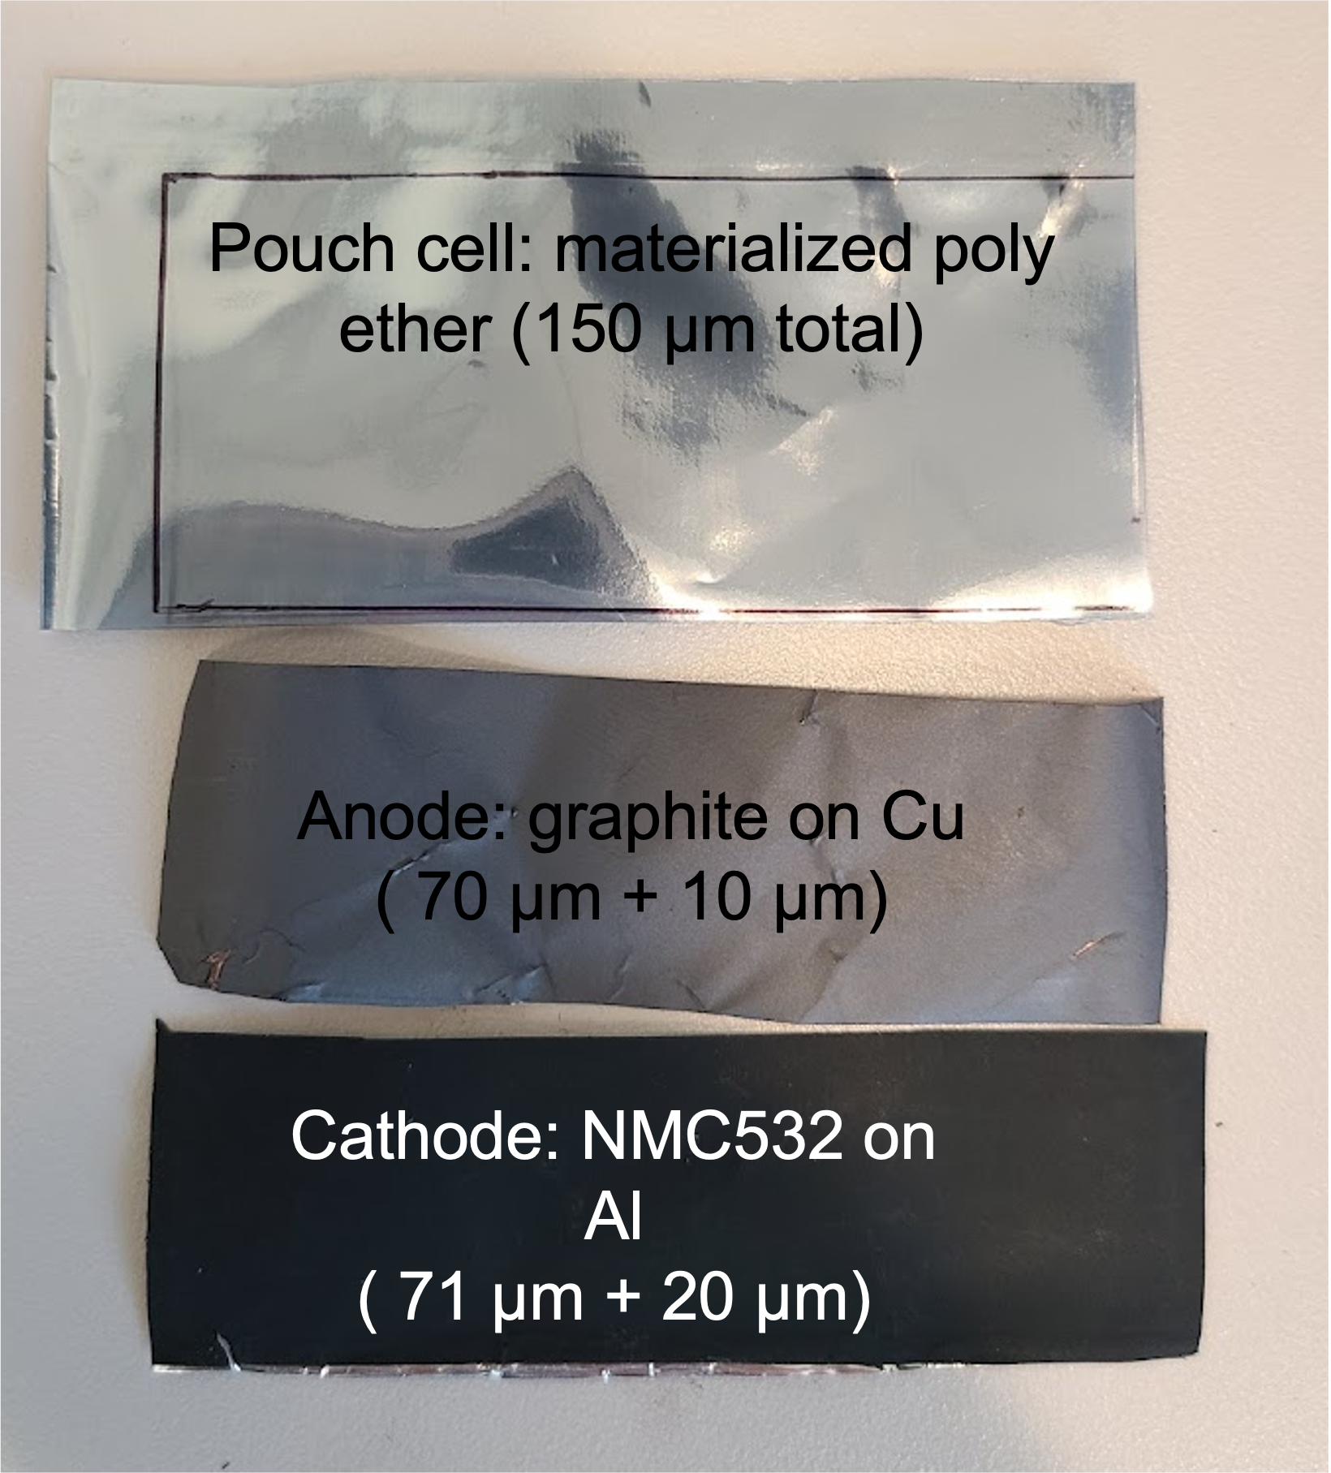
Compton Scattering
Li Battery (XSD SRS group)
Collected Compton Spectra on the Li pouch over three different “slices”
Filters minimize the fluorescence response in favor of the Compton peak
Elastic
scattering
Lithium pouch cell
Cu Kα
Compton
scattering
Ni Kα
Co Kα

Slide 24
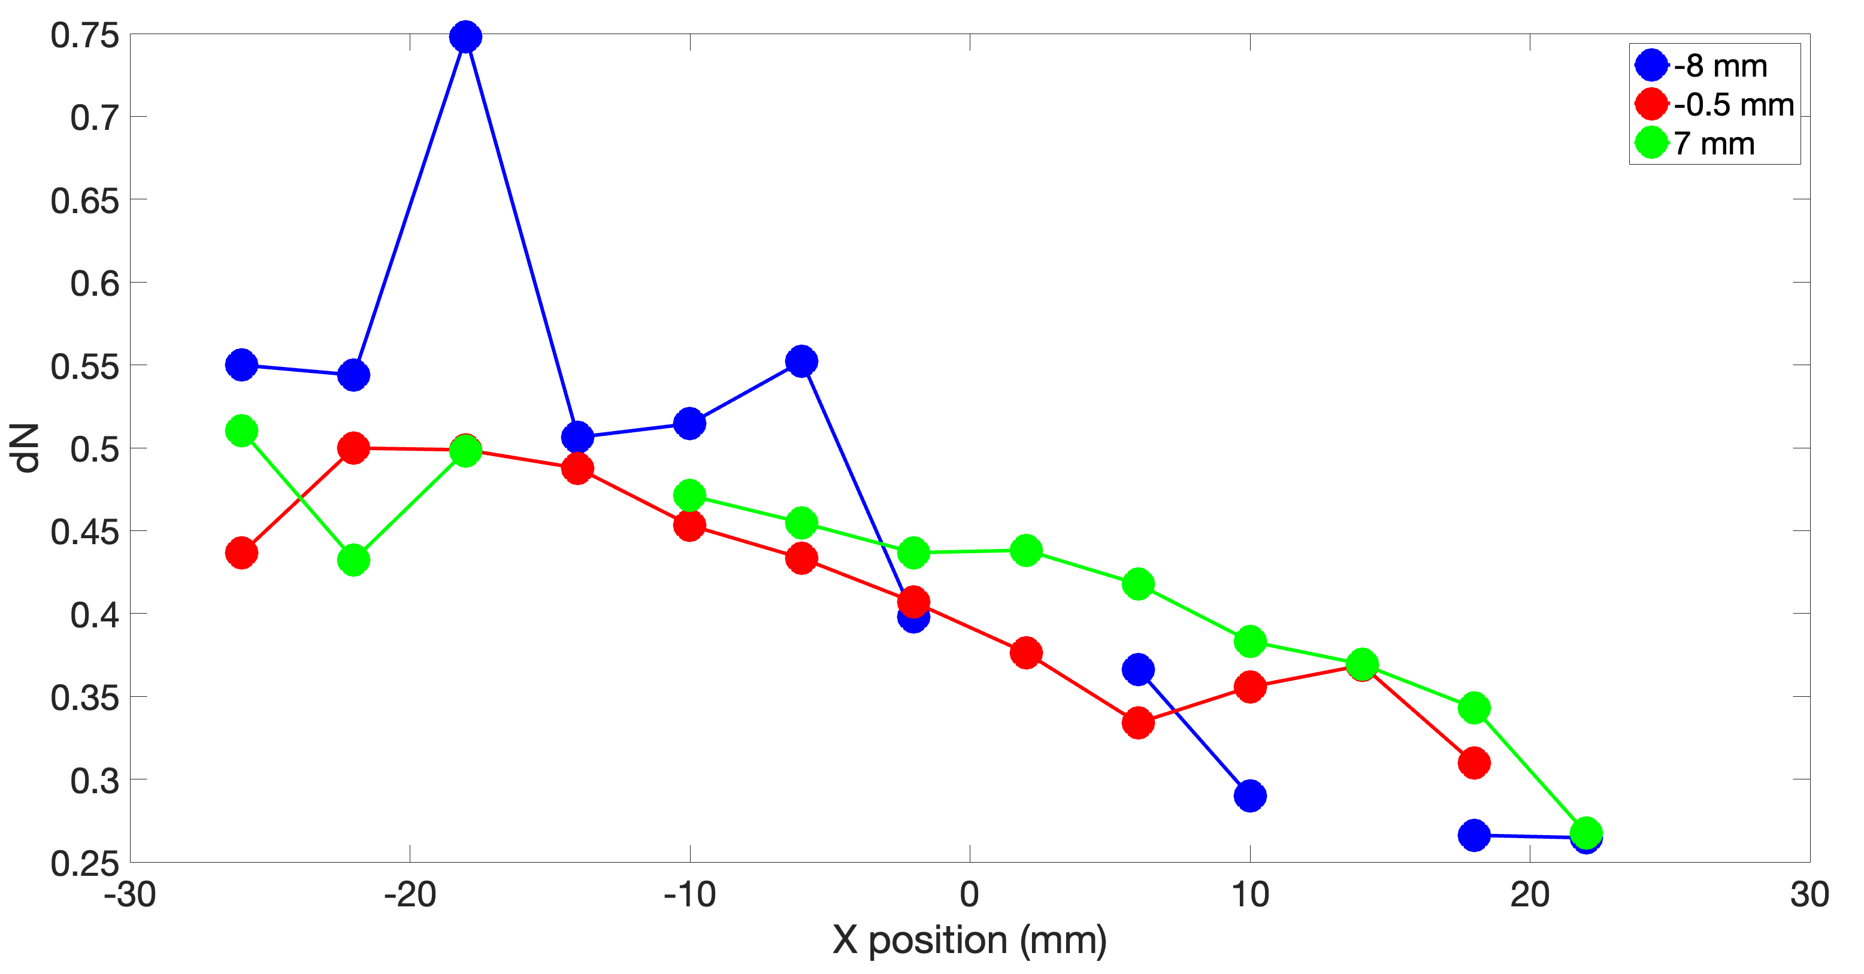
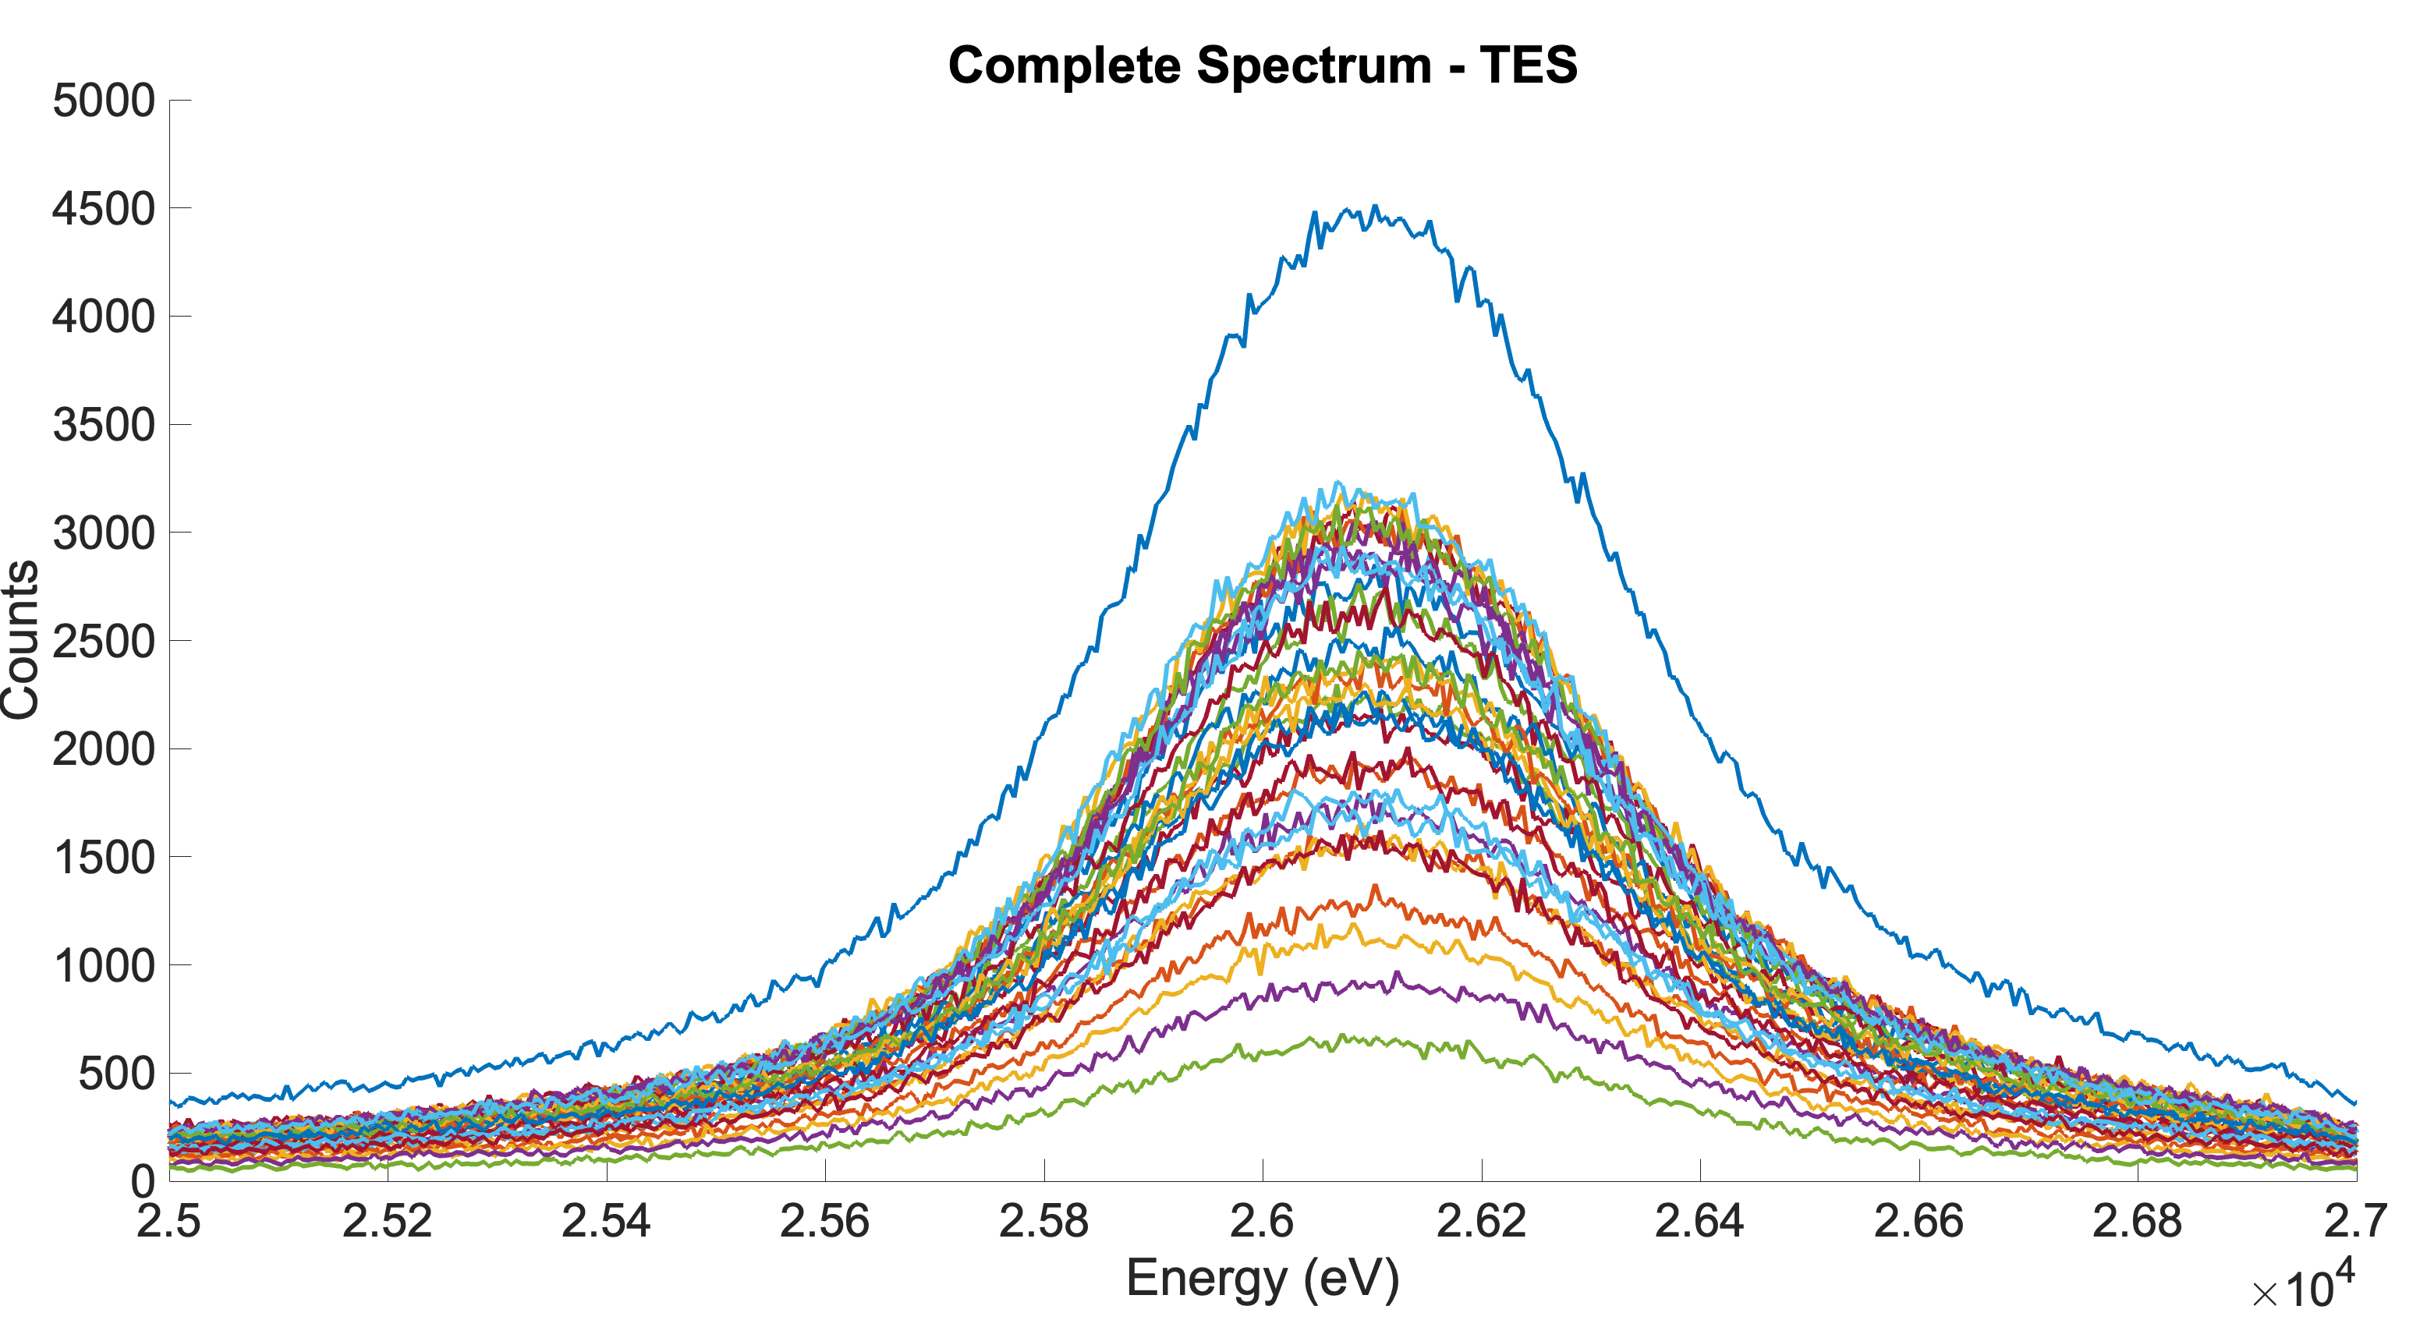
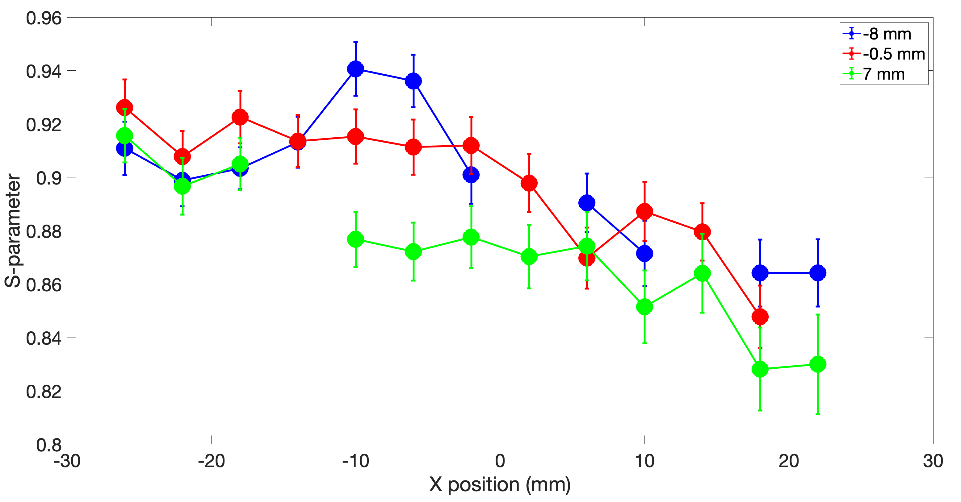
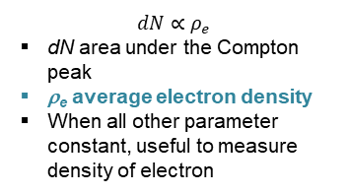
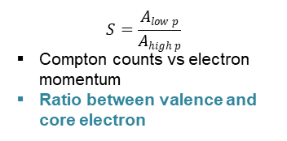
Compton Scattering
Li Battery (XSD SRS group)
Collected Compton Spectra on the Li pouch over three different “slices”
Filters minimize the fluorescent response in favor of the Compton peak
Can run scans!
$$dN∝ρ_{e}$$
dN area under the Compton peak
ρ_{e} average electron density
When all other parameter constant, useful to measure density of electron
$$S=\frac{Alow p}{Ahigh p}$$
Compton counts vs electron momentum
Ratio between valence and core electron

Slide 25
Conclusions and Future endeavors
TES spectrometers at APS
Developed, built and deployed a complete high-resolution hard X-ray TES spectrometer with resolutions of E/ΔE ~ 1000 at 500 cps
  Initial TES R&D at APS/CNM and large-scale fabrication at NIST
Run a series of protype experiments to explore possible applications
Continuous development of new sensors - materials, design, applications in collaboration with NIST:
  Currently working on new electroplated absorbers materials (e.g., Sn, SnBi, BiAu, etc.)
Hard X-ray instrument being installed at 11-ID-D to enable multimodal capabilities: high-energy X-ray diffraction in conjunction with high resolution spectroscopy and Compton scattering
Soft X-ray instrument in construction for 29-ID for resonant soft X-ray scattering

Slide 26
Questions?

