Slide 1
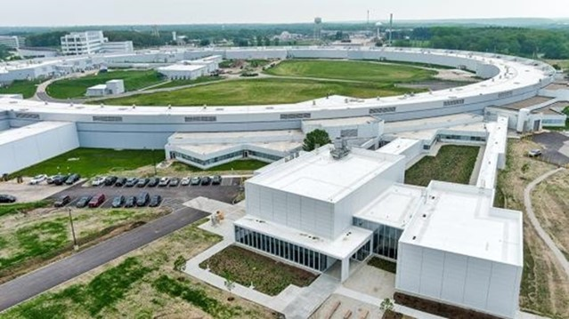
Design and implementation of X-ray wavefront sensors for APS-U beamline diagnostics
erhtjhtyhy
Xianbo Shi, Zhi Qiao, Matthew Frith, Matthew Highland, Luca Rebuffi, and Lahsen Assoufid
Advanced Photon Source, Argonne National Laboratory
TWG meeting
July 20th, 2023

Slide 2
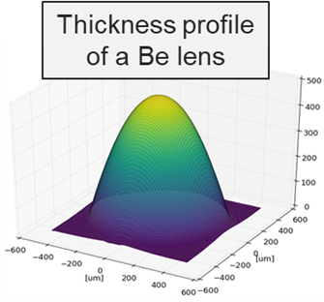
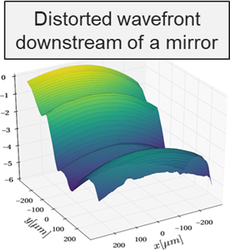
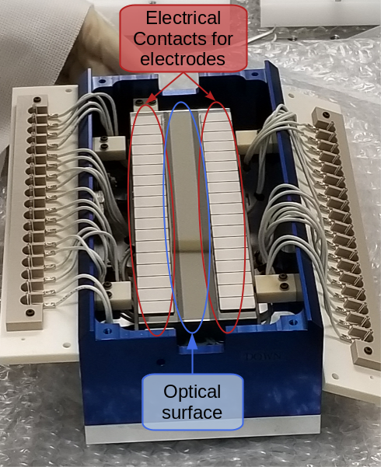
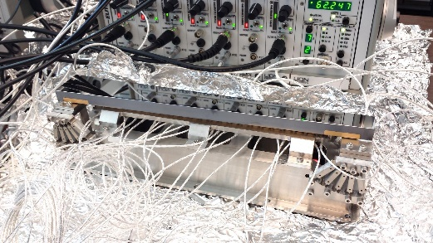
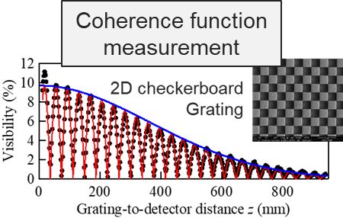
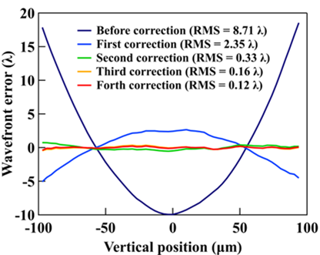
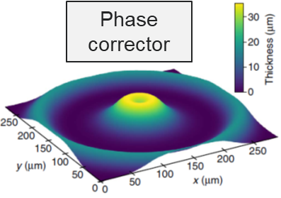
wavefront sensing techniques
Beamline X-ray optics characterization and diagnostics at the APS
X-ray wavefront sensing tools
Grating interferometry
Speckle tracking
Coded-mask-based technique
Adaptive optics
Apply
Optics/beam characterization
At-wavelength metrology
Wavefront sensing
Coherence measurements
Wavefront correction
Support
Extend
Optics development
Wavefront-preserving optics
Adaptive optics
Phase corrector
Beamline diagnostic
Wavefront and coherence monitor
Beamline control and optimization
2

Slide 3
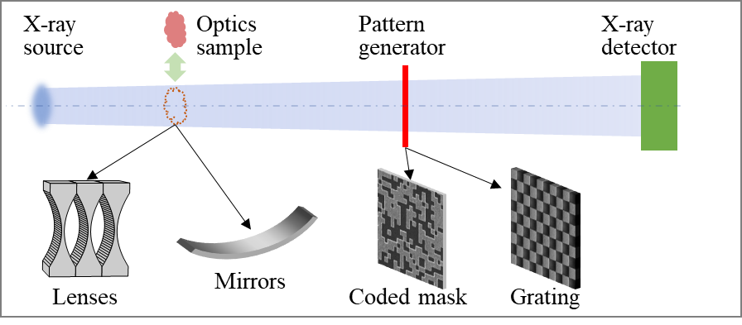
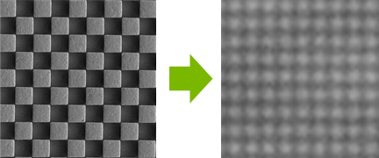
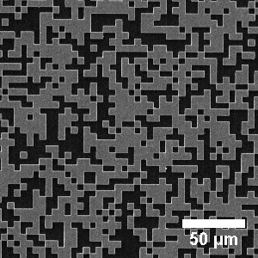
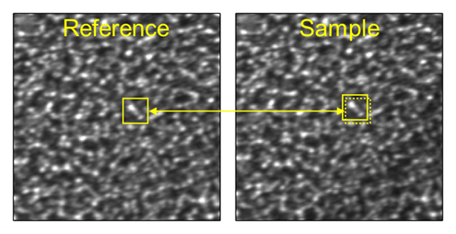
wavefront sensing techniques
Grating interferometry
Phase or absorption gratings with periodic pattern
Fourier-based analysis for grating pattern shifts
Coded-mask-based Wavefront Sensor
Harold H. Wen et al. Opt Lett. 35, 1932 (2010)
W. Grizolli, et al. Proc. SPIE 10385, 1038502 (2017)
W. Grizolli, et al., AIP Conference Proceedings, 2054, 060017 (2019)
  Designed non-periodic pattern
  Ultra-high-contrast >30%
  Pre-knowledge of the pattern
  High spatial resolution
  High phase sensitivity
  Better noise robustness
  Flexible and easy to use
Speckle tracking
Speckle generator (sandpaper, membrane filters) with completely random pattern
Based on near-field speckle pattern shifting
X. Shi, et al., US patent US20220265231 (2022).
Z. Qiao, et al., Appl. Phys Lett. 119, 011105 (2021).
Z. Qiao, et al., Optica 9, 391 (2022).
Z. Qiao, et al., Opt. Express 28, 33053 (2020).
Z. Qiao, et al., Proc. SPIE 11492, 114920O (2020).
Z. Qiao, et al., J. Imaging 7, 249 (2021).
X. Shi, et. al, Proc. SPIE 12240, 122400H (2022).
S. Berujon et al., J Synchrotron Radiat, 27, 284 (2020)
S. Berujon et al., J Synchrotron Radiat, 27, 293 (2020)
3

Slide 4
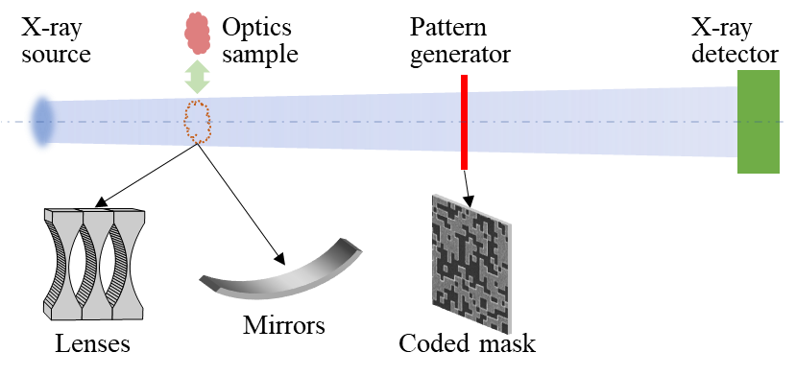
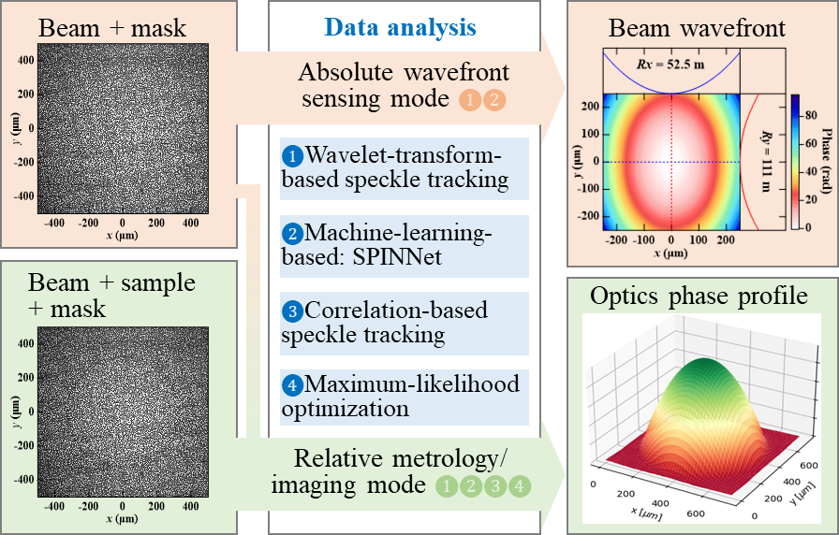
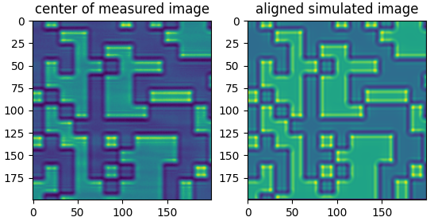
Coded-mask-based Wavefront SENSOR design
Two operation modes
  Relative metrology/imaging mode (two measured images)
  Absolute wavefront sensing mode (simulated reference images)
4

Slide 5



Coded-mask-based wavefront sensing
Single-shot measurements
Data analysis methods:
  Correlation-based speckle tracking
ref image
sample image
Pixel-by-pixel analysis
$$∆y$$
Find $∆x$ and $∆y$ to maximize c(x, y)
$$∆x$$
c(x, y) = cross-correlation( , )
Searching window
sample image
Template window
5

Slide 6
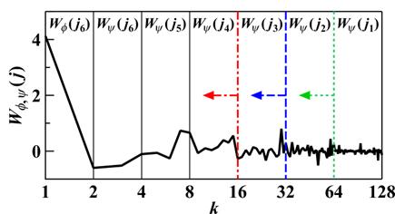


Coded-mask-based wavefront sensing
Single-shot measurements
Data analysis methods:
  Correlation-based speckle tracking
  Wavelet-transform-based speckle tracking
  Z. Qiao, et al., Proc. SPIE 11492, 114920O (2020).
Template
window
Wavelet
Transform
Find $∆x$ and $∆y$ to minimize Euclidean distance square
$$r=∑{\left|W_{φ,s}−W_{φ,r}\right|}^{2}$$
6

Slide 7
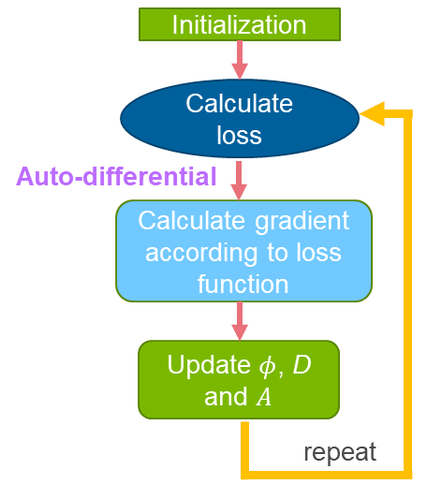

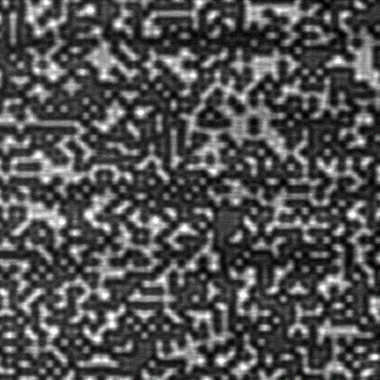


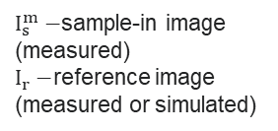

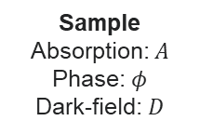
Coded-mask-based wavefront sensing
Single-shot measurements
Data analysis methods:
  Correlation-based speckle tracking
  Wavelet-transform-based speckle tracking
  Z. Qiao, et al., Proc. SPIE 11492, 114920O (2020).
  Maximum-likelihood optimization
  Z. Qiao, et al., Appl. Phys Lett. 119, 011105 (2021).
Coded mask
Detector image
$$I_{s}\left(r^{′}\right)=\frac{A(r)}{C(r)}\left\{{\overline{I}}_{r}\left(r\right)+D(r)\left[I_{r}\left(r\right)−{\overline{I}}_{r}\left(r\right)\right]\right\}$$
Sample
Loss function minimization
$$δr=r^{′}−r$$
$$∑\left[I_{s}−I_{s}^{m}\log\left(I_{s}\right)\right]+αTV\left({\left|\left|D\right|\right|}_{2}\right)+αTV\left({\left|\left|A\right|\right|}_{2}\right)+βTV({\left|\left|φ\right|\right|}_{2})$$
$TV−$ total variation
$I_{s}^{m}−$sample-in image (measured)
$I_{r}−$reference image (measured or simulated)
Pixel wise
optimization
d
Sample
Absorption: $A$
Phase: $φ$
Dark-field: $D$
7

Slide 8
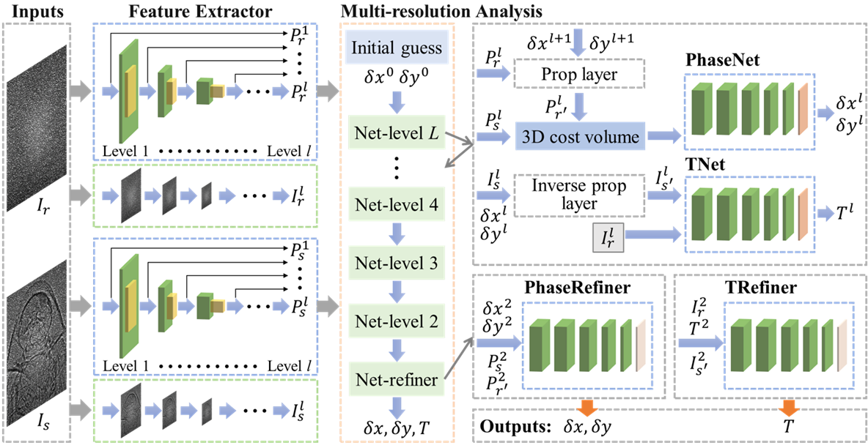
Coded-mask-based wavefront sensing
Single-shot measurements
Data analysis methods:
  Correlation-based speckle tracking
  Wavelet-transform-based speckle tracking
  Z. Qiao, et al., Proc. SPIE 11492, 114920O (2020).
  Maximum-likelihood optimization
  Z. Qiao, et al., Appl. Phys Lett. 119, 011105 (2021).
  Machine-learning-based method: SPINNet (Speckle-based Phase-contrast Imaging Neural Network)
  Z. Qiao, et al., Optica 9, 391 (2022).
8

Slide 9
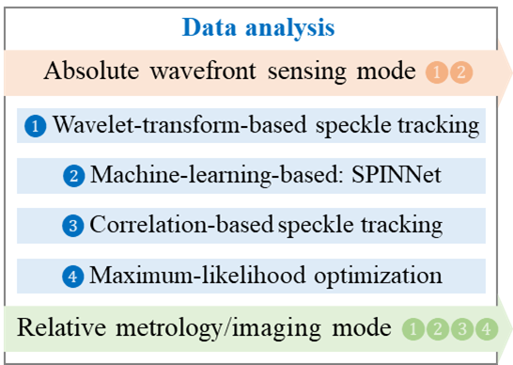
Coded-mask-based wavefront sensing
Single-shot measurements
Data analysis methods:
  Correlation-based speckle tracking
  Wavelet-transform-based speckle tracking
  Z. Qiao, et al., Proc. SPIE 11492, 114920O (2020).
  Maximum-likelihood optimization
  Z. Qiao, et al., Appl. Phys Lett. 119, 011105 (2021).
  Machine-learning-based method: SPINNet (Speckle-based Phase-contrast Imaging Neural Network)
  Z. Qiao, et al., Optica 9, 391 (2022).
9

Slide 10
WF sensor Design

Slide 11
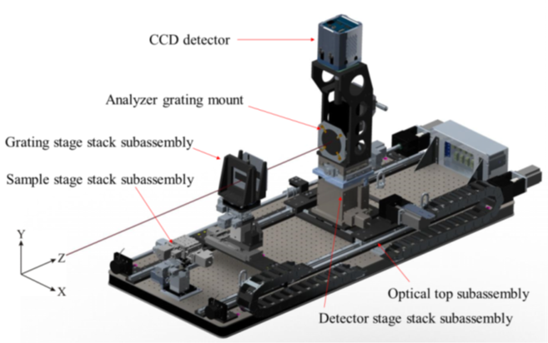
REFERENCE APS Wavefront SENSOR
L. Assoufid et al., Rev. Sci. Instrum. 87, 052004 (2016).
Portable WF sensor
11

Slide 12
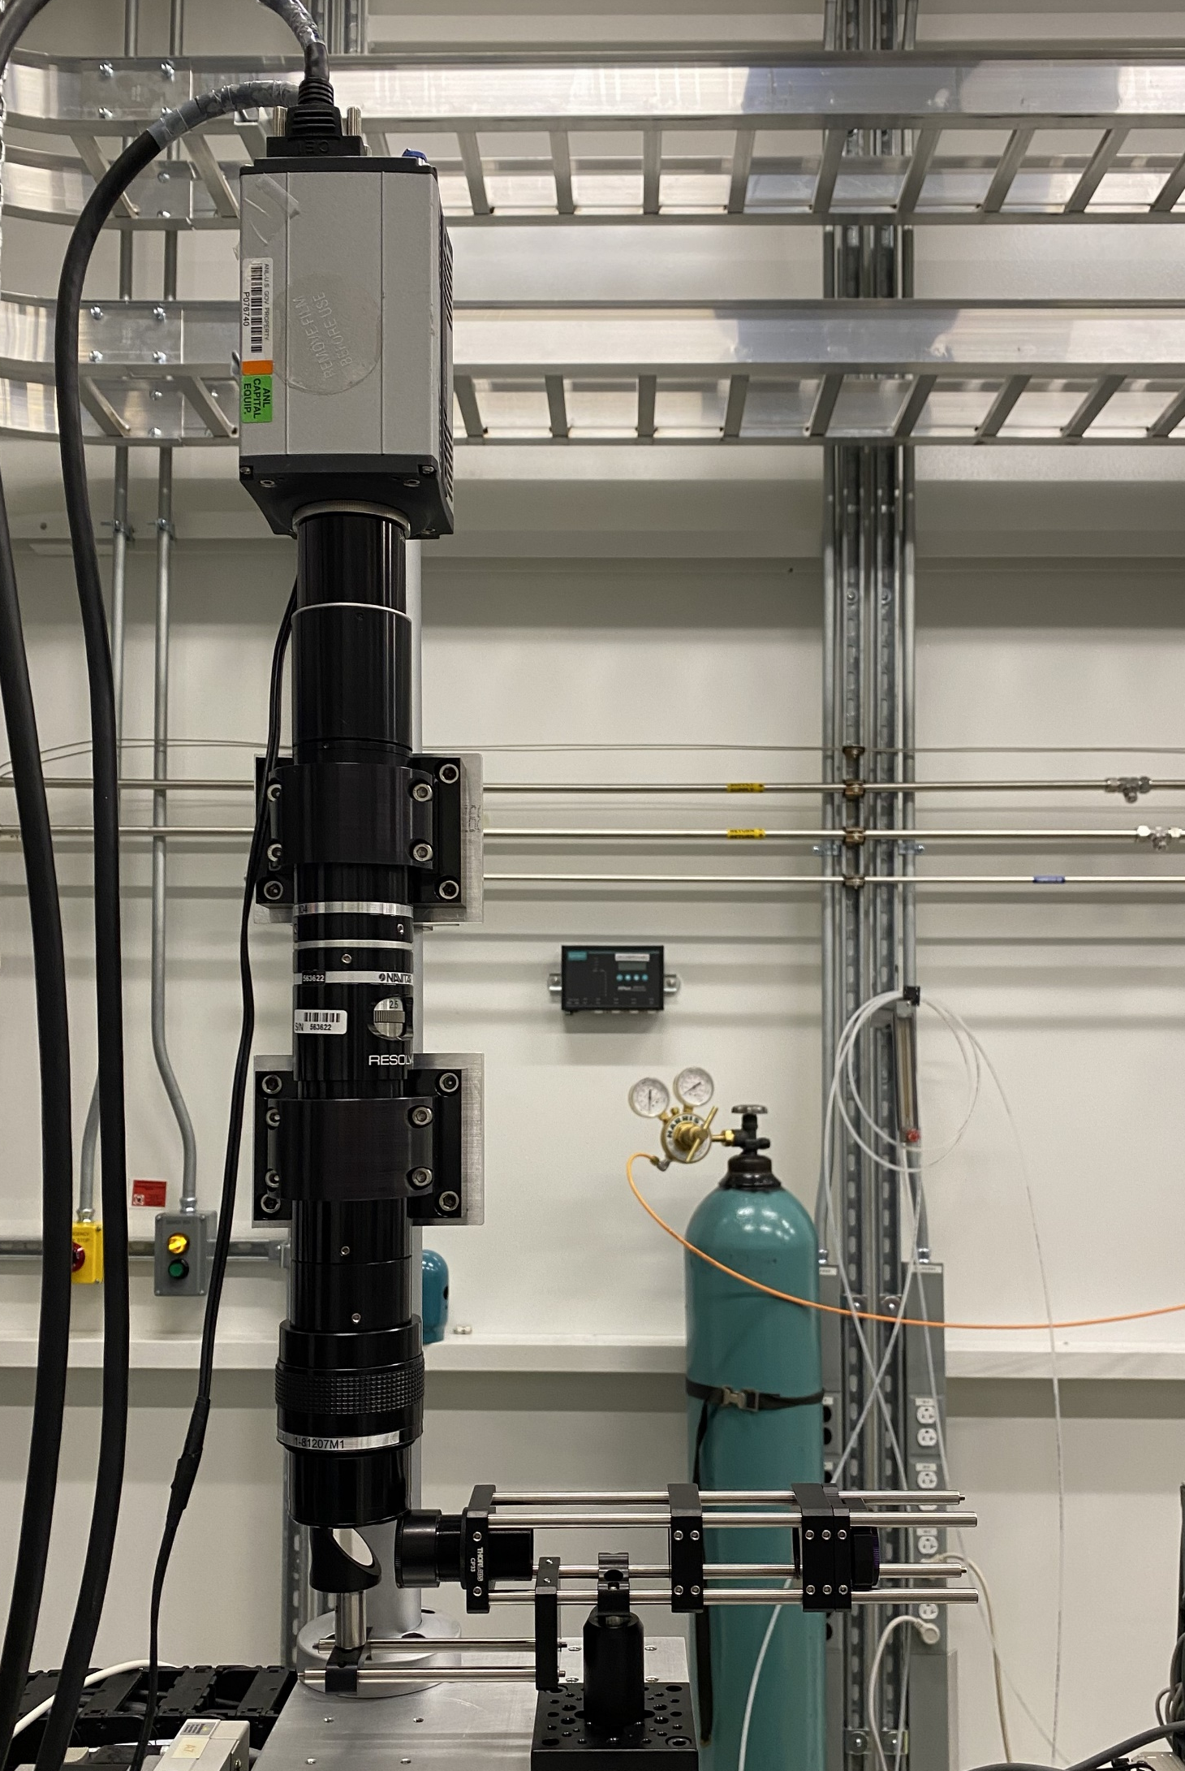
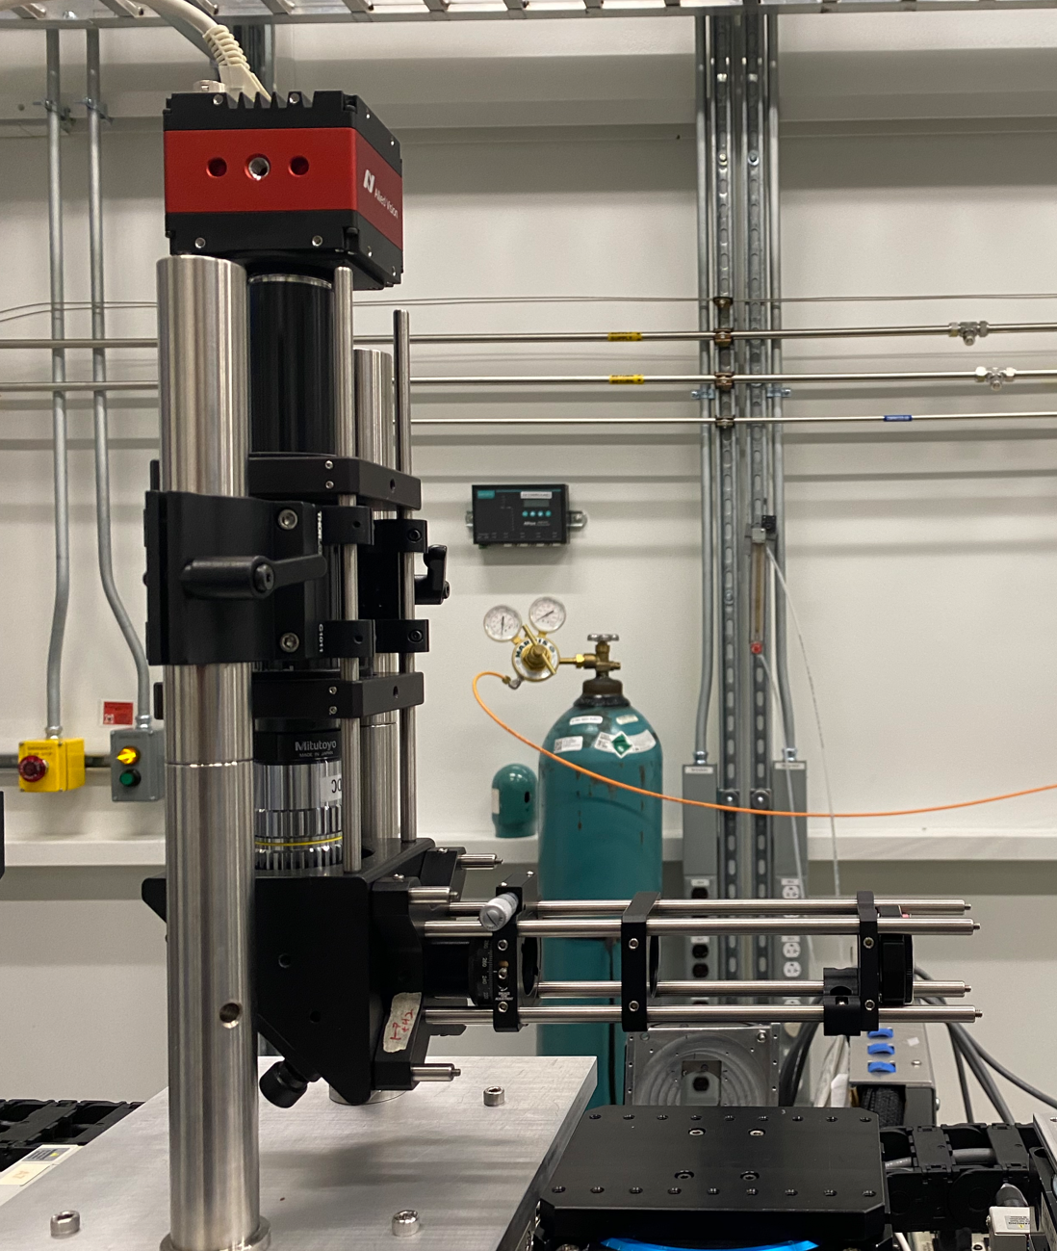
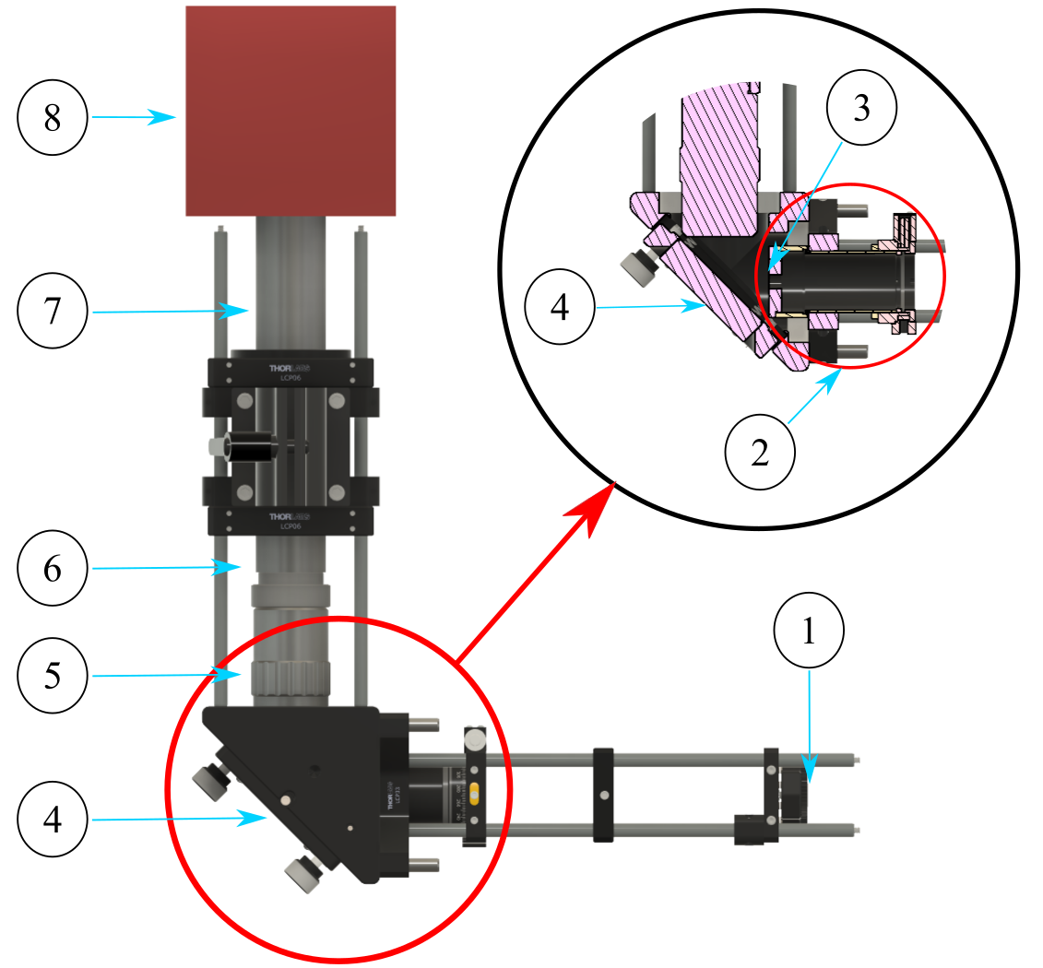
NEW Wavefront SENSOR prototypes
① mask/grating
② scintillator focusing assembly
③ scintillator
④ mirror
⑤ 10X Mitutoyo Objective
⑥ MT-4 Accessory Tube Lens
⑦ extension tube
⑧ camera
Compact WF sensor
A compact and cost-effective model as standard diagnostic tool optimized for each APS-U beamline.
Adjustable Zoom WF sensor
Adjustable zoom capabilities to adapt to various beam conditions and resolutions
M. Frith, et al., Rev. Sci. Instrum. (under preparation)
12

Slide 13
Compact WF sensor Parts List
Part Number | Description | Quantity | Manufacture | Unit price | Total price
Mask or grating | Fabricate by Michael Wojcik
SM1CP2M | Externally SM1-Threaded End Cap for Machining | 2 | Thorlabs | $20.59 | $41.18
CP44F | 30 mm Removable Cage Plate, Front and Back Plate, Internal SM1 Threading | 1 | Thorlabs | $57.07 | $57.07
CP33B | 30 mm Cage Mounting Bracket | 1 | Thorlabs | $16.08 | $16.08
CP14 | 30 mm Cage Plate with Ø1/2" Double Bore, 8-32 Tap | 1 | Thorlabs | $25.12 | $25.12
CRM1PT | Precision Cage Rotation Mount with Micrometer Drive, Ø1" Optics, 8-32 Tap | 1 | Thorlabs | $235.25 | $235.25
SM1V15 | Ø1" Adjustable Lens Tube, 1.31" Travel Range | 1 | Thorlabs | $38.66 | $38.66
LCP33 | 30 mm to 60 mm Cage Plate Adapter, 8-32 Tap | 1 | Thorlabs | $45.42 | $45.42
Scintillator | LuAG:Ce, both sides polished, dimensions: dia. 10 x 0.020 mm | 1 | Crytur | $1,250.00 | $1,250.00
KCB2 | Right-Angle Kinematic Mirror Mount with Tapped Cage Rod Holes, 60 mm Cage | 1 | Thorlabs | $187.26 | $187.26
PF20-03-G01 | Ø2" Protected Aluminum Mirror | 1 | Thorlabs | $108.11 | $108.11
46-144 | 10X Mitutoyo Plan Apochromat Objective, 436 - 656 nm, 0.28 NA, 34 mm WD | 1 | Mitutoyo | $1,021.00 | $1,021.00
54-428 | MT-4 Accessory Tube Lens | 1 | Edmund Optics | $827.00 | $827.00
56-992 | Mitutoyo to C-mount Camera 152.5mm Extension Tube | 1 | Edmund Optics | $180.00 | $180.00
14-709 | Allied Vision Prosilica GT4400 4/3" C-Mount Color CMOS Camera – Ethernet power and control | 1 | Edmund Optics | $5,614.00 | $5,614.00
ER8 | Cage Assembly Rod, 8" Long, Ø6 mm | 8 | Thorlabs | $12.65 | $101.20
ER1 | Cage Assembly Rod, 1" Long, Ø6 mm | 4 | Thorlabs | $5.60 | $22.40
RS6P8 | Ø1" Pillar Post, 8-32 Taps, L = 6" | 2 | Thorlabs | $37.00 | $74.00
RS6P8E | Ø1" Pedestal Pillar Post, 8-32 Taps, L = 6" | 2 | Thorlabs | $50.09 | $100.18
C1011 | LCP01B - 60 mm Cage Mounting Bracket | 2 | Thorlabs | $89.96 | $179.92
LCP33B | 60 mm Cage Mounting Bracket | 4 | Thorlabs | $35.00 | $140.00
LCP06 | 60 mm Cage Plate with Ø2" Double-Bore Optic Mount, 8-32 Tap | 2 | Thorlabs | $39.90 | $79.80
SM2A21 | Externally SM2-Threaded Mounting Adapter with Ø1.20" (Ø30.5 mm) Bore and 2" Outer Diameter | 2 | Thorlabs | $52.70 | $105.40
 |  |  |  | TOTAL: | $10,449.05
M. Frith, et al., Rev. Sci. Instrum. (under preparation)
13

Slide 14
Adjustable Zoom WF sensor Parts List
Part Number | Description | Quantity | Manufacture | Unit price | Total price
Mask or grating | Fabricate by Michael Wojcik
SM1CP2M | Externally SM1-Threaded End Cap for Machining | 2 | Thorlabs | $20.59 | $41.18
CP44F | 30 mm Removable Cage Plate, Front and Back Plate, Internal SM1 Threading | 1 | Thorlabs | $57.07 | $57.07
CP33T | SM1-Threaded 30 mm Cage Plate, 0.50" Thick, 2 Retaining Rings, 8-32 Tap | 3 | Thorlabs | $16.08 | $48.24
CP33B | 30 mm Cage Mounting Bracket | 2 | Thorlabs | $16.08 | $32.16
TR1.5 | Ø1/2" Optical Post, SS, 8-32 Setscrew, 1/4"-20 Tap, L = 1.5" | 1 | Thorlabs | $5.65 | $5.65
PH1.5 | Ø1/2" Post Holder, Spring-Loaded Hex-Locking Thumbscrew, L = 1.5" | 1 | Thorlabs | $8.40 | $8.40
UBP1/M | Universal Base Plate, 50 mm x 50 mm x 9.5 mm, Metric | 1 | Thorlabs | $38.85 | $38.85
CRM1PT | Precision Cage Rotation Mount with Micrometer Drive, Ø1" Optics, 8-32 Tap | 1 | Thorlabs | $235.25 | $235.25
SM1V15 | Ø1" Adjustable Lens Tube, 1.31" Travel Range | 1 | Thorlabs | $38.66 | $38.66
CP33 | SM1-Threaded 30 mm Cage Plate, 0.35" Thick, 2 Retaining Rings, 8-32 Tap | 1 | Thorlabs | $19.09 | $19.09
Scintillator | LuAG:Ce, both sides polished, dimensions: dia. 10 x 0.020 mm | 1 | Crytur | $1,250.00 | $1,250.00
TR1 | Ø1/2" Optical Post, SS, 8-32 Setscrew, 1/4"-20 Tap, L = 1" | 1 | Thorlabs | $5.38 | $5.38
H45B2 | 45° Mount Assembly for Ø1" Optics | 1 | Thorlabs | $51.67 | $51.67
PF10-03-G01 | Ø1" Protected Aluminum Mirror | 1 | Thorlabs | $108.11 | $108.11
ER8 | Cage Assembly Rod, 8" Long, Ø6 mm | 4 | Thorlabs | $12.65 | $50.60
ER4 | Cage Assembly Rod, 4" Long, Ø6 mm | 2 | Thorlabs | $7.68 | $15.36
MVR20L | 2.0X Resolv4K Magnifying Lens Attachment | 1 | Navitar/Thorlabs | $3,190.01 | $3,190.01
MVRLC | Resolv4K Coupler for Lens Attachments | 1 | Navitar/Thorlabs | $142.07 | $142.07
MVR4K | 7X Resolv4K Zoom Lens | 1 | Navitar/Thorlabs | $4,025.18 | $4,025.18
MVR20A | 2.0X Resolv4K Rear Adapter | 1 | Navitar/Thorlabs | $2,071.79 | $2,071.79
MVRCMC | Resolv4K C-Mount Adapter | 1 | Navitar/Thorlabs | $82.88 | $82.88
Camera | Zyla 5.5 sCMOS camera – Require dedicated computer | 1 | Andor | $20,000.00 | $20,000.00
1-80371 | Resolv4K Flat Mount Assembly- Inch | 2 | Navitar | $360.00 | $720.00
Adapter Plate | Custom Addapter plates for Resolv4K Flat Mount Assembly- Inch to Newport 42 | 2 |  |  | $0.00
340-RC | Post Clamp, 1.5 in. Diameter Posts, 1/4-20 Thread | 2 | Newport | $97.00 | $194.00
42 | Optical Post, 24 in. Height, 1.5 in. Diameter, 1/4-20 Thread | 2 | Newport | $396.00 | $792.00
 |  |  |  | TOTAL: | $33,223.60
Replace Zyla with Prosilica GT4400: |  |  |  | Replace Zyla with Prosilica GT4400: | $18,837.60
M. Frith, et al., Rev. Sci. Instrum. (under preparation)
14

Slide 15
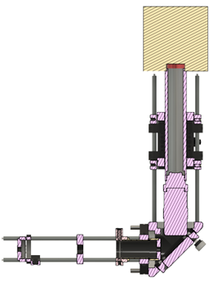
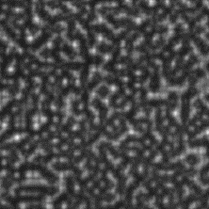
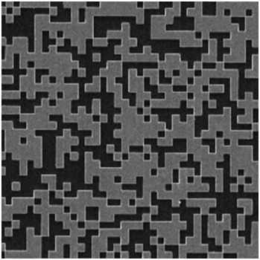
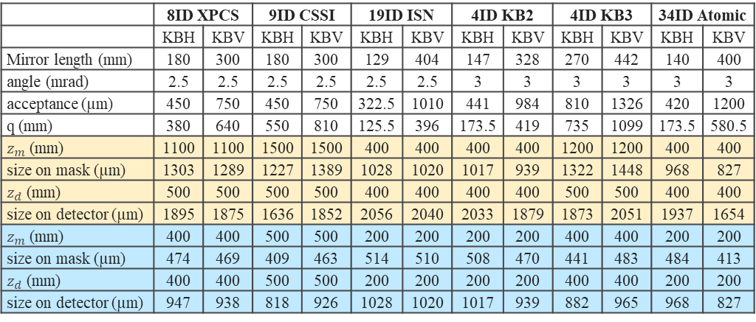
WF sensor Design for APS-U beamlines
Coded mask
Focus
Detector
Compact WF sensor
Focusing
optics
$$z_{m}$$
$$z_{d}$$
 | 8ID XPCS |  | 9ID CSSI |  | 19ID ISN |  | 4ID KB2 |  | 4ID KB3 |  | 34ID Atomic
 | KBH | KBV | KBH | KBV | KBH | KBV | KBH | KBV | KBH | KBV | KBH | KBV
Mirror length (mm) | 180 | 300 | 180 | 300 | 129 | 404 | 147 | 328 | 270 | 442 | 140 | 400
angle (mrad) | 2.5 | 2.5 | 2.5 | 2.5 | 2.5 | 2.5 | 3 | 3 | 3 | 3 | 3 | 3
acceptance (µm) | 450 | 750 | 450 | 750 | 322.5 | 1010 | 441 | 984 | 810 | 1326 | 420 | 1200
q (mm) | 380 | 640 | 550 | 810 | 125.5 | 396 | 173.5 | 419 | 735 | 1099 | 173.5 | 580.5
$z_{m}$ (mm) | 1100 | 1100 | 1500 | 1500 | 400 | 400 | 400 | 400 | 1200 | 1200 | 400 | 400
size on mask (µm) | 1303 | 1289 | 1227 | 1389 | 1028 | 1020 | 1017 | 939 | 1322 | 1448 | 968 | 827
$z_{d}$ (mm) | 500 | 500 | 500 | 500 | 400 | 400 | 400 | 400 | 500 | 500 | 400 | 400
size on detector (µm) | 1895 | 1875 | 1636 | 1852 | 2056 | 2040 | 2033 | 1879 | 1873 | 2051 | 1937 | 1654
$z_{m}$ (mm) | 400 | 400 | 500 | 500 | 200 | 200 | 200 | 200 | 400 | 400 | 200 | 200
size on mask (µm) | 474 | 469 | 409 | 463 | 514 | 510 | 508 | 470 | 441 | 483 | 484 | 413
$z_{d}$ (mm) | 400 | 400 | 500 | 500 | 200 | 200 | 200 | 200 | 400 | 400 | 200 | 200
size on detector (µm) | 947 | 938 | 818 | 926 | 1028 | 1020 | 1017 | 939 | 882 | 965 | 968 | 827
$$z_{d}$$
Prosilica GT4400
detector pixel size (µm) | 3.45 | 3.45
objective magnification | 5 | 5
Effective pixel size (µm) | 0.69 | 0.69
pixel number | 4432 | 4436
FOV (µm) | 3058 | 3061
objective magnification | 10 | 10
Effective pixel size (µm) | 0.345 | 0.345
pixel number | 4432 | 4436
FOV (µm) | 1529 | 1530
Also designed for 2-ID 7-ID 34-ID(3DMN) KBs, open for other beamlines
15

Slide 16
WF sensor prototype testing

Slide 17
WF sensor prototype testing
CRL measurements at APS 28-ID-B
Reference WF sensor
Compact WF sensor
Zoom (×10) WF sensor
Zoom (×18) WF sensor
M. Frith, et al., Rev. Sci. Instrum. (under preparation)
17

Slide 18
WF sensor prototype testing
Absolute wavefront measurements at APS 28-ID-B
Reference WF sensor
Compact WF sensor
Zoom (×10) WF sensor
Zoom (×18) WF sensor
Original beam
With a vertical 1D CRL
M. Frith, et al., Rev. Sci. Instrum. (under preparation)
18

Slide 19
Wavefront sensing application:
Adaptive mirror control

Slide 20
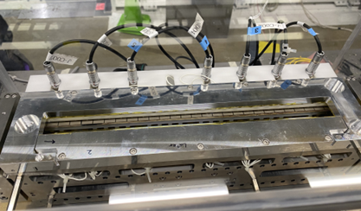
Wavefront sensing application
Adaptive mirrors: dynamic focusing and wavefront shaping
OSAKA-Nagoya-JTEC-APS collaboration
APS mechanical bender mirrors
JTEC bimorph mirrors
Hybrid adaptive mirrors
J. Anton, et al., Proc. SPIE 11100, 111000B (2019).
X. Shi, et al., Proc. SPIE 11491, 1149110 (2020).
20

Slide 21
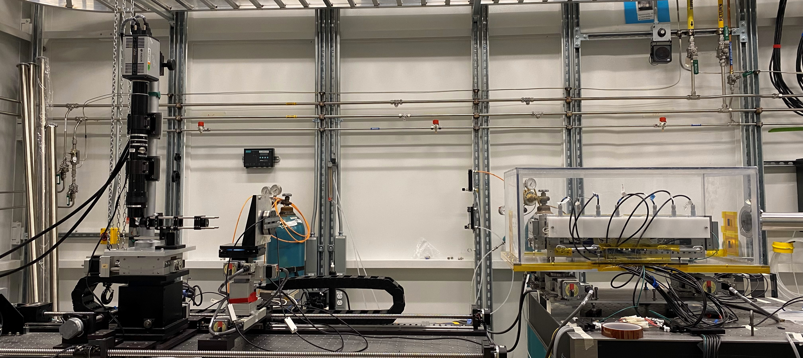
Wavefront sensing application
Hybrid adaptive mirror testing
Piezo response with no mechanical bending
28-ID-B
Hybrid adaptive mirror
Adjustable Zoom WF sensor
Results from last week of beamtime before APS shutdown
Mechanical bender response
Downstream bent to 40N
21

Slide 22
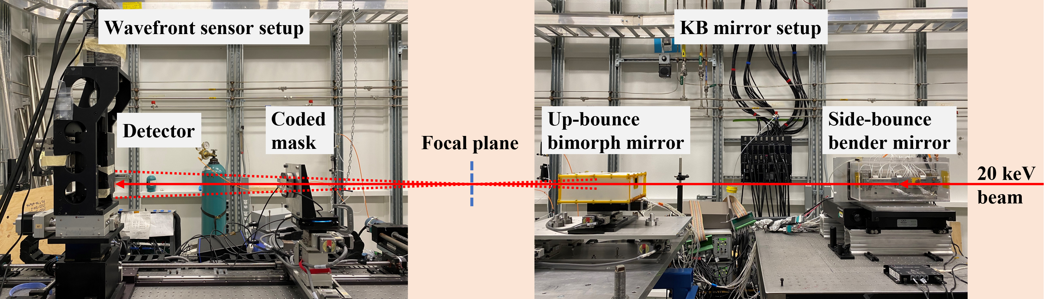
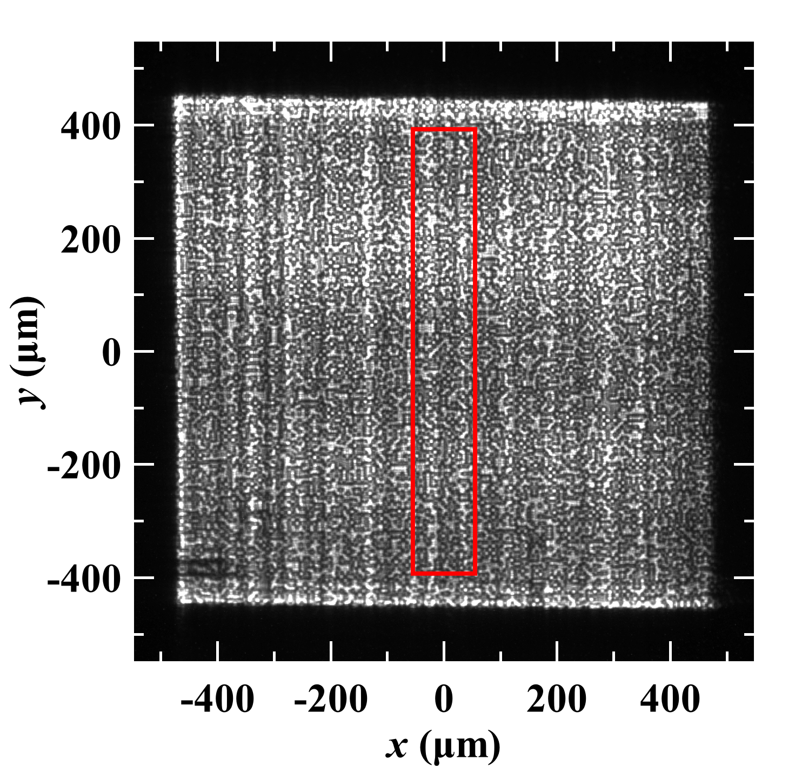
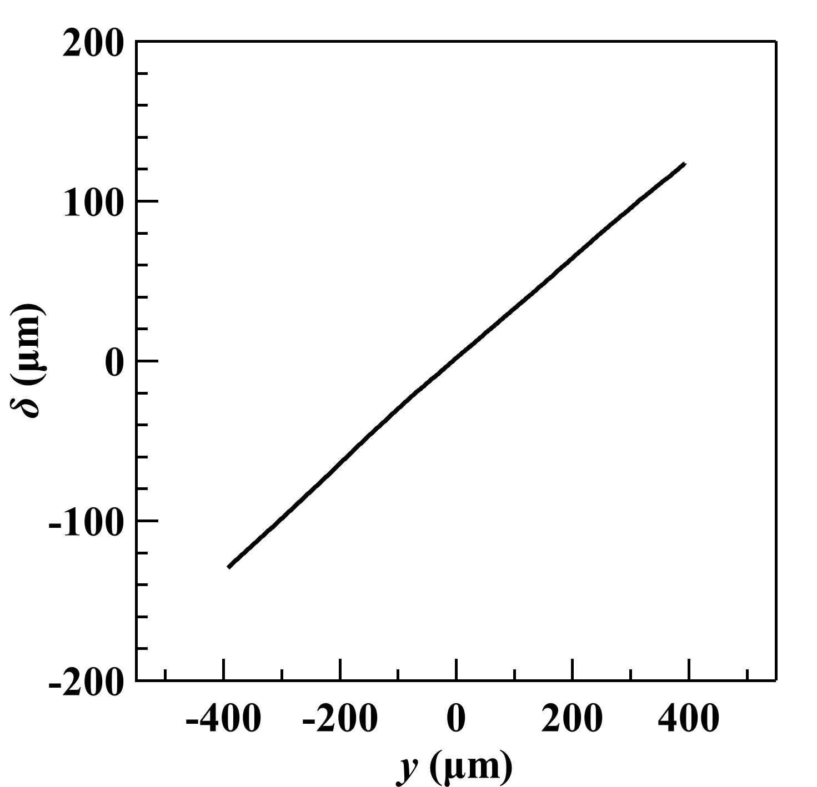
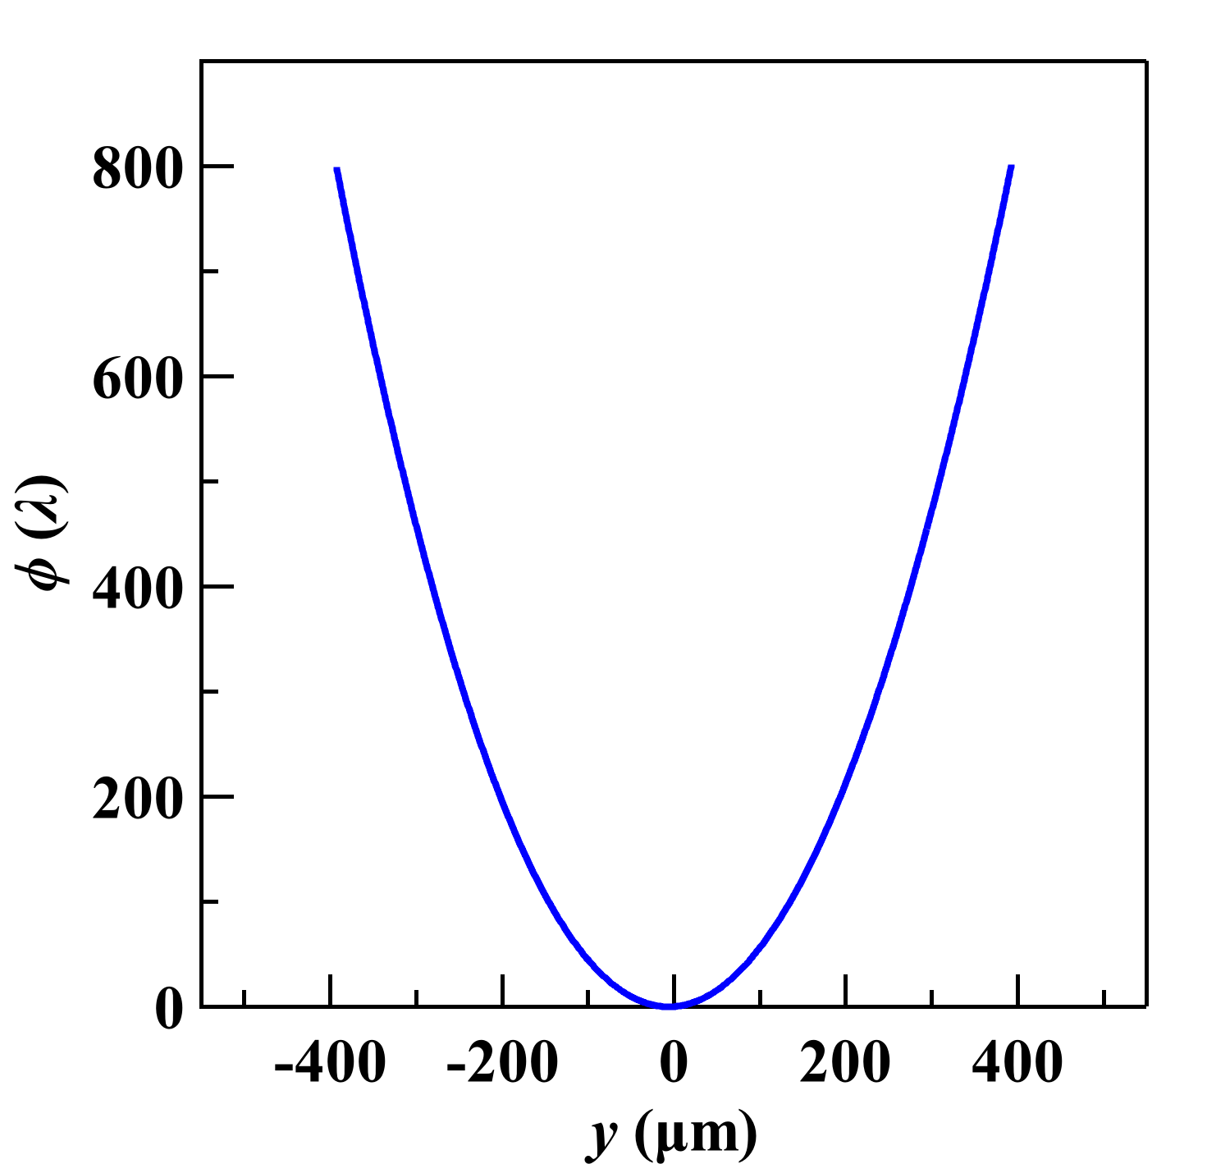
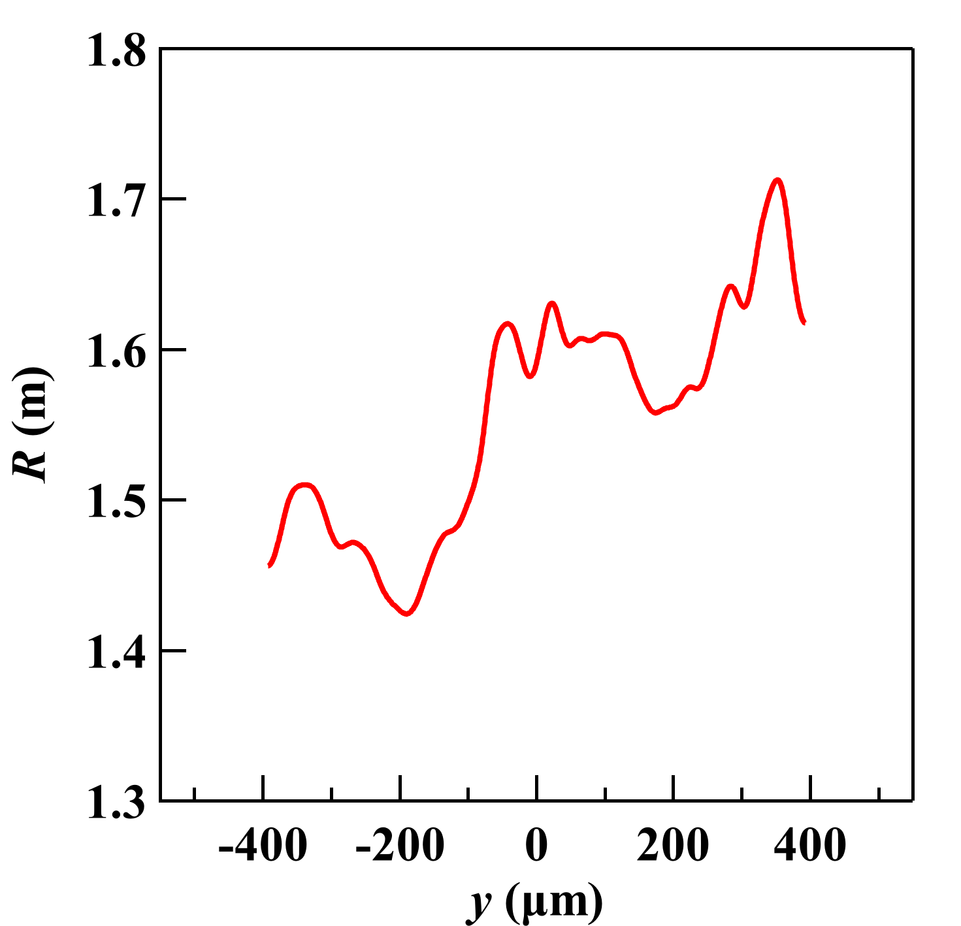
Wavefront sensing application
Machine learning (ML) control system for bimorph mirrors
28ID-B
Speckle displacement
Local radius of curvature
Phase
&
L. Rebuffi, et al., Opt. Express 31, 21264 (2023) doi:10.1364/OE.488189

Slide 23
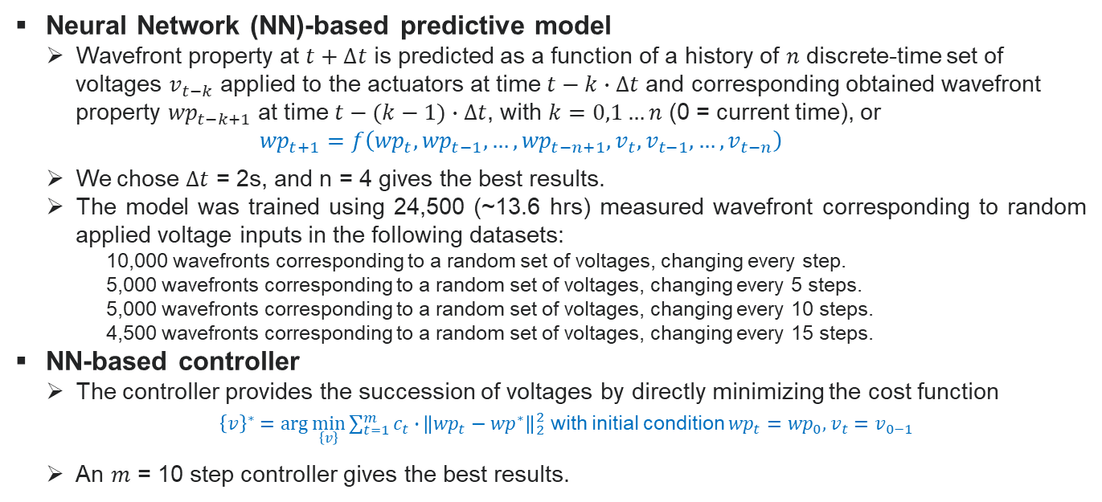
Wavefront sensing application
Machine learning (ML) control system for bimorph mirrors
Neural Network (NN)-based predictive model
  Wavefront property at $t+∆t$ is predicted as a function of a history of $n$ discrete-time set of voltages $v_{t−k}$ applied to the actuators at time $t−k∙∆t$ and corresponding obtained wavefront property ${wp}_{t−k+1}$ at time $t−(k−1)∙∆t$, with $k=0,1…n$ (0 = current time), or
  $${wp}_{t+1}=f\left({wp}_{t}, {wp}_{t−1},…,{wp}_{t−n+1},v_{t},v_{t−1},…,v_{t−n}\right)$$
  We chose $∆t$ = 2s, and n = 4 gives the best results.
The model was trained using 24,500 (~13.6 hrs) measured wavefront corresponding to random applied voltage inputs in the following datasets:
10,000 wavefronts corresponding to a random set of voltages, changing every step.
5,000 wavefronts corresponding to a random set of voltages, changing every 5 steps.
5,000 wavefronts corresponding to a random set of voltages, changing every 10 steps.
4,500 wavefronts corresponding to a random set of voltages, changing every 15 steps.
  NN-based controller
  The controller provides the succession of voltages by directly minimizing the cost function
  ${\left\{v\right\}}^{∗}=\arg{\min_{\left\{v\right\}}{\sum_{t=1}^{m}{c_{t}∙}}}{\left\|{wp}_{t}−{wp}^{∗}\right\|}_{2}^{2}$ with initial condition ${wp}_{t}={wp}_{0}, v_{t}=v_{0−1}$
  An $m$ = 10 step controller gives the best results.
L. Rebuffi, et al., Opt. Express 31, 21264 (2023) doi:10.1364/OE.488189
G. Gunjala, et al., J. Synchrotron Radiat. 30(1), 57–64 (2023) doi:10.1107/S1600577522011080

Slide 24
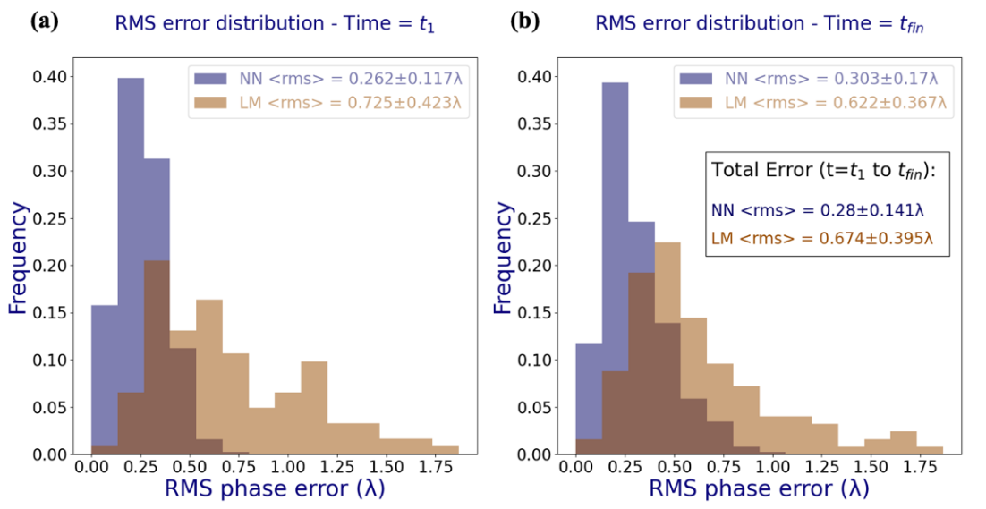
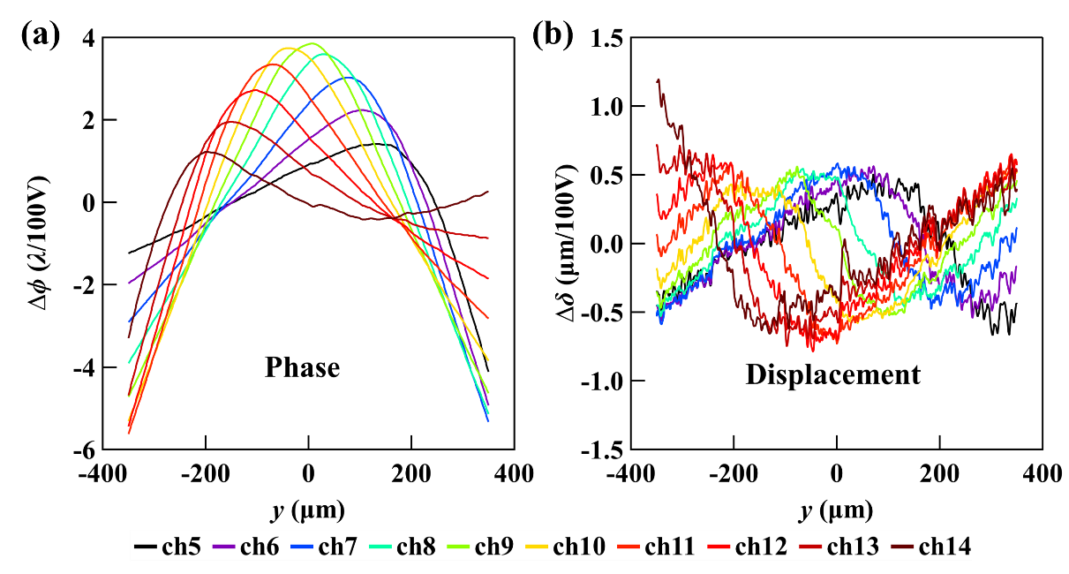
Wavefront sensing application
Machine learning (ML) control system for bimorph mirrors
Comparison with linear model
125 experiments (constant radius)
The NN model gives a factor of 2~3 improvement over all time steps
The narrow distribution indicates that the NN model is more reliable in providing correct solutions over a broader range of wavefronts
L. Rebuffi, et al., Opt. Express 31, 21264 (2023) doi:10.1364/OE.488189

Slide 25
Summary
The APS established a full bank of techniques and tools for advanced X-ray metrology and wavefront sensing
Evaluated quality and performance of various optical components at the IDEA Beamline and 1-BM beamline
Developed machine learning (ML) control system for bimorph mirrors with response time of a few seconds and sub-wavelength accuracy
Future work:
  Complete design and fabrication of dedicated WF sensors for the commission and operation of APS-U beamlines
  WF sensing technique
    Develop calibration procedure and analysis
    Improve SPINNet (training with targeted data)
    User friendly data collection and analysis code development
  Continue developing ML-based control and AI-based auto-alignment system (LDRD#: 2023-0004, postdoc Runyu Zhang).
25

Slide 26
Acknowledgement
  Zhi Qiao (ShanghaiTech Uni.)
  Matthew Frith
  Matthew Highland
  Luca Rebuffi
  Michael Wojcik
  Lahsen Assoufid
  Saugat Kandel
  Mathew Cherukara
  Jayson Anton
  Steve Kearney
  Deming Shu
  Kazuto Yamauchi (OSAKA Uni.)
  Takato Inoue (Nagoya Uni.)
  Yoshio Ichii (JTEC Corporation)
  Gautam Gunjala (UC Berkeley & ALS-LBNL)
  Antoine Wojdyla (ALS-LBNL)
  Kenneth Goldberg (ALS-LBNL)
  Laura Waller (UC Berkeley)
THANK YOU!
This work was supported by the US Department of Energy, Office of Science, Office of Basic Energy Sciences, under Contract No. DE-AC02-06CH11357.

