Slide 1
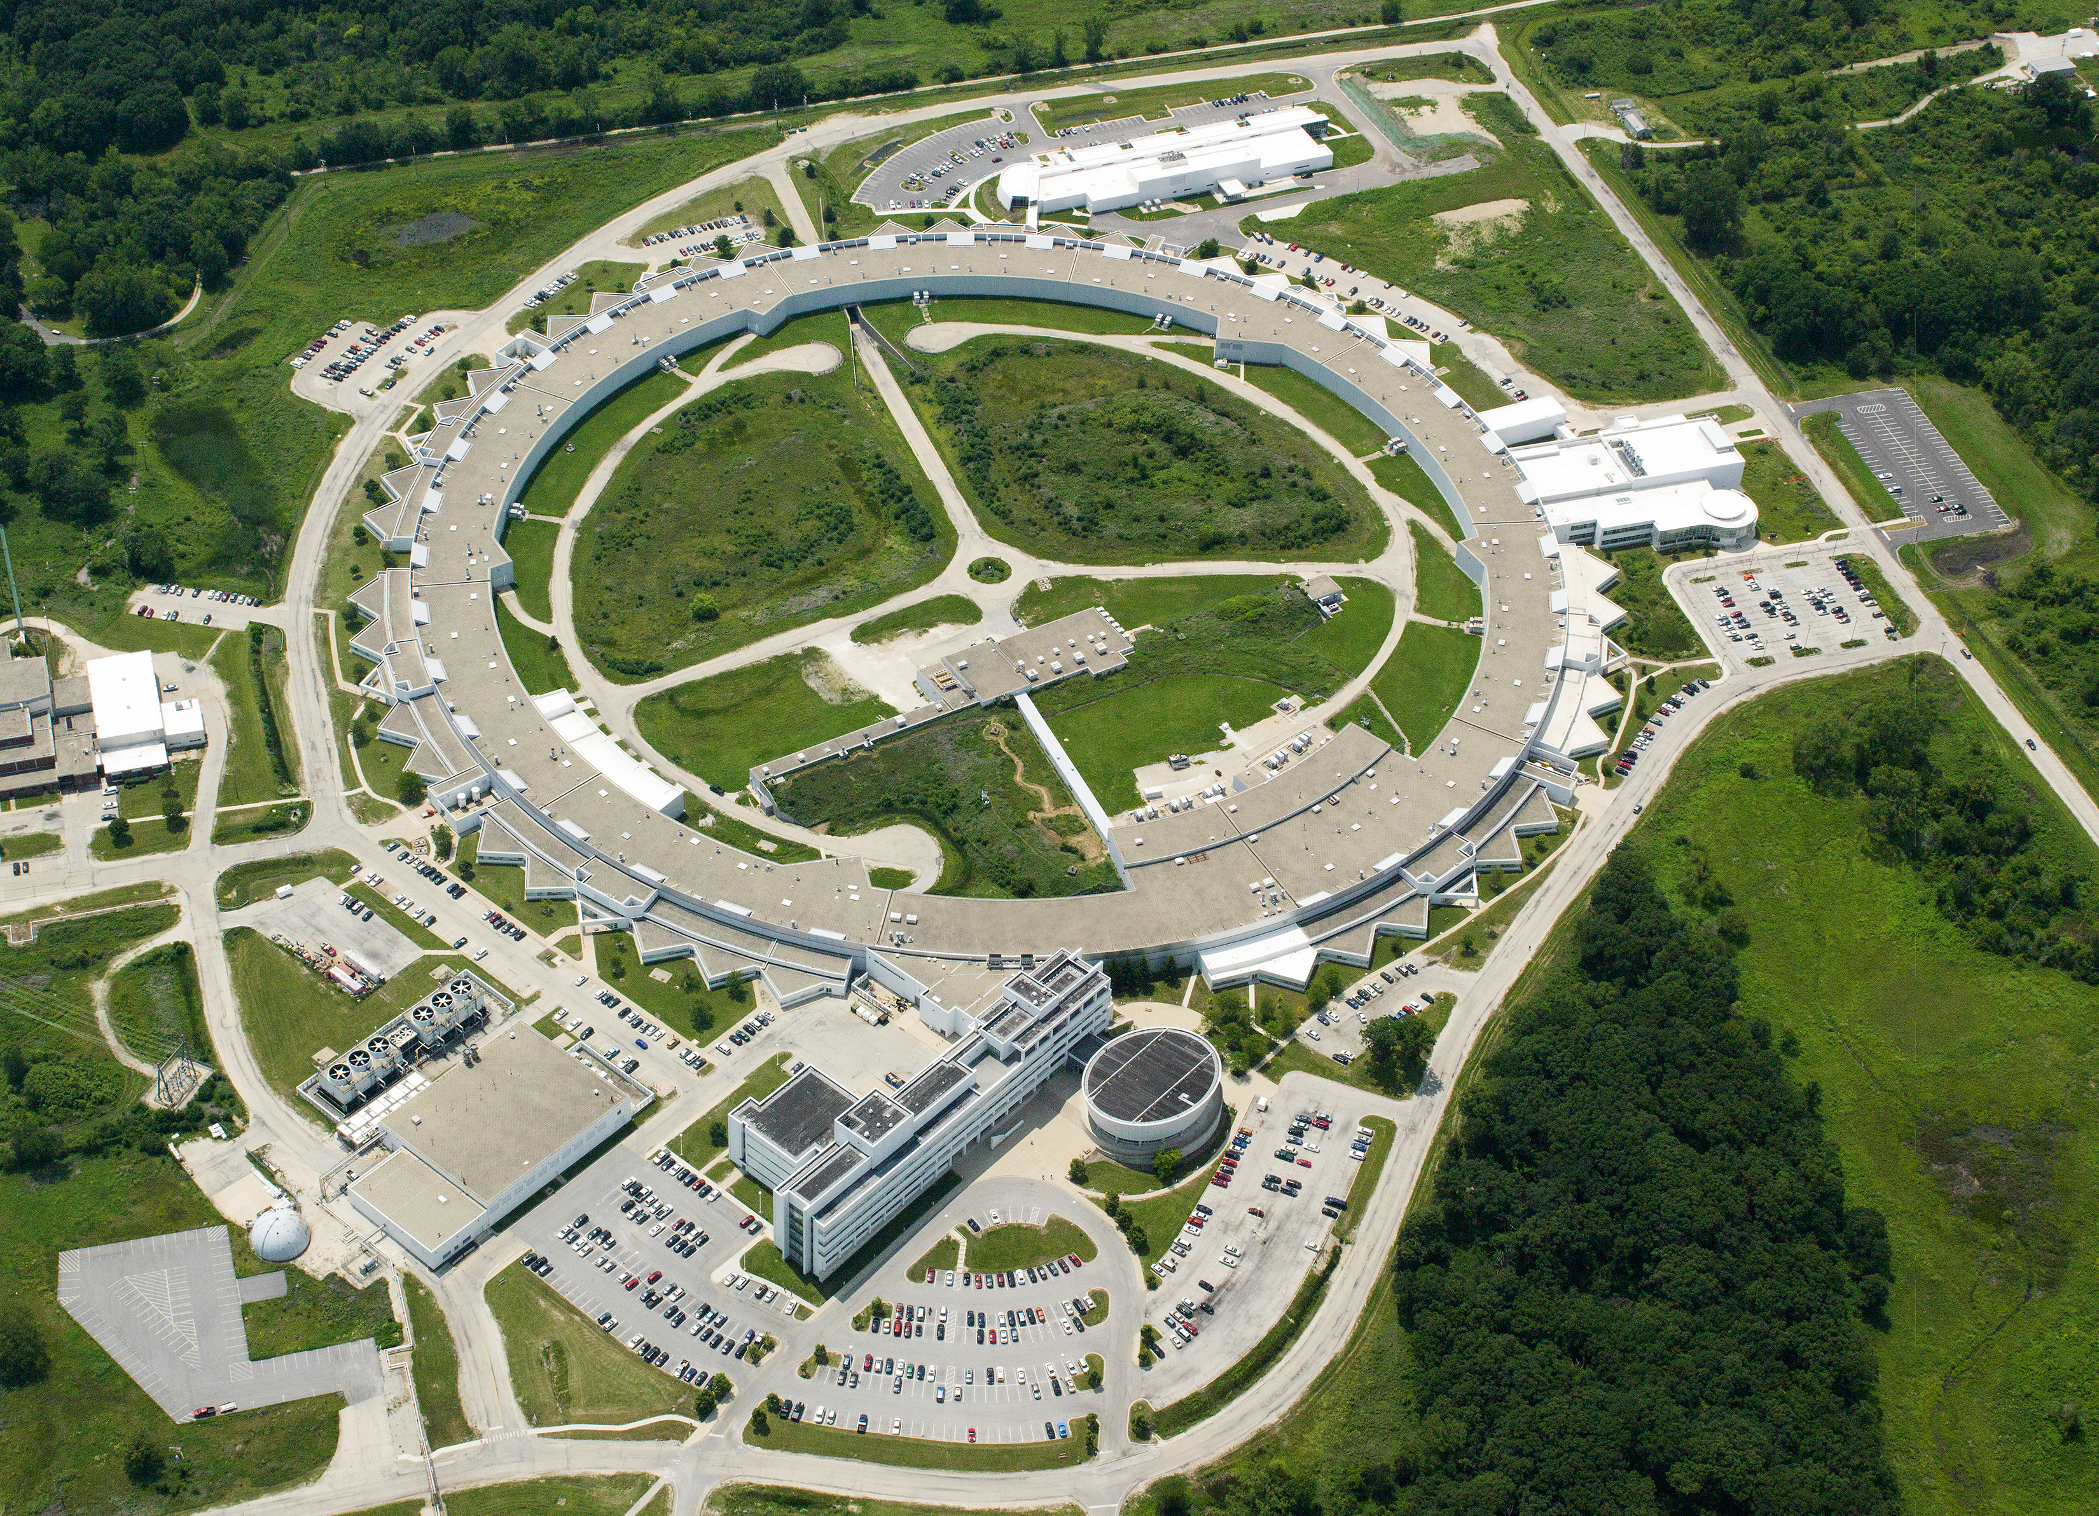

advanced photon source
The Advanced Photon Source is a U.S. Department of Energy (DOE) Office of Science User Facility operated for the DOE Office of Science by Argonne National Laboratory under Contract No. DE-AC02-06CH11357.

Slide 2
The Advanced Photon Source at Argonne supports the mission of the U.S. Department of Energy Office of Science by operating a technologically sophisticated, outstanding synchrotron radiation research facility that provides researchers in nearly every scientific discipline with high-brightness, high-energy, highly penetrating x-ray beams for studying the structure, chemistry, and behavior of the materials, both physical and biological, that comprise our world.
Notes:
The Advanced Photon Source is a national synchrotron X-ray user facility at Argonne. It was funded for construction and now for operation by the U.S. Department of Energy's Office of Science, and is managed by the Scientific User Facilities Division of the Basic Energy Sciences Program Office.

Slide 3
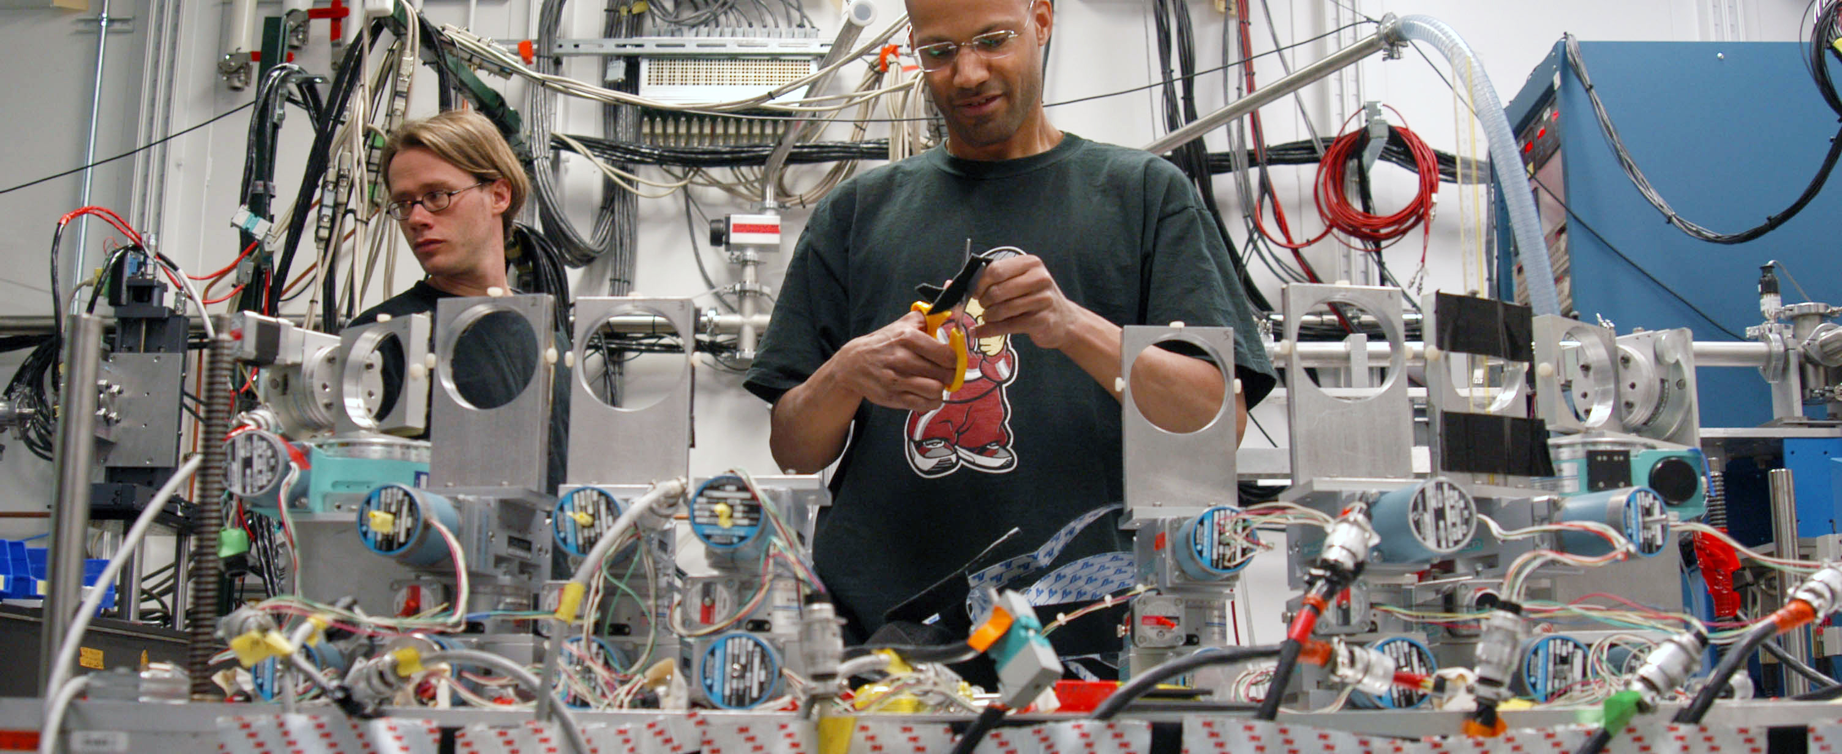
5700 researchers each year
Advanced Photon Source
Researchers come to the APS from:
50 states plus Puerto Rico and the District of Columbia
33 countries
150 companies
250 universities
Notes:
What is it?
The APS is a keystone for state-of-the-art scientific research that brings together experts from labs, academia, and industry. Opened in 1996, the APS is currently undergoing plans for an upgrade that will make it the brightest storage-ring-based X-ray source in the United States.
Why do we care?
The brighter the X-rays are the more detail they can capture, akin to the difference between using a pen light versus a floodlight. The upgrade will make the APS more coherent, which means the X-rays will be focused into smaller spaces so researchers can see even greater detail.
The vastly improved coherence afforded by the APS Upgrade will allow scientists to view the structure of systems and materials at extremely small scales under real conditions, which will increase our fundamental knowledge about ourselves and our world, and revolutionize the development of new materials, new technologies, and new pharmaceuticals.

Slide 4
Advanced photon source – seeks answers to Big questions
What drives a material’s electrical and mechanical properties?
How are new physics revealing secrets of superconductors?
What are the keys to new pharmaceuticals?
How do we gain a complete understanding of plutonium?
What is the Earth’s core made of?
Why do battery electrodes degrade over time?
How do stresses and impurities alter a material’s durability?
Notes:
What are the big questions the APS helps us answer?
Research at the APS will answer big questions about the world we live in. Virtually every field of science is studied at the APS. – think biology, energy, medicine, materials, chemistry, physics, deep earth geology, and environmental science, to name a few.
Researchers use the APS to study the properties of metals, alloys, and large biological molecules like proteins, which make up every part of our bodies. By understanding how the structure of these materials determines their behavior, we hope to learn how to design new materials with new properties and build them one atom at a time, and how to design new pharmaceuticals to fight disease.

Slide 5
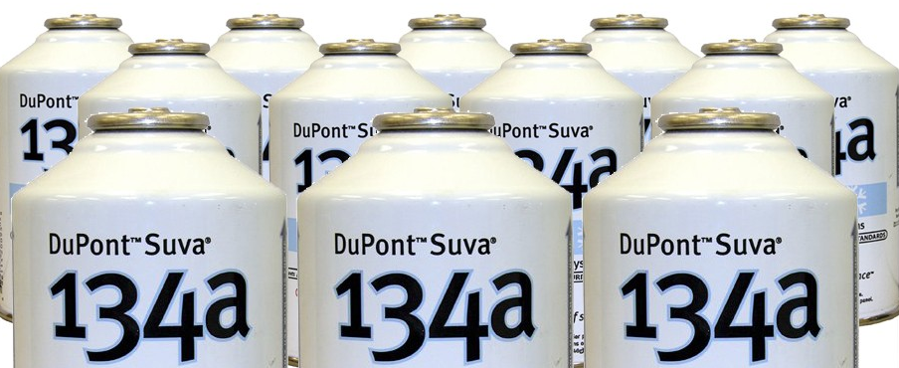
DUPONT’S SUVA®
Safe alternative to Freon® for automotive, residential,
and commercial air-conditioning systems
APS allowed DuPont researchers to characterize
substitute catalysts
This was important information in development of Suva®.
Notes:
Notable research at the APS
For many decades, Freon™ was the most common air-conditioning refrigerant in the world, but its use it restricted now and is being phased out because it is suspected of damaging the Earth's ozone layer.
Synchrotron X-ray techniques and high-intensity APS X-ray beams allowed DuPont researchers to develop Suva® – a reliable, proven, and safe replacement for Freon™ – by characterizing metal oxide contents of candidate substitute catalysts.
Suva® is used in refrigerators and freezers, fire extinguishers, propellants, and residential and light commercial air conditioning applications.
Suva® has the potential for zero impact on ozone depletion while reducing energy consumption and waste products in the manufacturing process

Slide 6
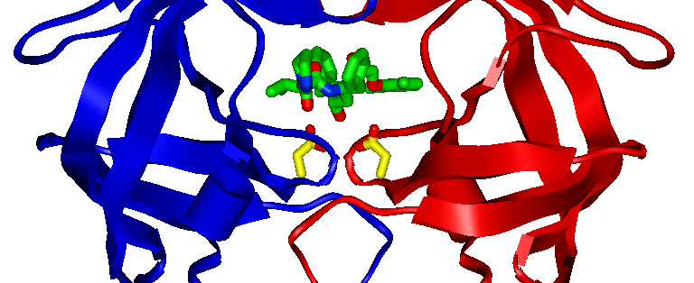
ABBOTT LABS’ KALETRA
World-leading drug to fight AIDS
Atomic-resolution structural research of HIV-drug interactions at APS
Notes:
Notable research at the APS
Structural studies of a portion of the HIV virus helped Abbott Labs develop Kaletra, a world-leading drug to fight AIDS
Kaletra is currently the most prescribed drug in its class for AIDS therapy.
Abbott researchers knew that creating an effective anti-HIV drug requires precise design: The drug must be highly target-specific so that it impacts only the point where the drug can be most effective. Also important are the lock-and-key requirements for drug designers. The news drug's molecular structure must lock tightly to the particular structure of the target molecule, while being flexible enough to accommodate changes in that structure. Using the powerful X-rays at the Advanced Photon Source, researchers found the points of attack of the HIV protease inhibitors, biochemical agents that stop HIV from making new copies of itself by blocking the last step in the process, when the virus attempts to replicate.
The image shows a ribbon diagram of a 99-amino acid protein from the HIV virus called HIV protease. Two identical polymer chains of the protein have a crystallographic 2-fold symmetry relationship, and are represented by blue and red ribbons. The drug molecule, Kaletra®, shown in green, is an organic compound that fits inside of the protein and “plugs a hole” that the virus needs to replicate. Two amino acids of high importance in drug binding to the protein are shown in yellow.

Slide 7
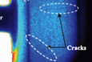
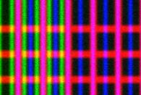
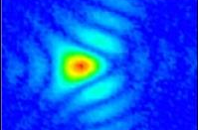
Aps upgrade: the ultimate 3d microscope
A next-generation synchrotron light source for science and industry
High Energy
Penetrating bulk materials
and operating systems
Brightness
Providing time-resolved, macroscopic
fields of view with nm-scale resolution
100 nm
CuAsW
Coherence
Enabling highest spatial resolution
even in non-periodic materials
Notes:
What is the APS Upgrade?
Summary: APS-U opens frontiers inaccessible with today’s instruments
HIGH ENERGY:
World’s brightest source of hard X-rays
3D mapping, deep inside samples
X-ray cinematography in previously inaccessible regimes
BRIGHTNESS
Multi-scale imaging – connecting nanometer features across macroscopic dimensions
Fast sampling with chemical, magnetic, electronic sensitivity
COHERENCE
Extends lensless imaging to hard X-ray domain, with resolution down to <1 nm, localizing atoms
Increases phase contrast for fast full field imaging
Correlation methods improve by 10,000-1,000,000x

Slide 8
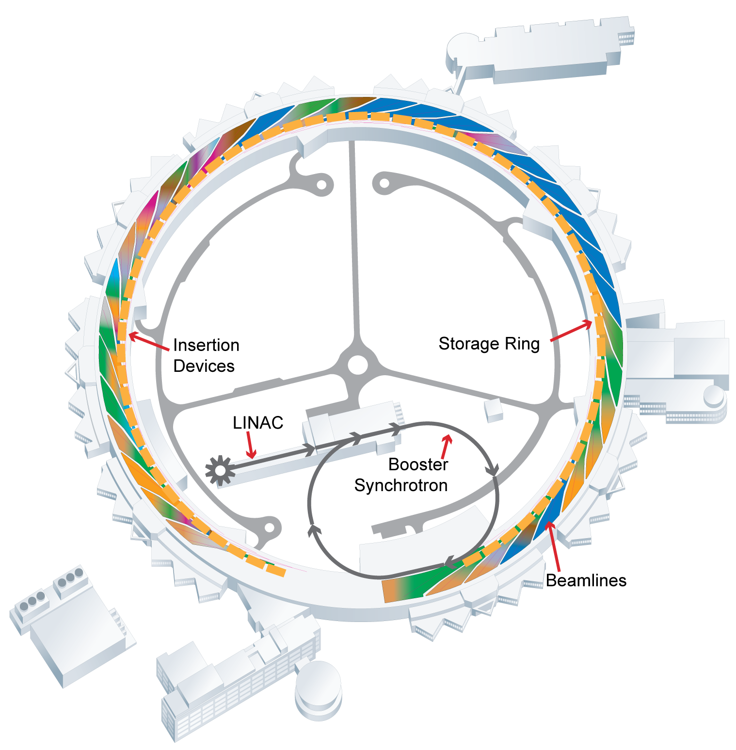
HOW THE APS WORKS
LINAC
Booster Synchrotron
Storage Ring
Insertion Devices
Beamlines
Notes:
How the APS works
The APS is a specialized research facility for state-of-the-art science. Science that makes a big impact requires big machines like the APS. There are five main components that make up the APS technical facility:
the linear accelerator,
the booster synchrotron,
the electron storage ring,
insertion devices
and the experiment hall.
The system is designed to increase the speed of the electrons, the way you would change gears on a car to get it to racing speed, and then use those electrons to produce high-brightness X-rays.

Slide 9
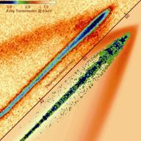
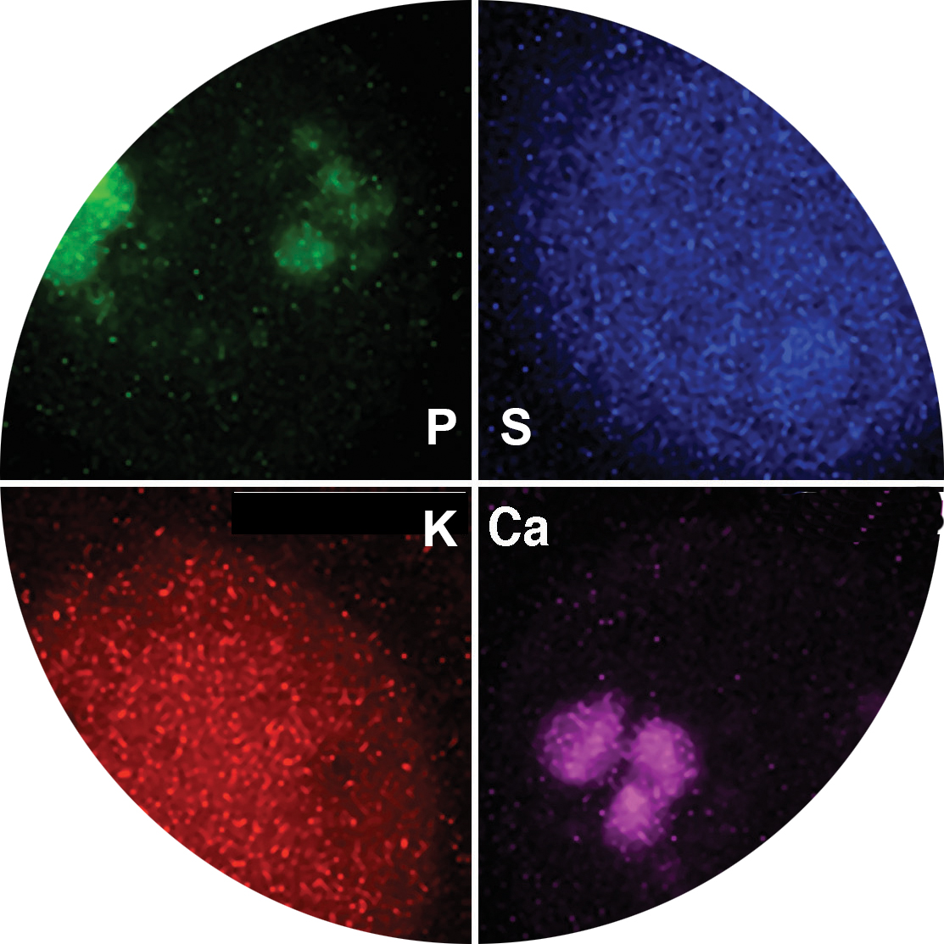
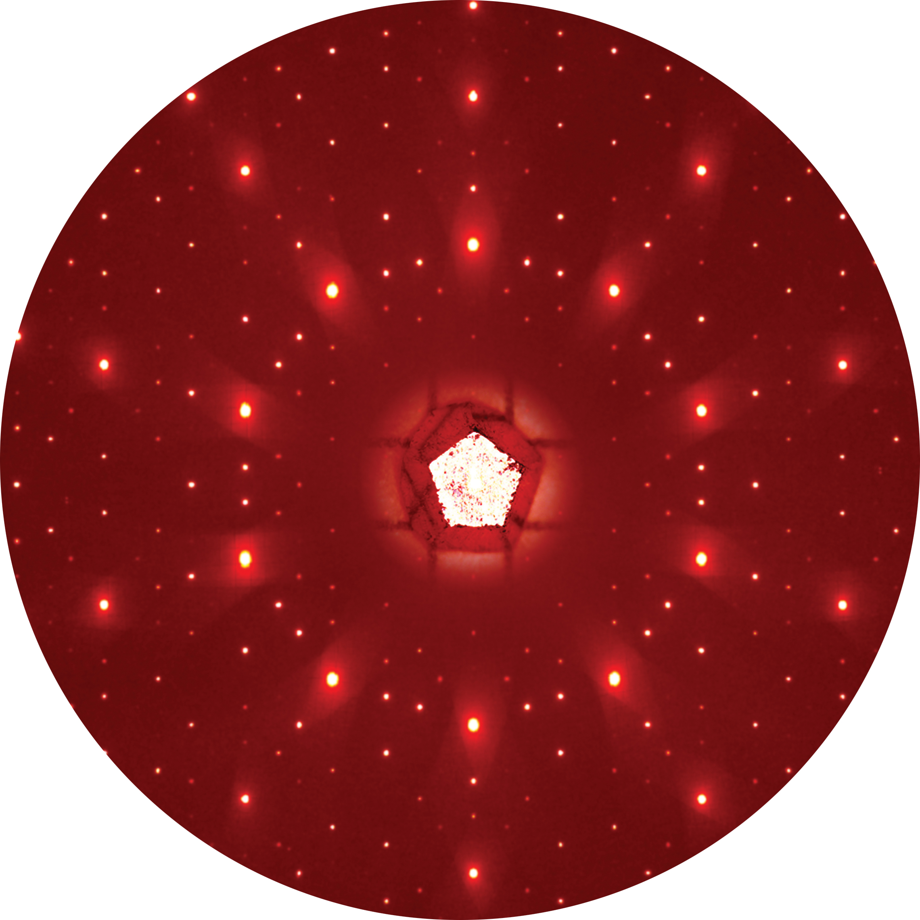
ADVANCED PHOTON SOURCE research –
THREE EXPERIMENT TYPES
A number of techniques can be combined to gain the deepest understanding of a material or a physical or biological system.
Results are increasingly multimodal and track changes as a sample evolves in time.
IMAGING
Spectroscopy
Scattering
A number of techniques can be combined to gain the deepest understanding of a material or a physical or biological system.
Results are increasingly multimodal and track changes as a sample evolves in time.
Notes:
Three main categories of experiment:
Spectroscopy is used to study the energies of particles that are emitted or absorbed by samples that are exposed to the light-source beam and is commonly used to determine the characteristics of chemical bonding and electron motion.
X-ray scattering techniques are a family of non-destructive analytical techniques that reveal information about the crystal structure, chemical composition, and physical properties of materials and thin films. These techniques are based on observing the scattered intensity of an X-ray beam hitting a sample as a function of incident and scattered angle, polarization, and wavelength or energy. Note that X-ray scattering is different from X-ray diffraction, which is widely used for X-ray crystallography.
X-ray imaging collects detailed information from about a sample through either full-field imaging, where the whole sample is illuminated, or scanning, where a small spot of X-rays is scanned across the sample. The high-brightness, high-energy X-rays from the APS allow researchers to image an extensive range of materials and sample thicknesses at extremely high resolution.
The strength of our research program comes from our integrated approach – studies at the APS almost always combine a number of these techniques to gain the most comprehensive understanding of a material or a physical or biological system.
IMAGES:
Spectroscopy: Figure: Data from X-ray fluorescence microscopy of the green alga Chlamydomonas reinhardtii. X-ray fluorescence maps reveal the elemental composition of the alga.
Imaging: Figure: The time evolution of transient fuel sprays from a high-pressure injector, capturing the propagation of spray-induced shock waves in a gaseous medium and revealing the complex nature of the spray hydrodynamics.
Scattering: Figure: A high-energy X-ray diffraction pattern from a single grain of icosahedral rare-earth-cadmium quasicrystal, taken with X-ray beam from the APS superconducting undulator at beamline 6-ID-D.

Slide 10

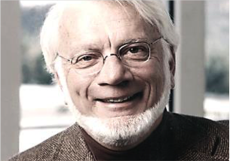
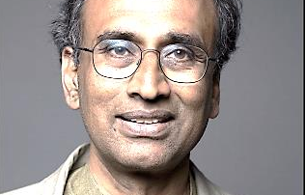
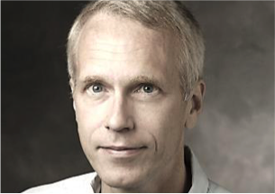

Nobel-Prize winning RESEARCH AT THE APS
 |  |  | 2009 Nobel Prize in Chemistry Structure and function of the ribosome
Ada Yonath Weizmann Institute of Science, Israel | Thomas Steitz Yale University, U.S. | Venkatraman Ramakrishnan MRC Laboratory of Molecular Biology, U.K.
 | 2012 Nobel Prize in Chemistry Studies of G-protein-coupled receptors (GPCRs)
 |  | Brian K. Kobilka Stanford University, U.S. | Robert J. Lefkowitz Duke University, U.S.
Important discoveries about human physiology and clues to new pharmaceuticals to combat disease
Notes:
Nobel-winning research at the APS
Top: All three recipients of the 2009 Nobel Prize in Chemistry published papers on their award-winning work based on data collected at Argonne's Advanced Photon Source.
Between them, biochemists Thomas Steitz of Yale University, Ada Yonath of Israel's Weizmann Institute, and Venkatraman Ramakrishnan of Cambridge, England's Medical Research Center have published more than 60 papers that describe research performed at the APS. The three shared the award for their study of the structure and function of the ribosome.
Argonne was the first place where scientists could visualize this extraordinarily complex combination of macromolecules at the atomic level.
The ribosome works as a protein factory in all organisms from humans to bacteria. As genetic material carrying the code for the protein sequence – messenger ribonucleic acid (mRNA) – passes through the ribosome, transfer RNAs bring a chain of amino acids to the ribosome, creating a protein, which in turn facilitates the vast majority of biochemical processes within the organism.
The X-ray beamlines at the APS were especially suited to the Nobel-winning work because they allowed the researchers to focus their beams to a very small diameter, enabling them to view the assembly's subunits with much finer detail than ever before.
The improved knowledge of the structure and function of the ribosome — especially in bacteria — has opened up a new avenue of medical research as scientists try to identify antibiotics that can interfere with bacterial protein synthesis. This is one of the most important processes that occurs within the cell, and the work done at Argonne provided one of the first opportunities for scientists to truly look 'under the hood' at the biochemical mechanisms that underpin it.
Bottom: Much of the research that led to the 2012 Nobel Prize in Chemistry was conducted at the Advanced Photon Source. The research focused on G-protein-coupled receptors (GPCRs).
GPCRs are a large set of proteins embedded in a cell’s membrane that sense molecules outside the cell and activate a cascade of different cellular processes in response, including breathing and dilating of arteries.
Nearly half of today’s pharmaceuticals work by connecting with many of the 800 or so GCPRs. But this requires knowing exactly how these proteins work and are structured, which is difficult because the long, slender protein chains are folded in an intricate pattern that threads in and out of the cell’s membrane.
Nearly all of the Nobel Prize-winning X-ray research done to unravel and identify how GPCRs work was done at the APS because the scientists needed an X-ray beam that was very stable, intense, and focused to a small spot. This work included discovering the first structure of a human GPCR and, later, the first study of a GPCR in the process of sending signals to activate cellular response.
These studies represent a huge leap forward in understanding how cells work at the molecular level, lay the groundwork for new therapies, and open up new frontiers in biology.

Slide 11
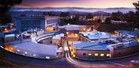
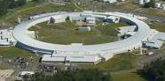
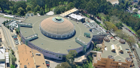
Department of Energy’s X-ray Light Sources
U.S. Department of Energy OFFICE OF SCIENCE X-ray Light Sources
Linac Coherent Light Source and Stanford Synchrotron Radiation Light Source at SLAC National
Accelerator Laboratory
National Synchrotron Light Source II at Brookhaven
National Laboratory
Advanced Photon Source at Argonne
National Laboratory
Advanced Light Source
at Lawrence Berkeley
National Laboratory
Sources of scientific discovery and technological innovation
A critical component of maintaining U.S. leadership in the physical sciences
11
Notes:
Department of Energy Office of Science X-ray light sources
The APS is one of five DOE X-ray light sources operated around the nation for the benefit of researchers from industry, academia and national laboratories. They all have different capabilities and research specializations. All have contributed to significant scientific advances in many fields and to new products that are on the market today. They are:
Advanced Light Source at Lawrence Berkeley National Laboratory – One of the world's brightest sources of high-quality, reliable vacuum-ultraviolet light and soft X-rays, enabling a wide variety of scientific disciplines.
Advanced Photon Source at Argonne National Laboratory – One of only four third-generation, hard X-ray synchrotron radiation light sources in the world, which has brought about new discoveries in a wide range of scientific fields.
National Synchrotron Light Source at Brookhaven National Laboratory – A state-of-the-art synchrotron light source that allows scientists to probe the fundamental properties of matter, paving the way to new scientific discoveries and innovations.
There are two light sources at SLAC National Accelerator Laboratory
Linac Coherent Light Source – The world’s first hard X-ray free-electron laser facility capable of producing X-rays that are both very intense and clumped into ultrafast pulses.
Stanford Synchrotron Radiation Lightsource – Produces intense X-rays for researchers to study our world at the atomic and molecular level, allowing for research and advances in energy production, environmental remediation, nanotechnology, new materials and medicine.

Slide 12
questions?
Notes:
This concludes an overview of Advanced Photon Source and the work we do there.
I hope it gives you a strong sense of who we are at Argonne National Laboratory – how we roll up our sleeves on your behalf to help improve the human condition through science and technology.
We pursue ambitious ideas to improve the world, because we believe that what we do makes a difference.
We have our noses down in the details, but we also keep a strong focus on the big picture, ask the big questions, and accept the big challenges.
Science today is a team sport, so we actively create teams of researchers from many disciplines, both inside Argonne and from outside universities, private companies, and other government laboratories.
We begin with Yes, and we push the boundaries of what seems possible to create new ideas and approaches to solving today's biggest challenges in energy, environment and national security.
Thank you for your time and attention.
I'll be happy to try and answer any of your questions about this presentation or about Argonne in general. If I can't, I'll find someone who can get back to you.

